Slide 1
Core IDCC(b)
External Parallel Run KPI Report
01/03/2024 – 28/05/2024

Slide 2
Parallel Run KPIs
Introduction
Context
  According to Article 26(4) of the Core FB ID CCM, Core TSOs shall:
    continuously monitor the effects and the performance of the application of this methodology during the parallel run
    develop, in coordination with the Core regulatory authorities, the Agency and stakeholders, the monitoring and performance criteria and report on the outcome of this monitoring on quarterly basis in a report
  IDCC external // run started on 5th of December 2022. Since this business day, results of capacity calculation have been published on JAO website [LINK]
On the next slide the overview of the KPIs covered in this KPI report is provided.
  A Reading Guide with a detail description of the KPIs is also available on JAO [LINK]

Slide 3
Parallel Run KPIs
Overview of parallel run KPIs
ATC related KPIs
    Duration curve of Core oriented bidding zone borders with simultaneous zero (or negative) ID ATCs​
    Frequency of zero and negative ID ATCs by oriented Core bidding zone border, and Core average​
    Frequency of isolated BZs of zero (or negative) ID ATCs in import, export and both directions​
    Mean positive ID ATCs by oriented Core bidding zone border, and Core average​
    TSOs’ adjustment after validation
    Share of MTUs with intervention per TSO
    Limiting elements
    Limiting constraints of the ATC domain​
    Most often pre-solved CNECs​
    Net positions
    Min/Max Net Positions​
      Based on final FB domain
      Based on final ID ATC

Slide 4
Parallel Run KPIs
Reporting period and limitations
Reporting period
  This KPI report covers three months (March – May) of the Core IDCC process in Core region, i.e. period 01/03/2024 – 28/05/2024.
  The following business days were excluded from the report:
    14/03 (Zero Capacity Fallback applied for all 24 TS),
    16/03 – 18/03 (process failed / Zero Capacity Fallback applied for all 24 TS),
    29/03 – 09/04 (data misalignment in the input to the process caused the results to be non-representative),
    22/04 – 24/04 (CCCt 4.0.1 deployment related issues),
    05/05 (failed process due to missing AACs on XBID CuteTSO for several borders).
  As a result, KPI report contains results of 69 business days.

Slide 5
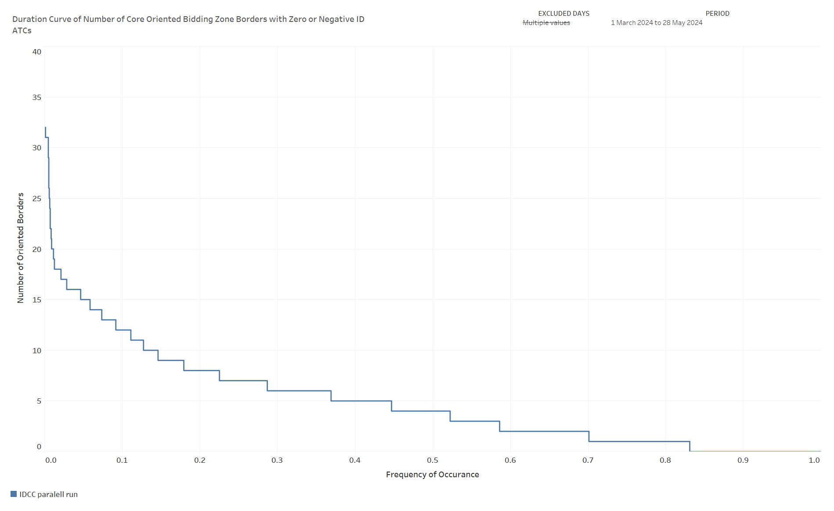
KPI 1
Duration curve of Core oriented bidding zone borders with simultaneous zero (or negative) ID ATCs​

Slide 6
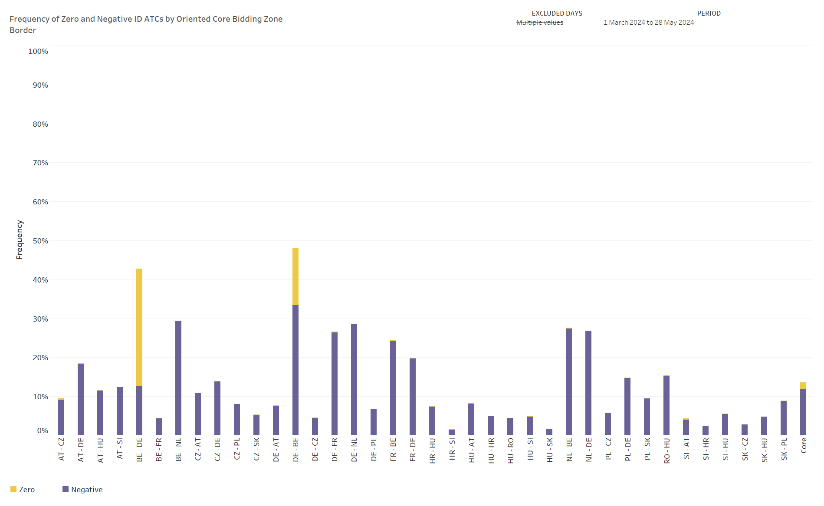
KPI 2
Frequency of zero and negative ID ATCs by oriented Core bidding zone border, and Core average​

Slide 7
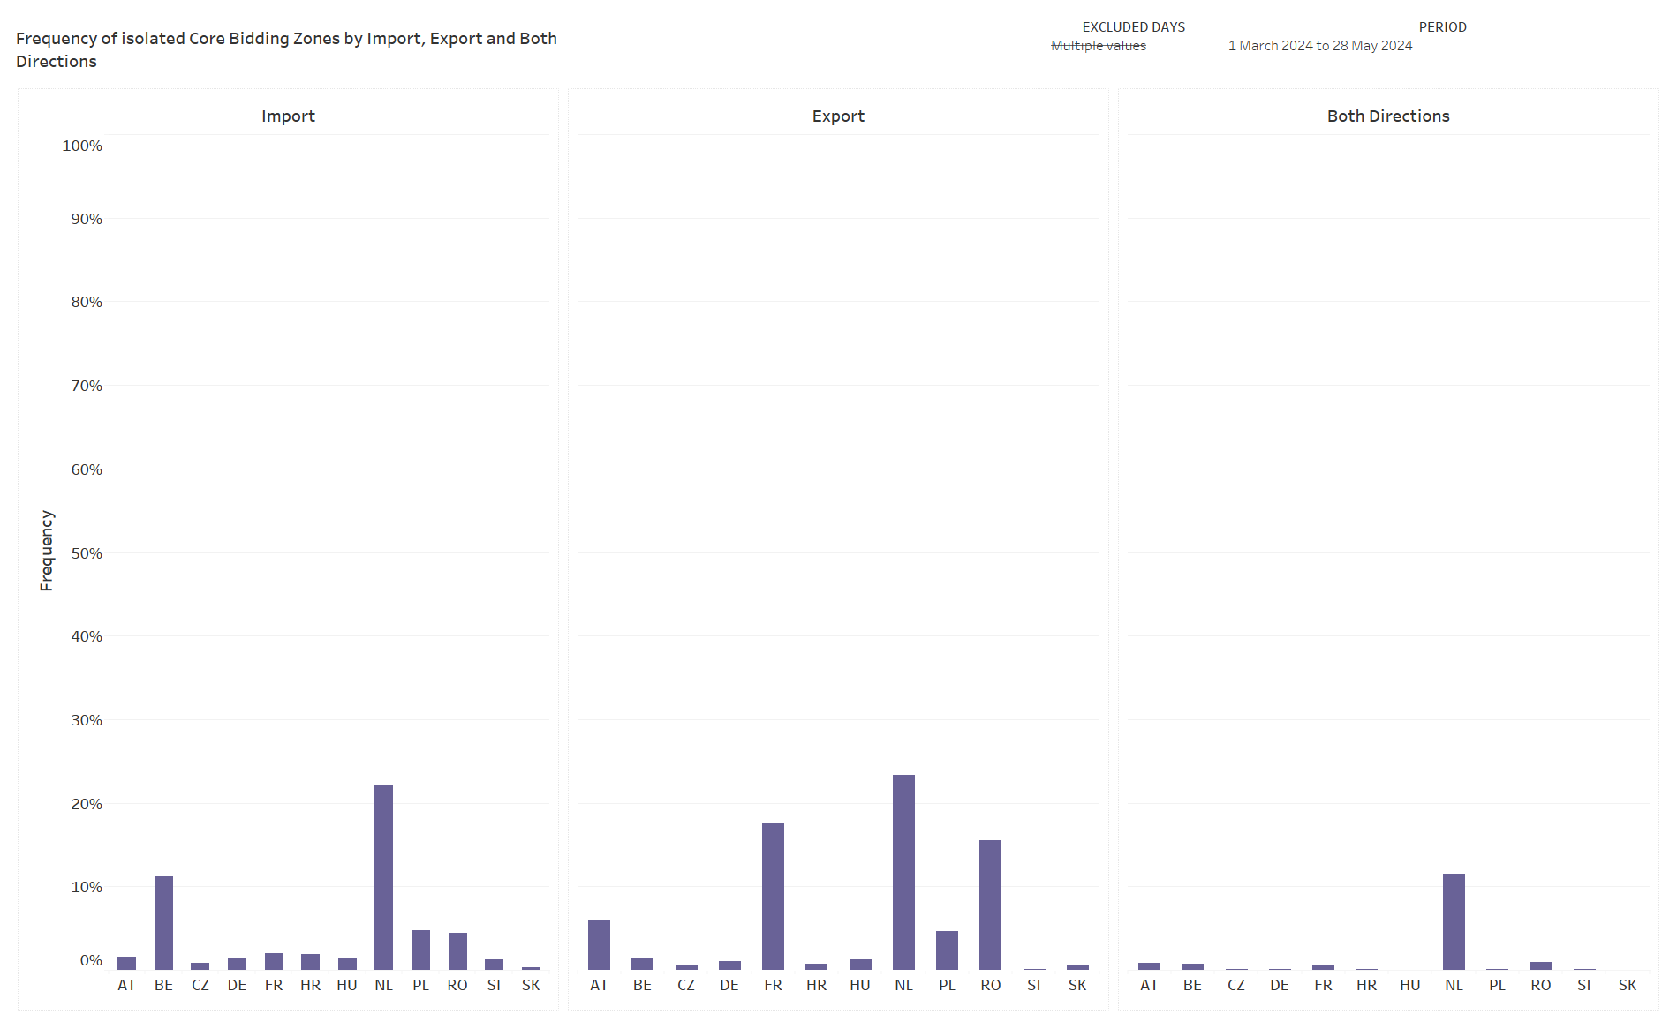
KPI 3
Frequency of isolated BZs of zero (or negative) ID ATCs in import, export and both directions​​

Slide 8
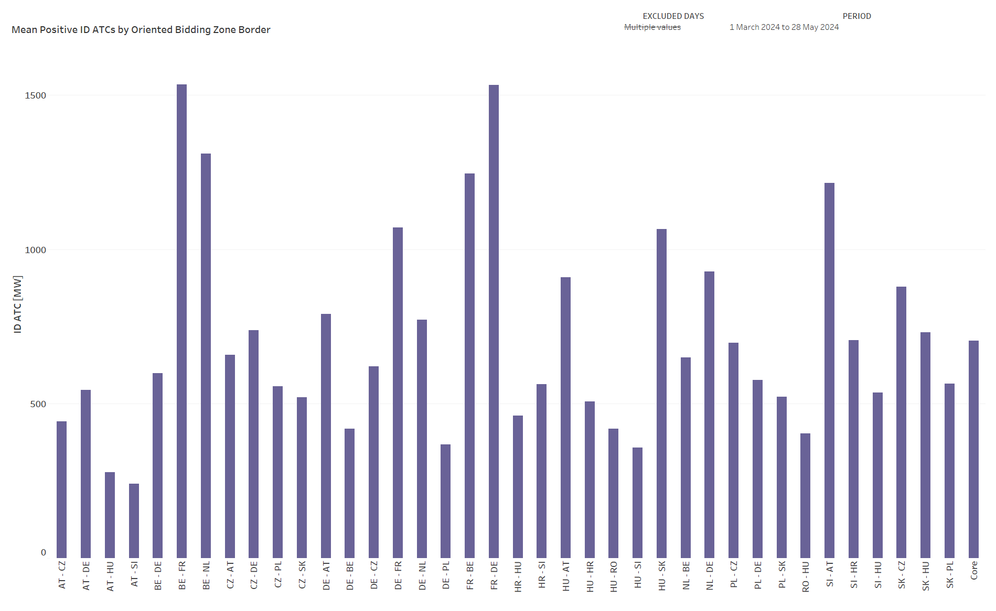
KPI 4
Mean positive ID ATCs by oriented Core bidding zone border, and Core average​

Slide 9
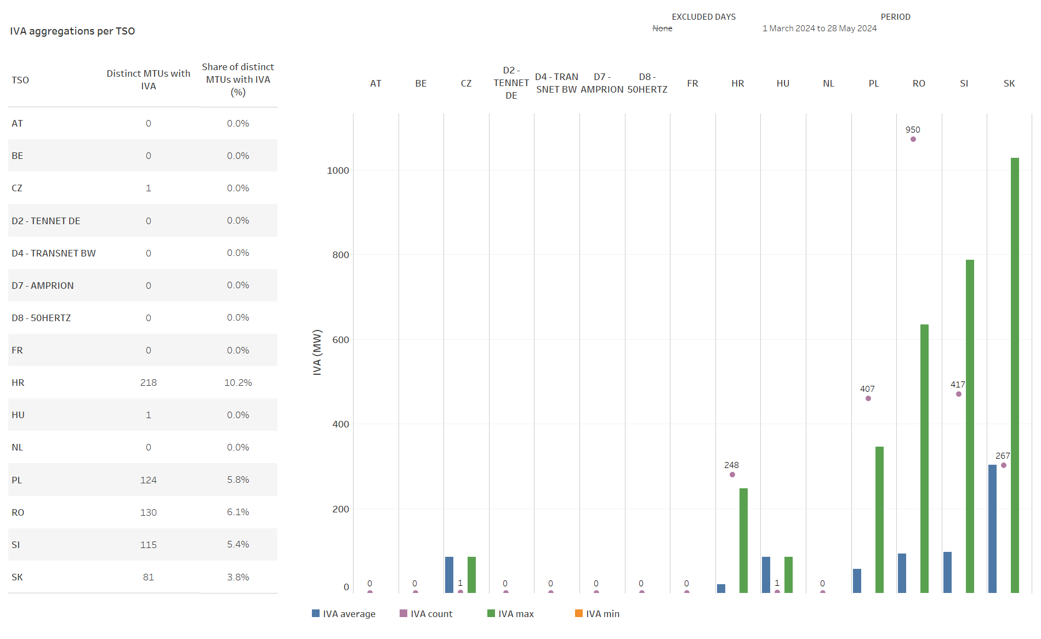
KPI 5
Share of MTUs with intervention per TSO

Slide 10
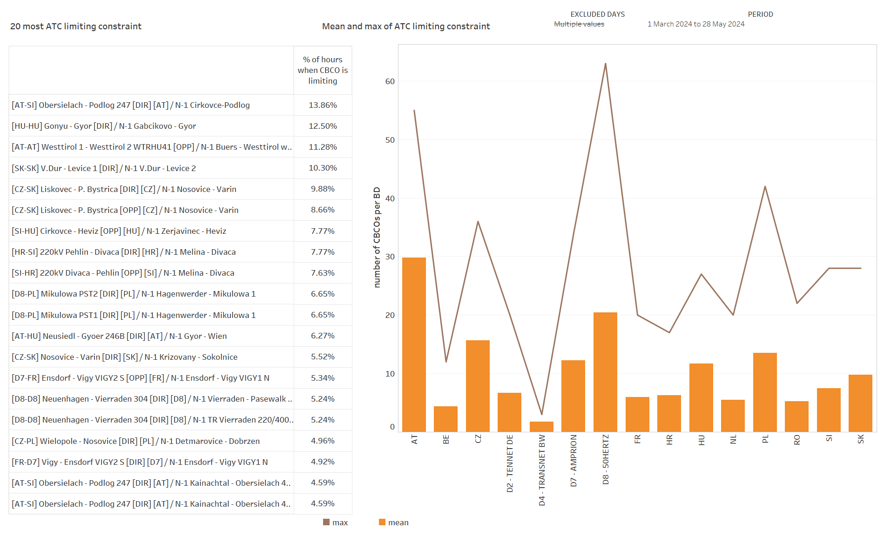
KPI 6
Limiting constraints of the ATC domain​

Slide 11
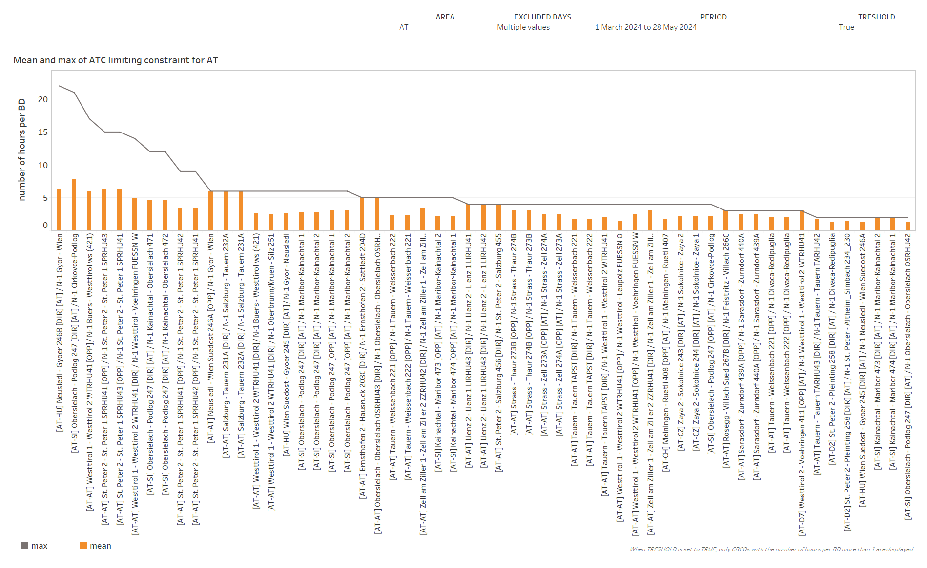
KPI 6
Limiting constraints of the ATC domain​

Slide 12
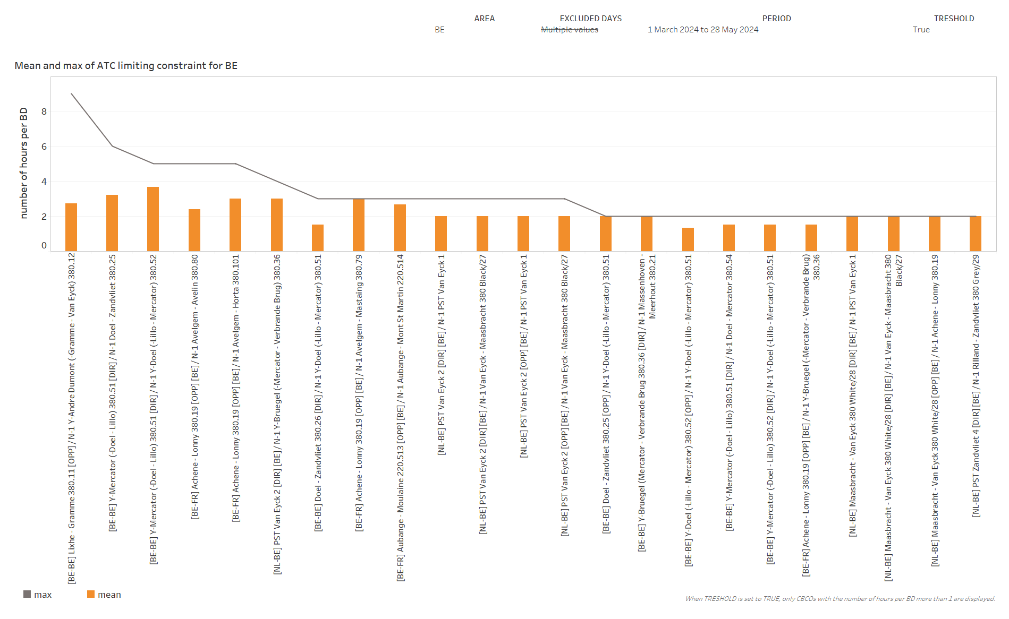
KPI 6
Limiting constraints of the ATC domain​

Slide 13
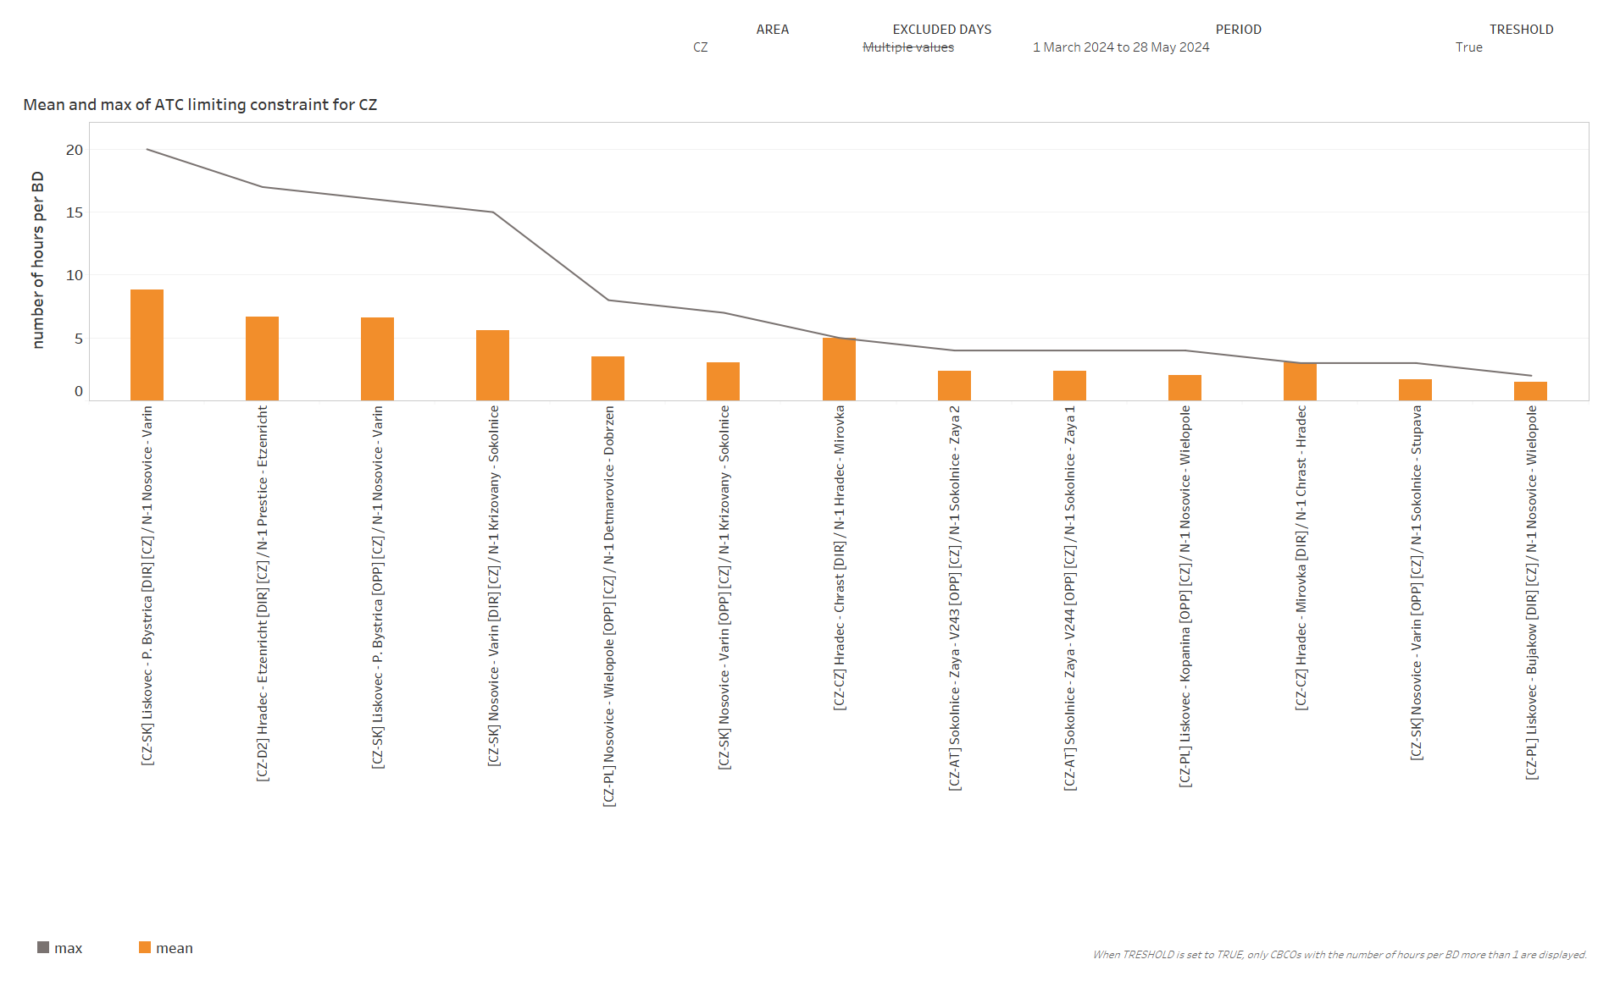
KPI 6
Limiting constraints of the ATC domain​

Slide 14
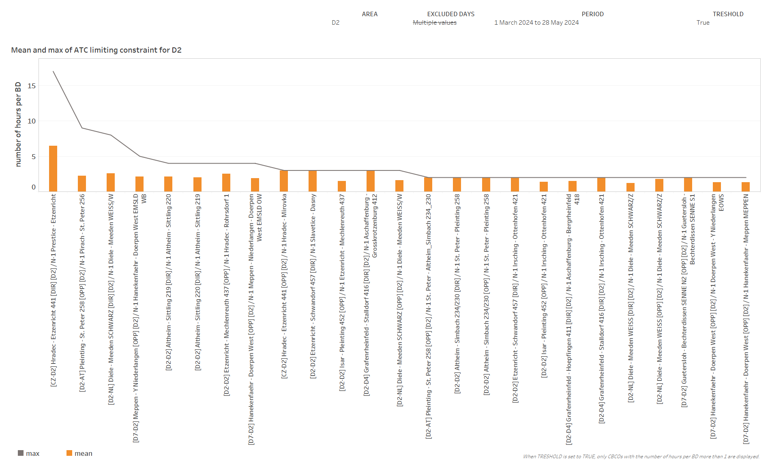
KPI 6
Limiting constraints of the ATC domain​

Slide 15
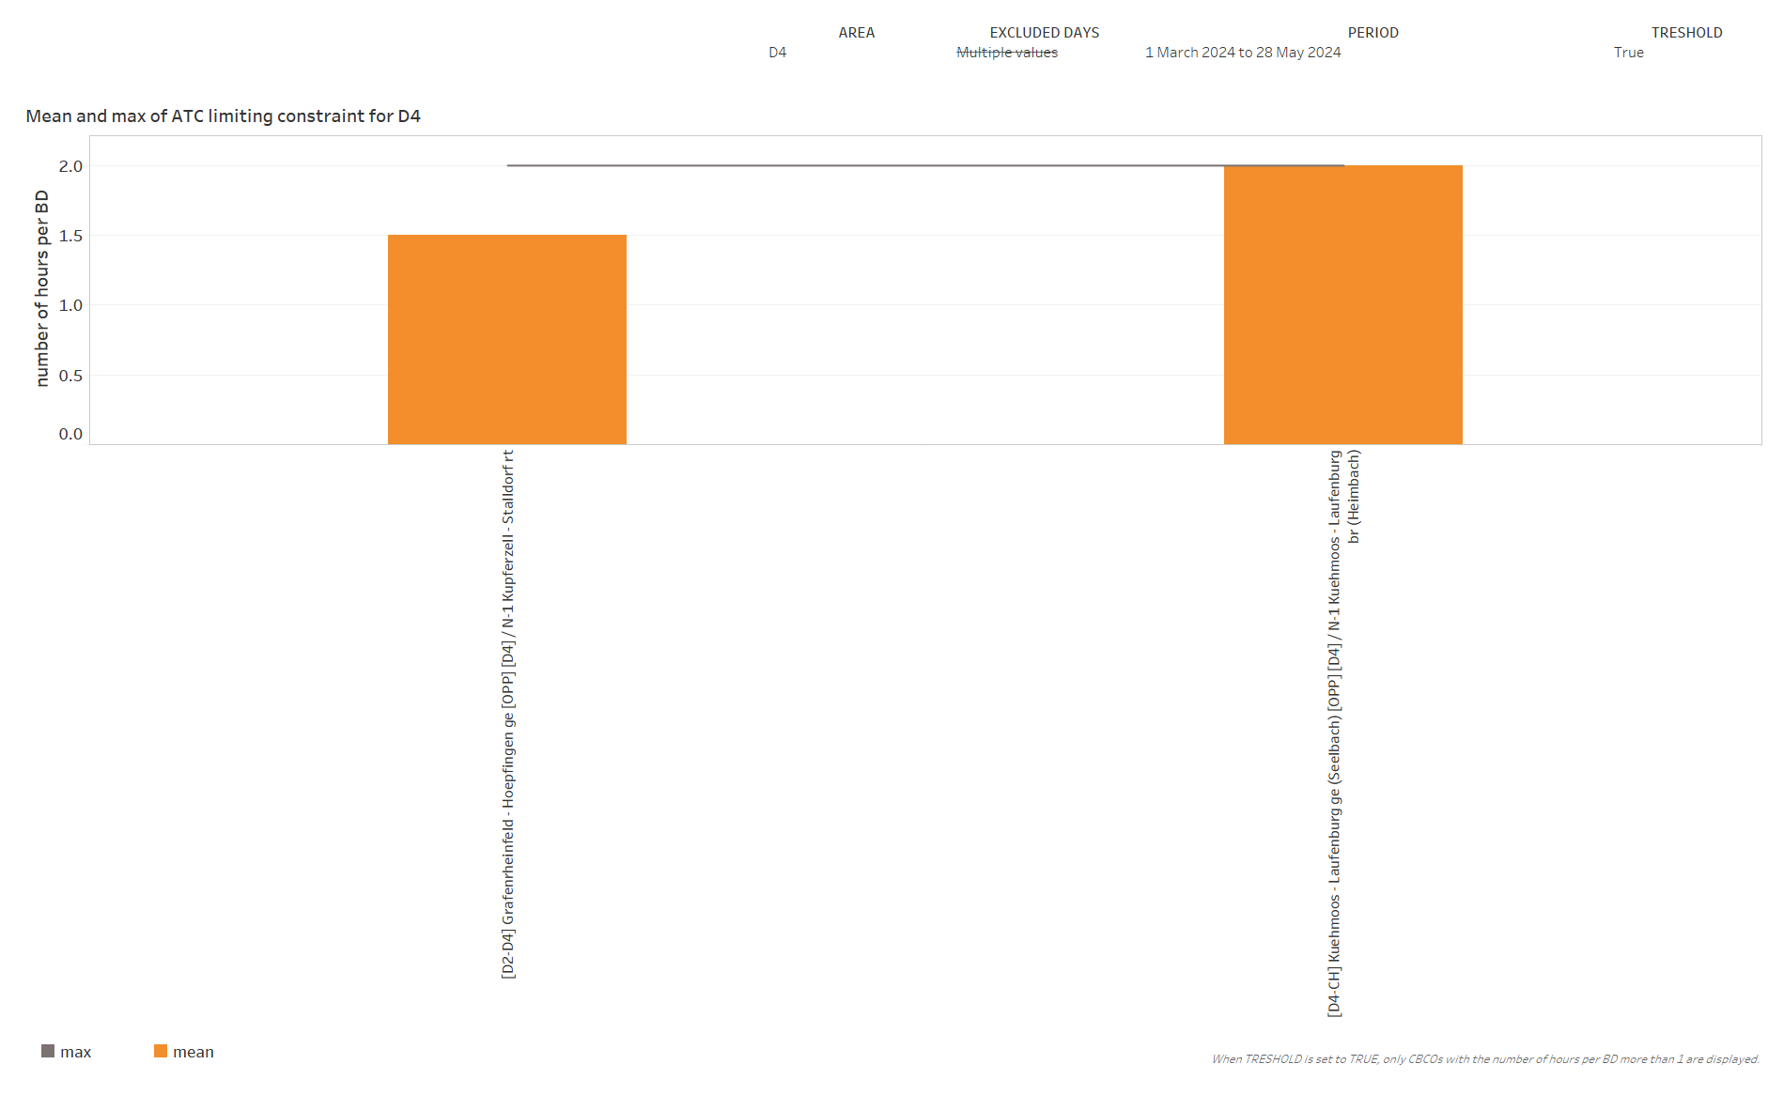
KPI 6
Limiting constraints of the ATC domain​

Slide 16
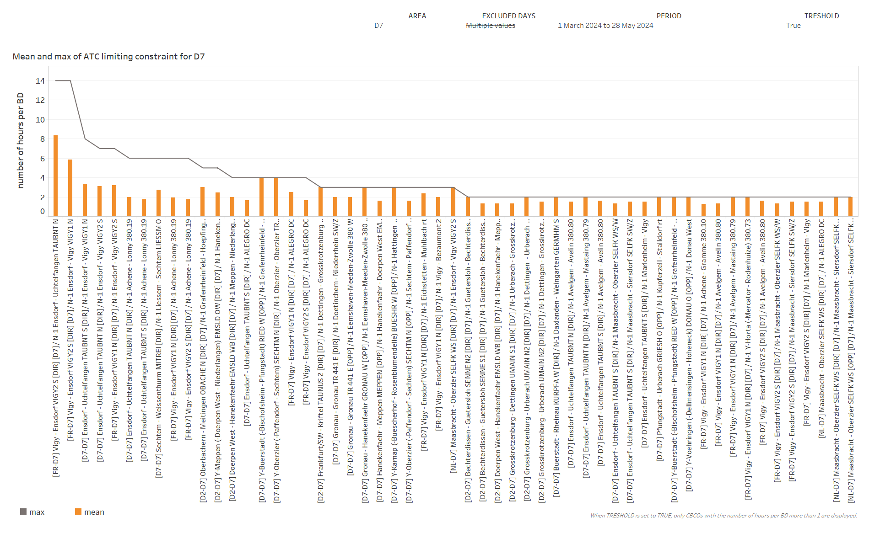
KPI 6
Limiting constraints of the ATC domain​

Slide 17
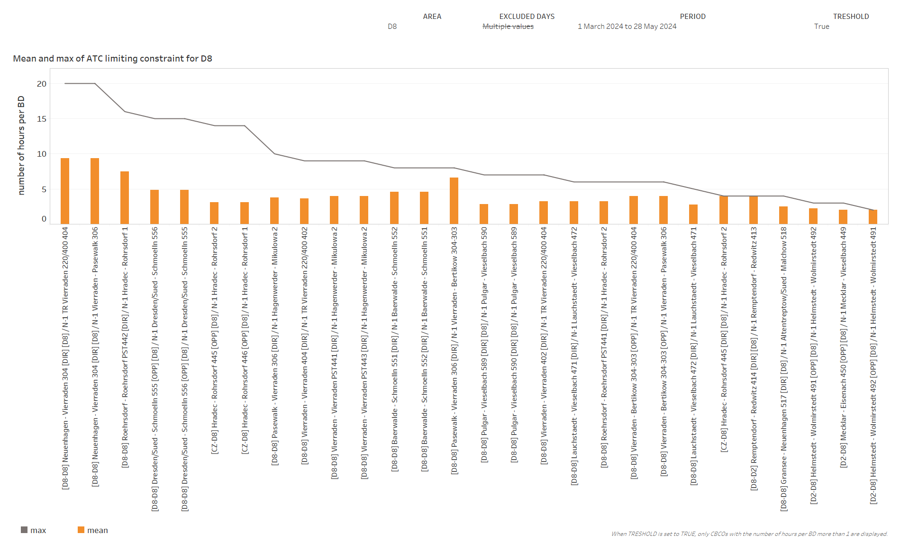
KPI 6
Limiting constraints of the ATC domain​

Slide 18
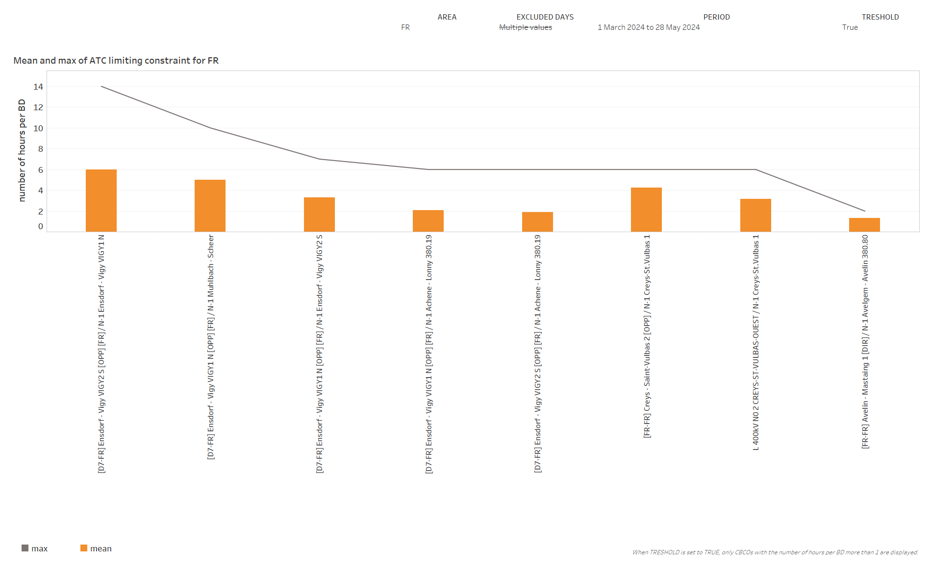
KPI 6
Disclaimer - Results of the French TSO for KPI 6 (Limiting constraints of the ATC domain) should be interpreted with care, due to the dynamically changing FR CBCO ID.
Limiting constraints of the ATC domain​

Slide 19
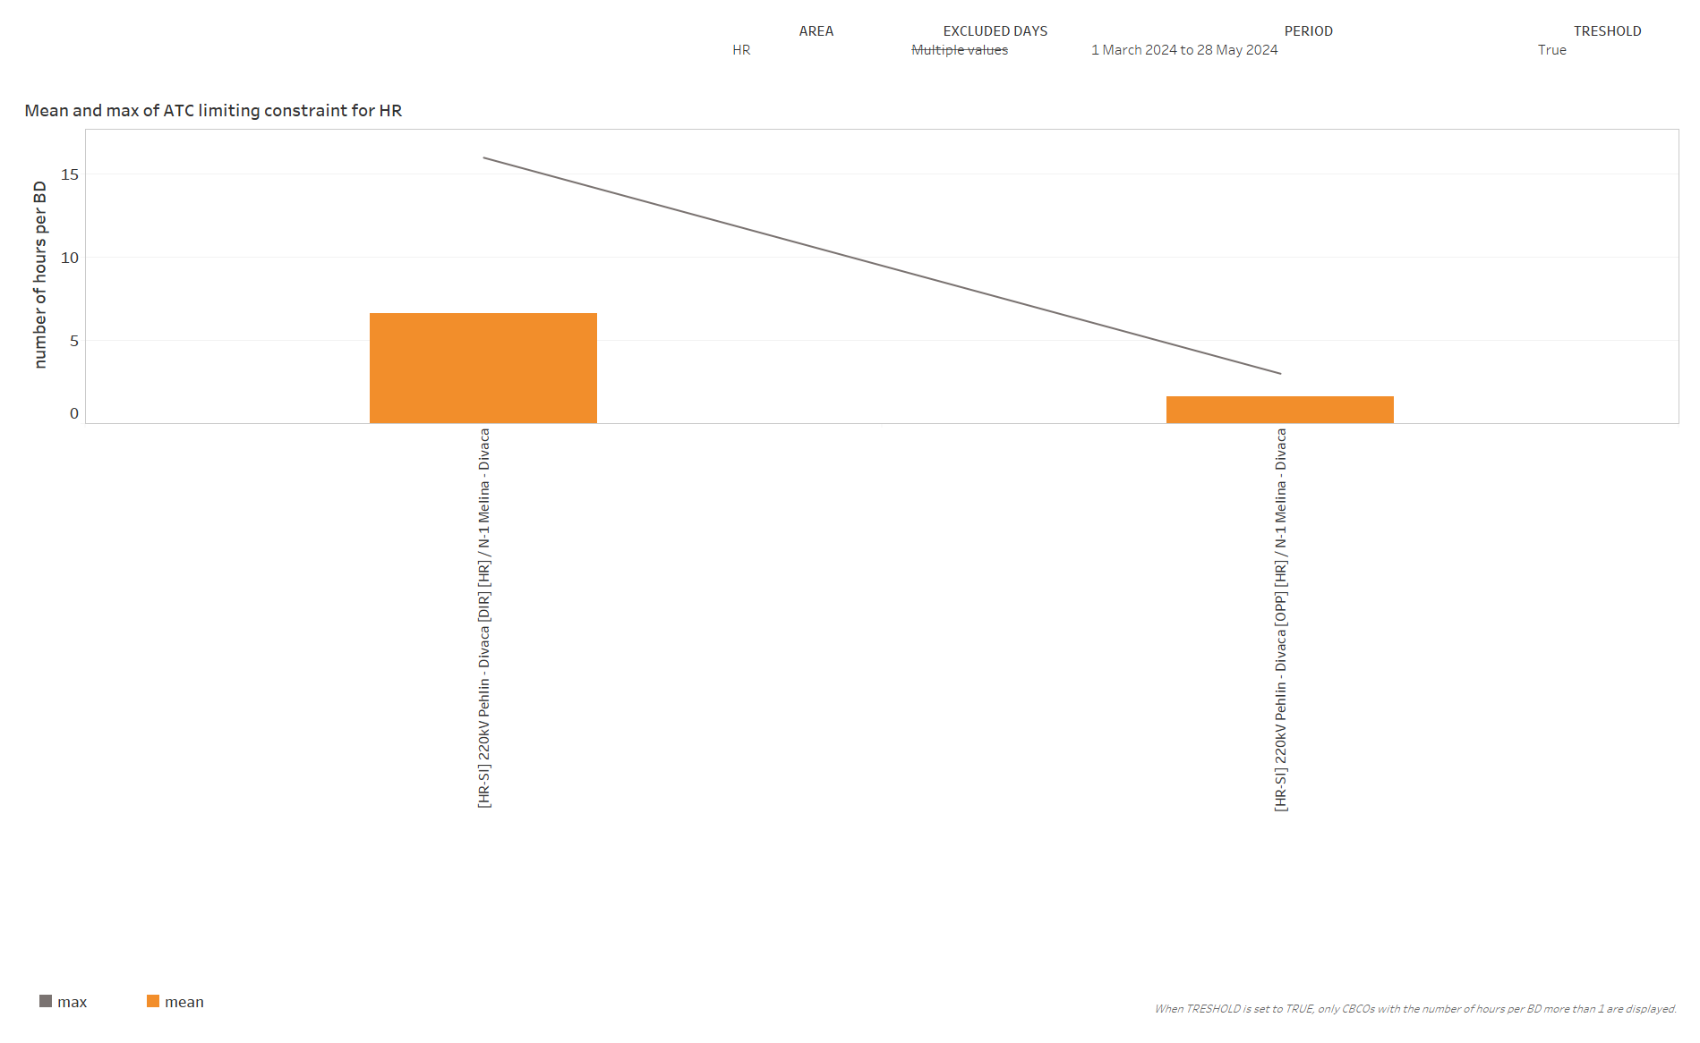
KPI 6
Limiting constraints of the ATC domain​

Slide 20
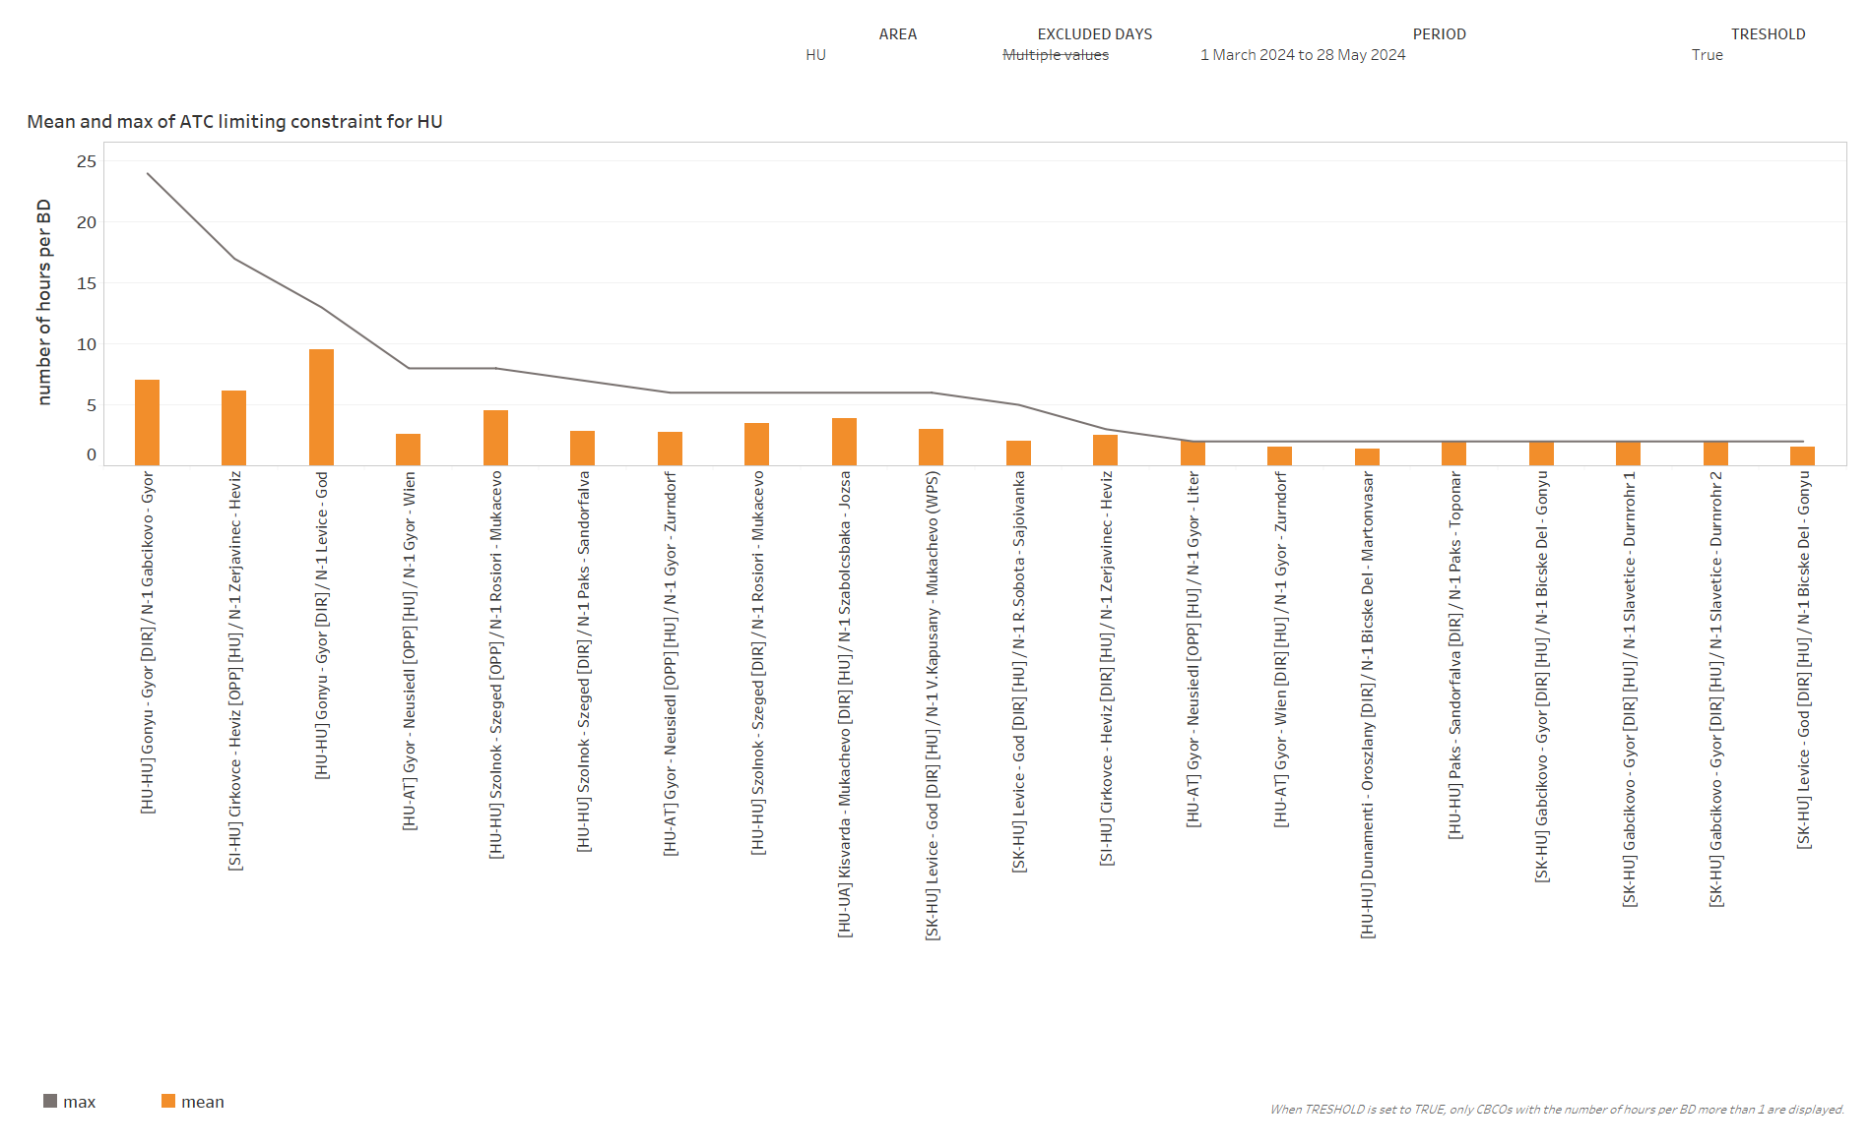
KPI 6
Limiting constraints of the ATC domain​

Slide 21
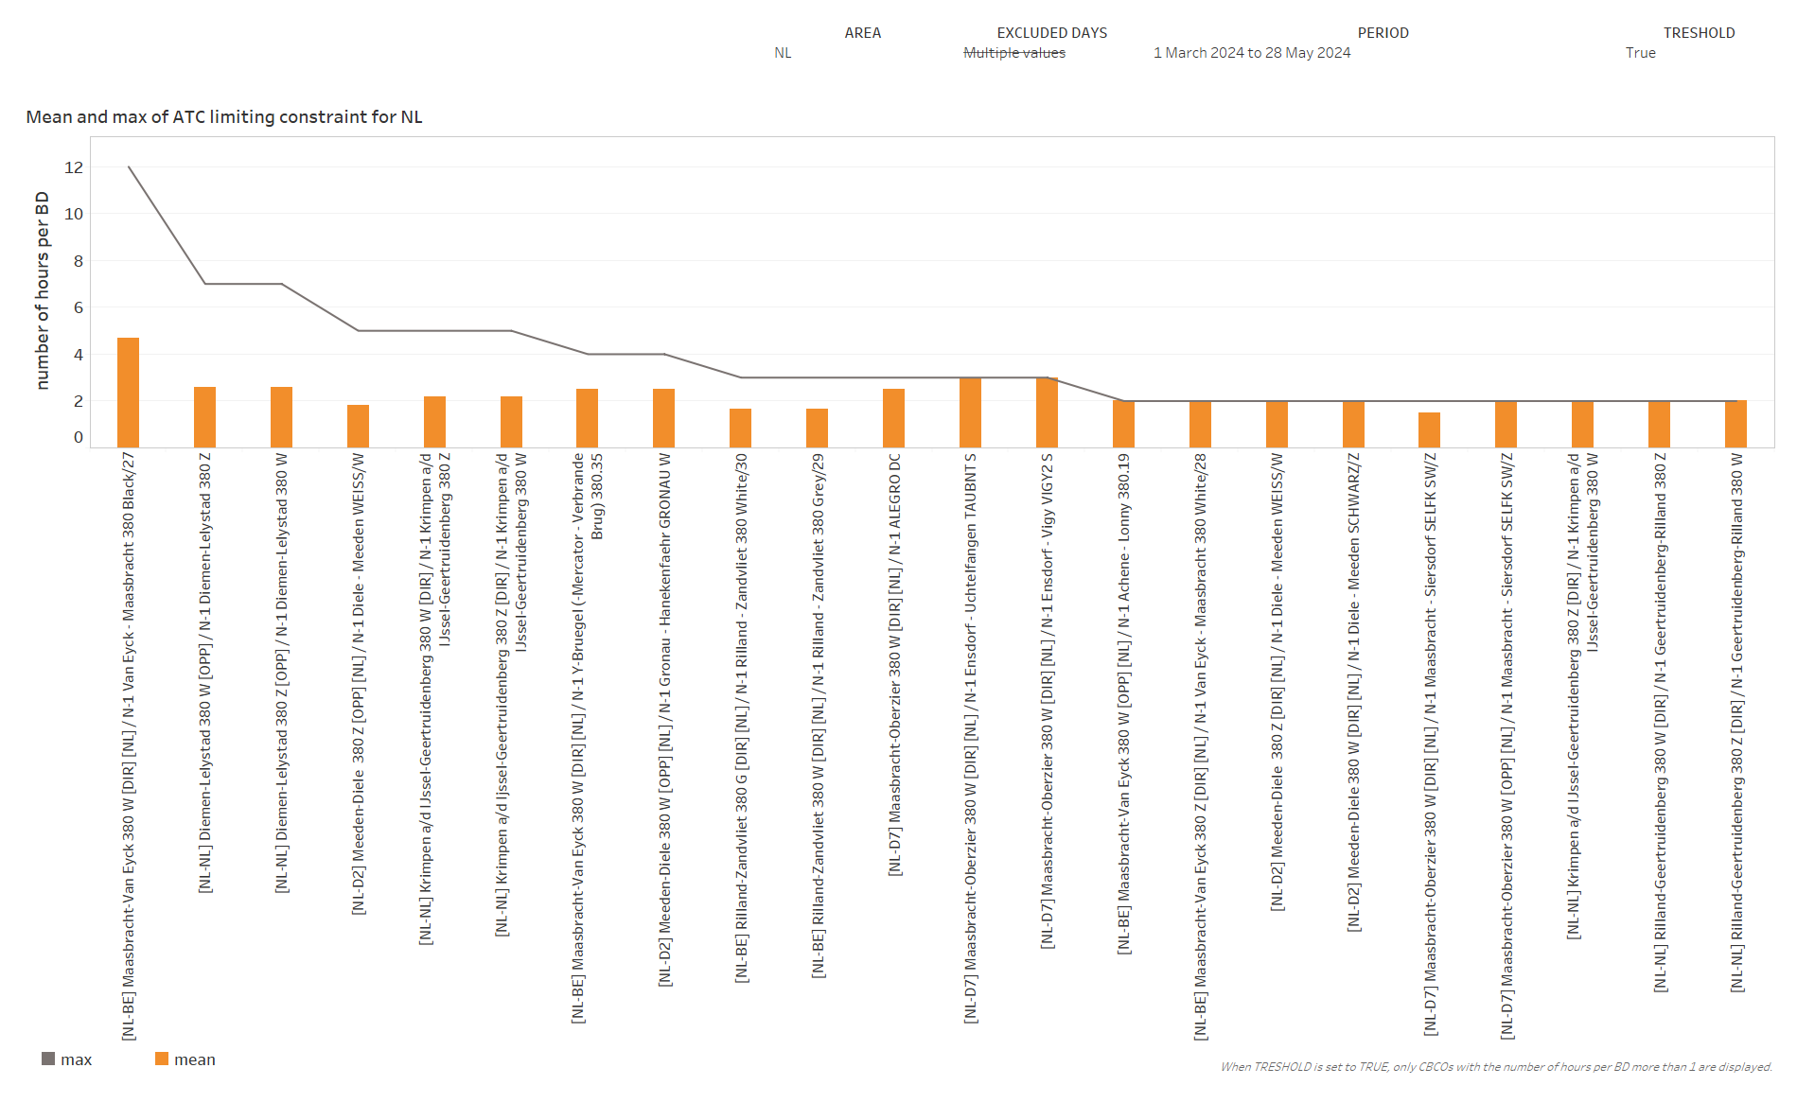
KPI 6
Limiting constraints of the ATC domain​

Slide 22
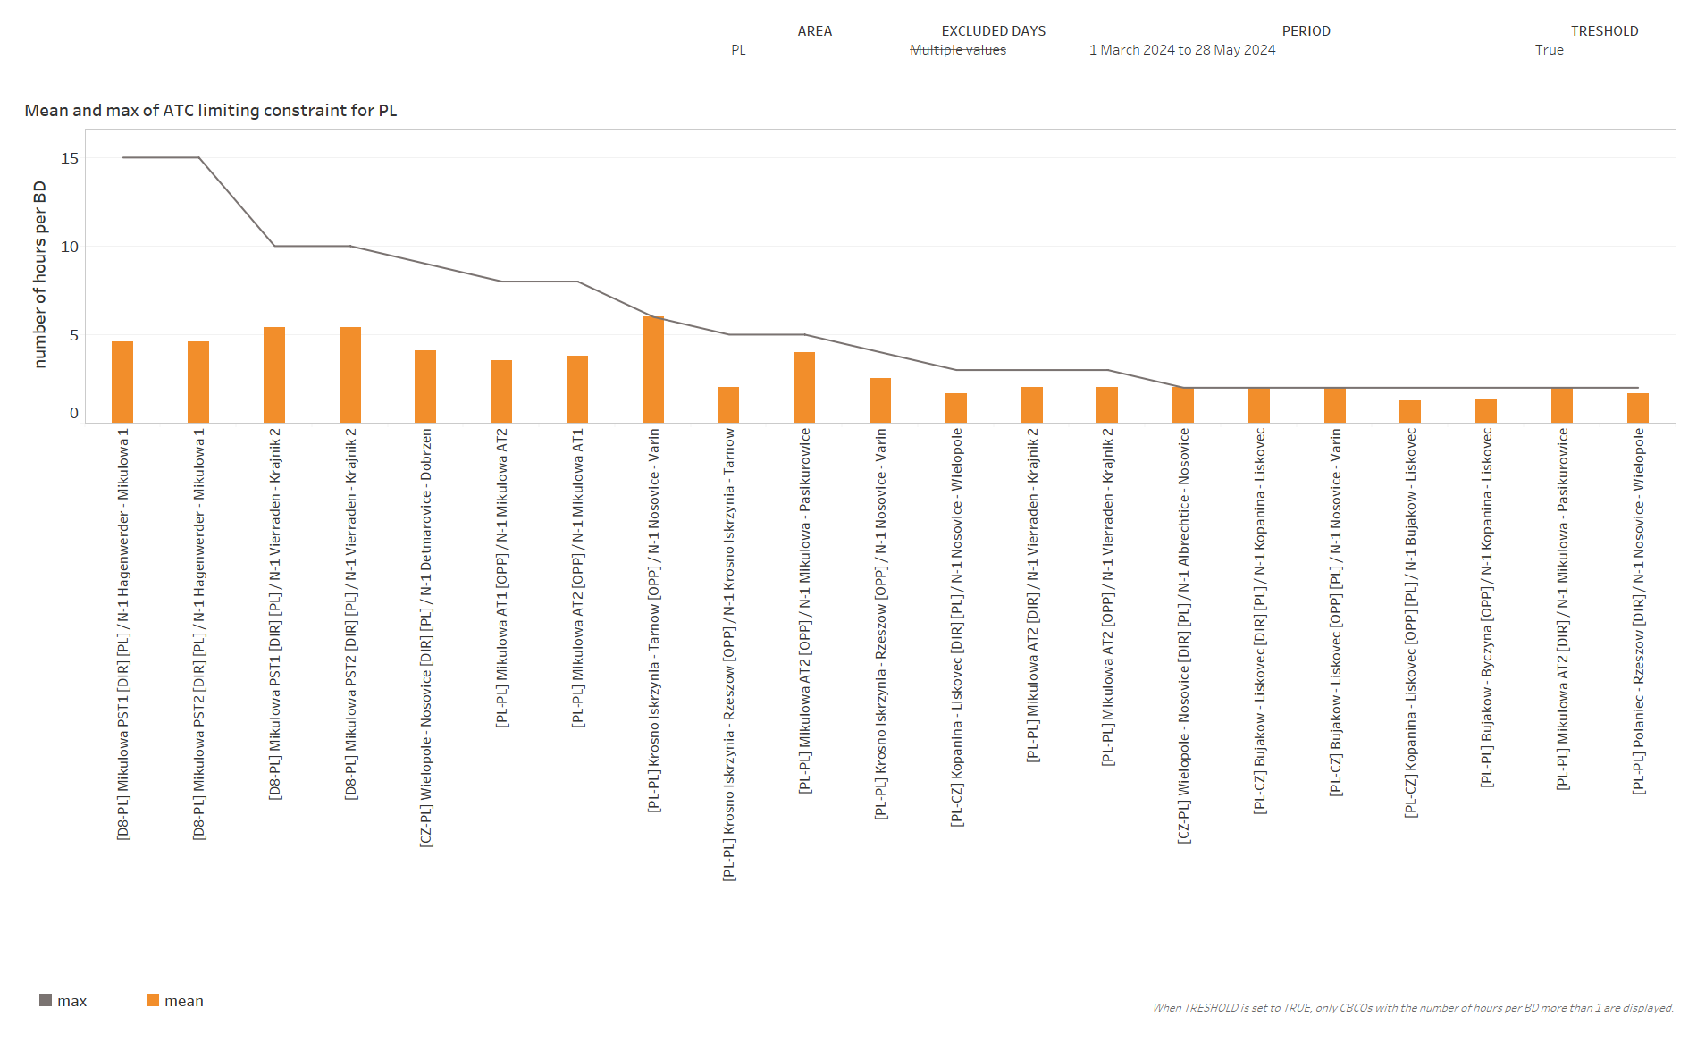
KPI 6
Limiting constraints of the ATC domain​

Slide 23
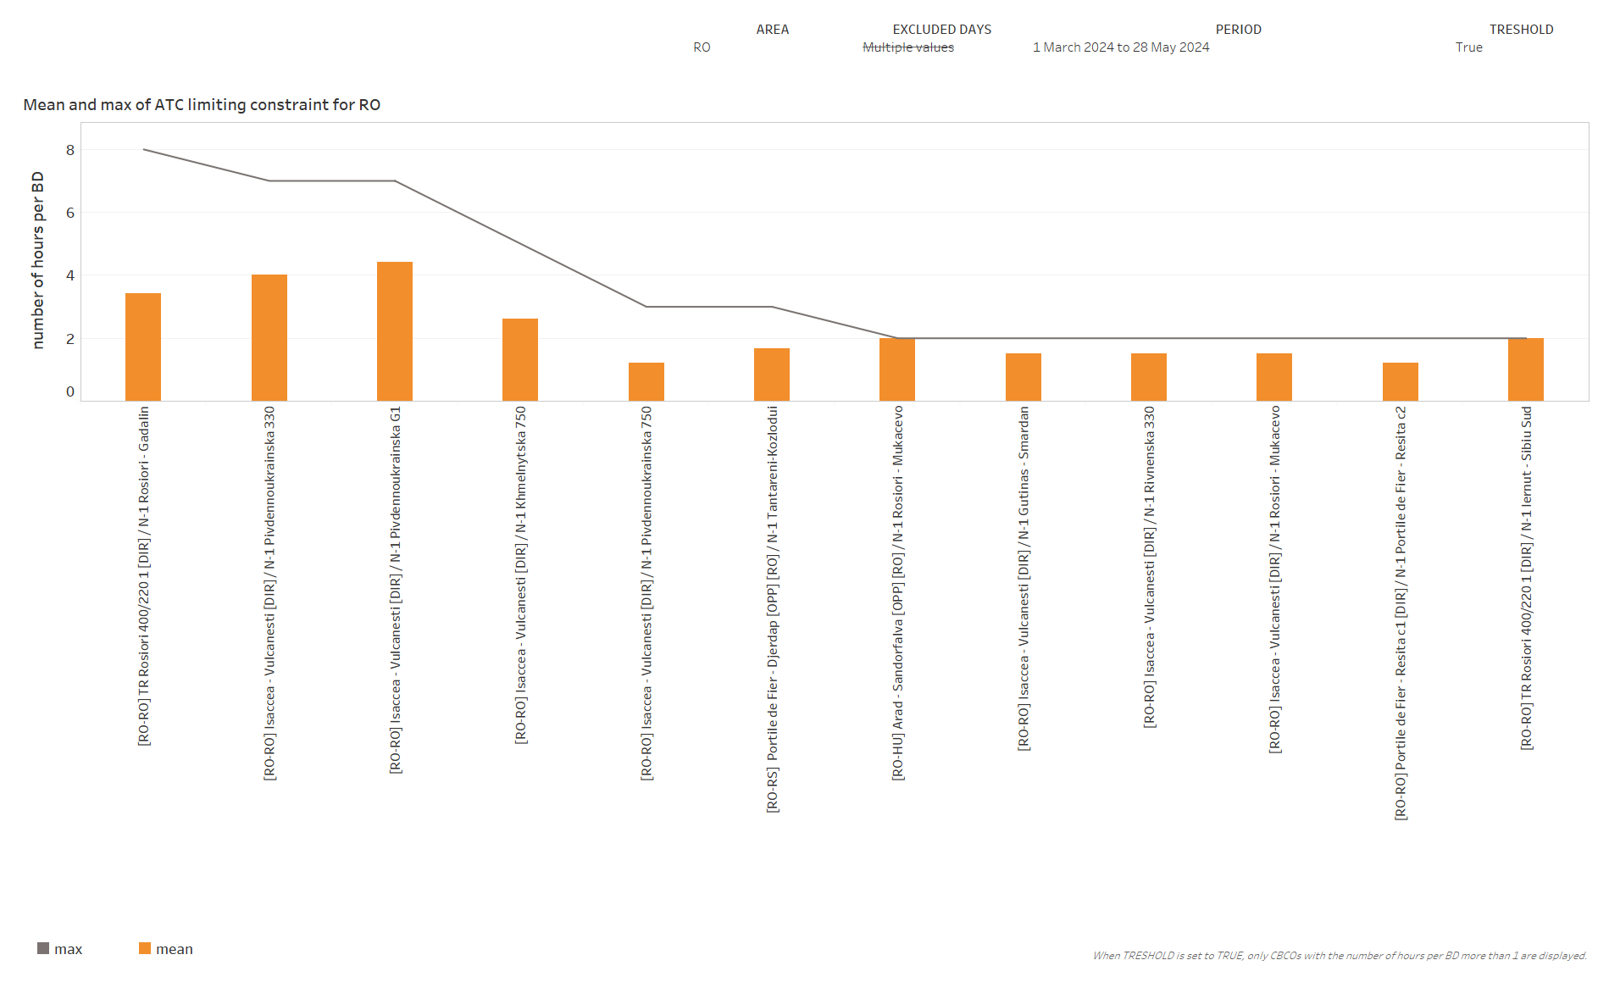
KPI 6
Limiting constraints of the ATC domain​

Slide 24
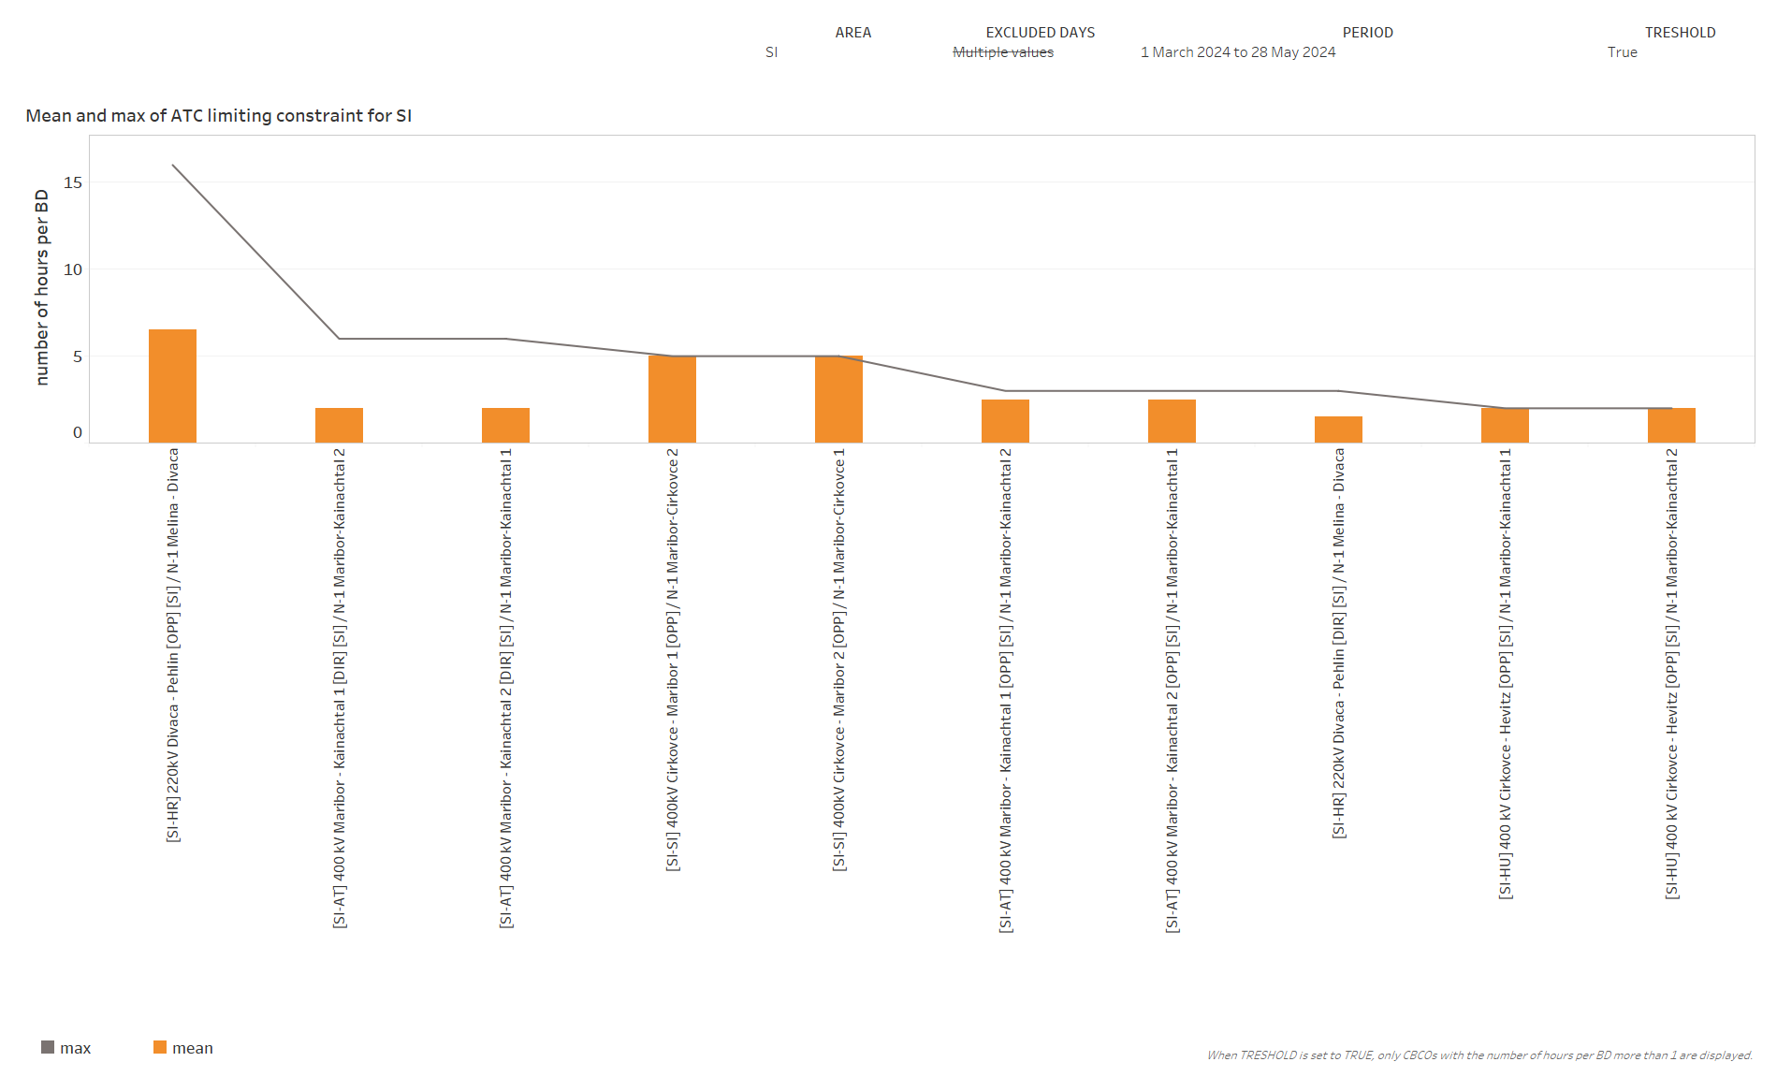
KPI 6
Limiting constraints of the ATC domain​

Slide 25
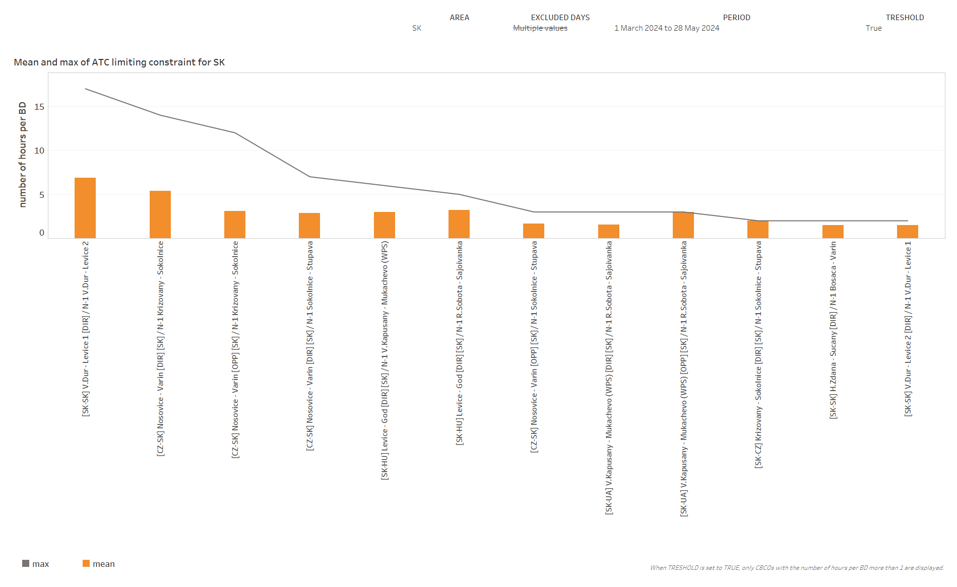
KPI 6
Limiting constraints of the ATC domain​

Slide 26
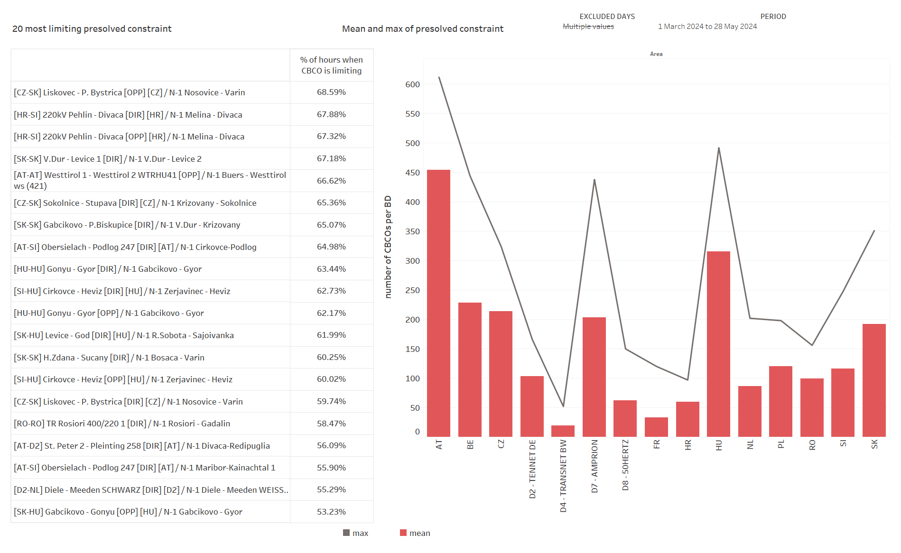
KPI 7
Most often pre-solved CNECs​

Slide 27
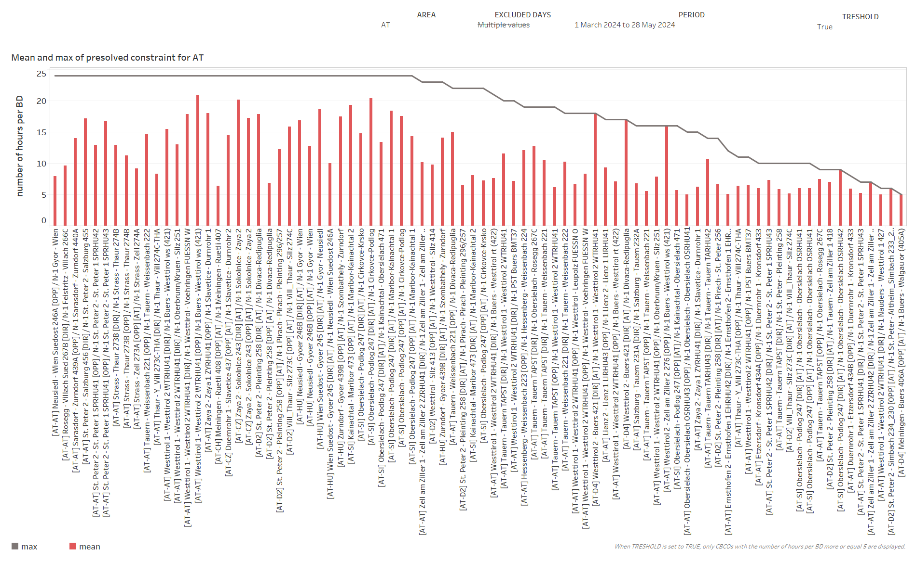
KPI 7
Most often pre-solved CNECs​

Slide 28
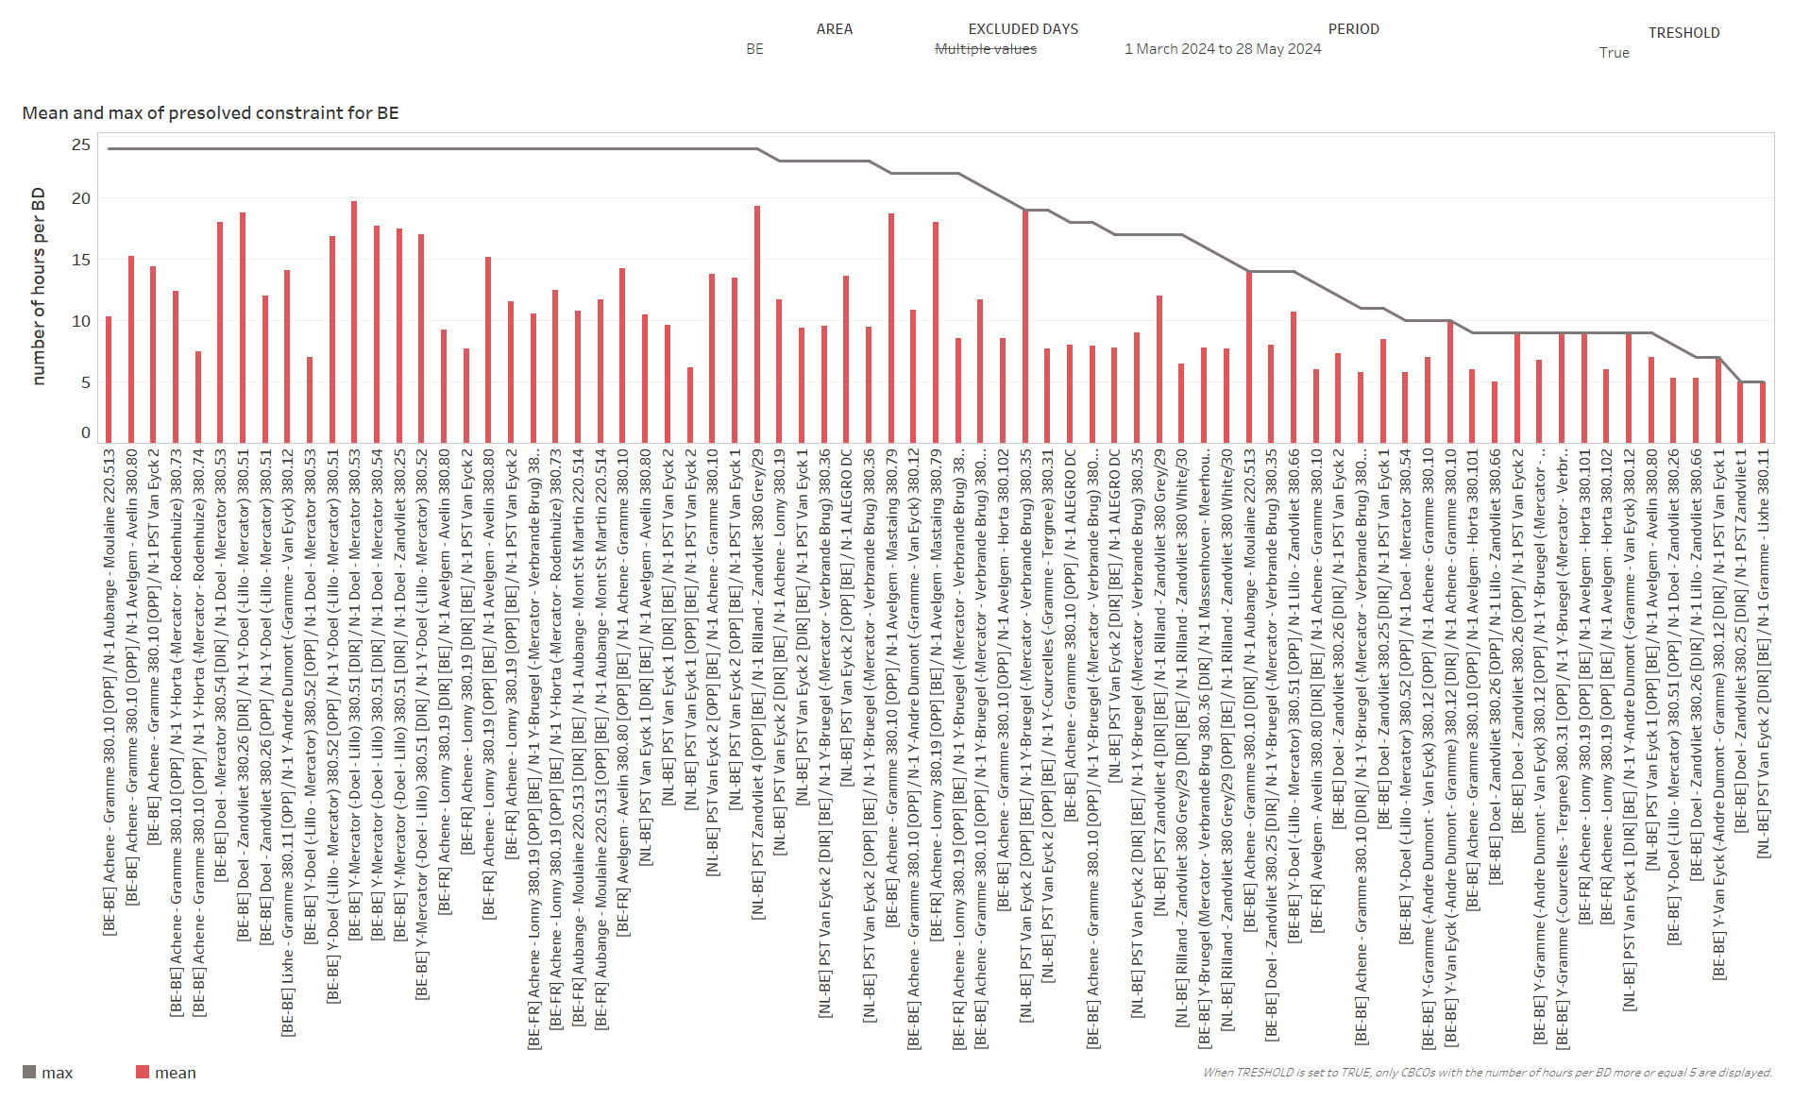
KPI 7
Most often pre-solved CNECs​

Slide 29
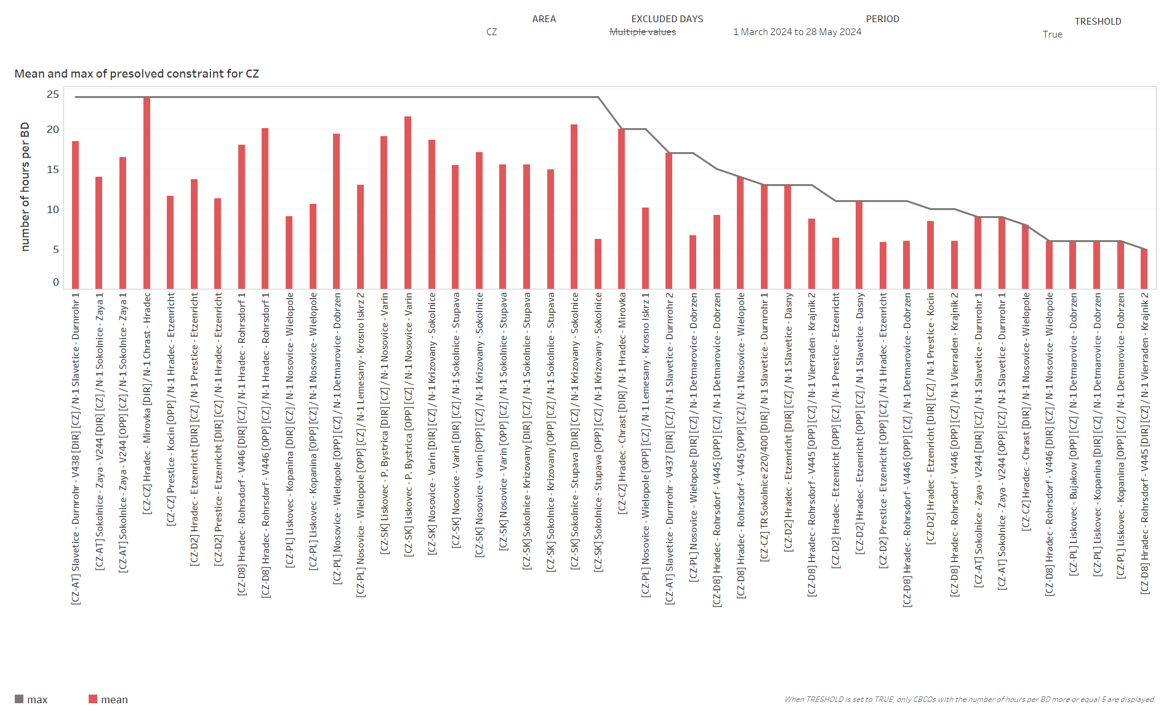
KPI 7
Most often pre-solved CNECs​

Slide 30
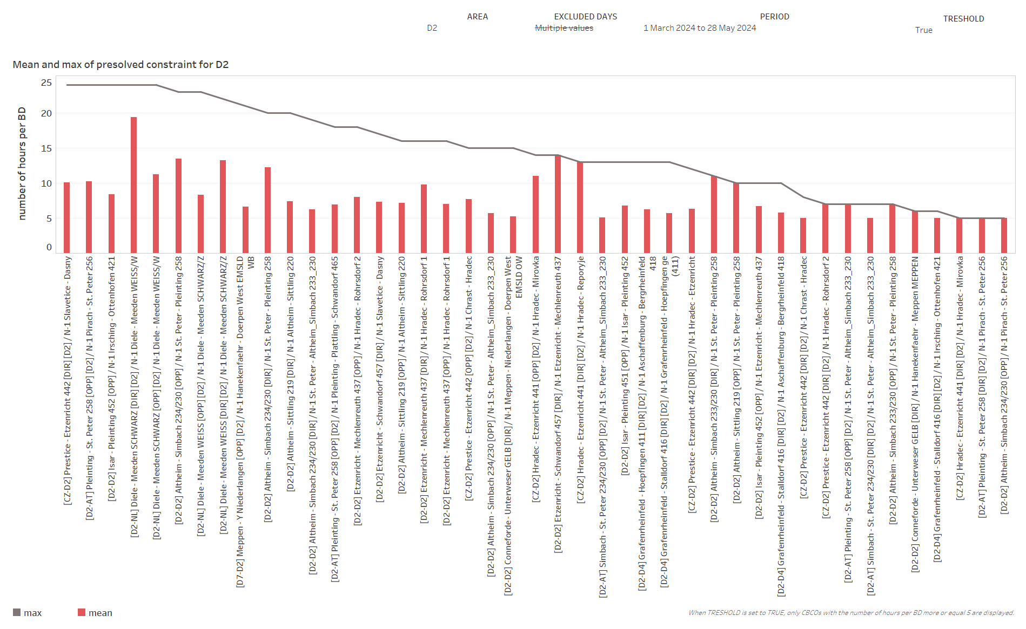
KPI 7
Most often pre-solved CNECs​

Slide 31
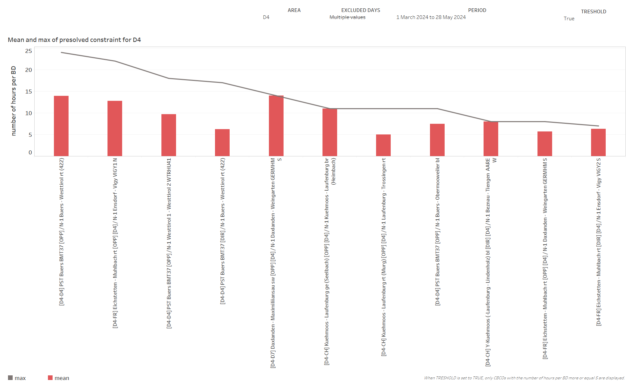
KPI 7
Most often pre-solved CNECs​

Slide 32
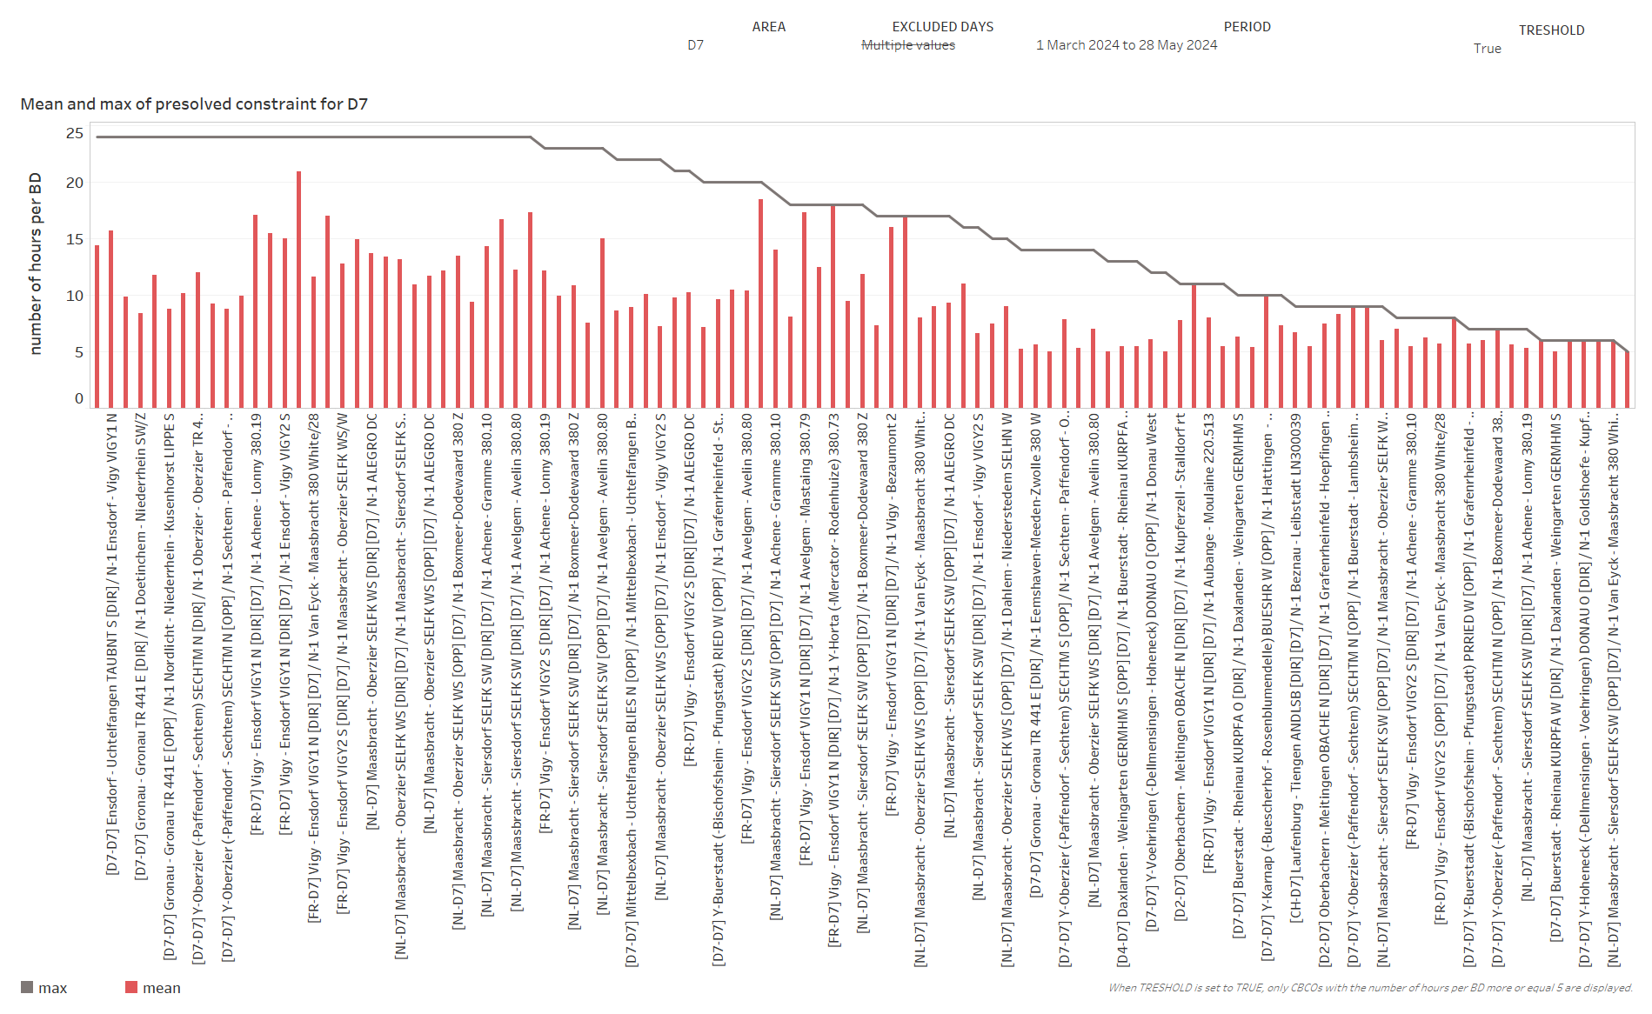
KPI 7
Most often pre-solved CNECs​

Slide 33
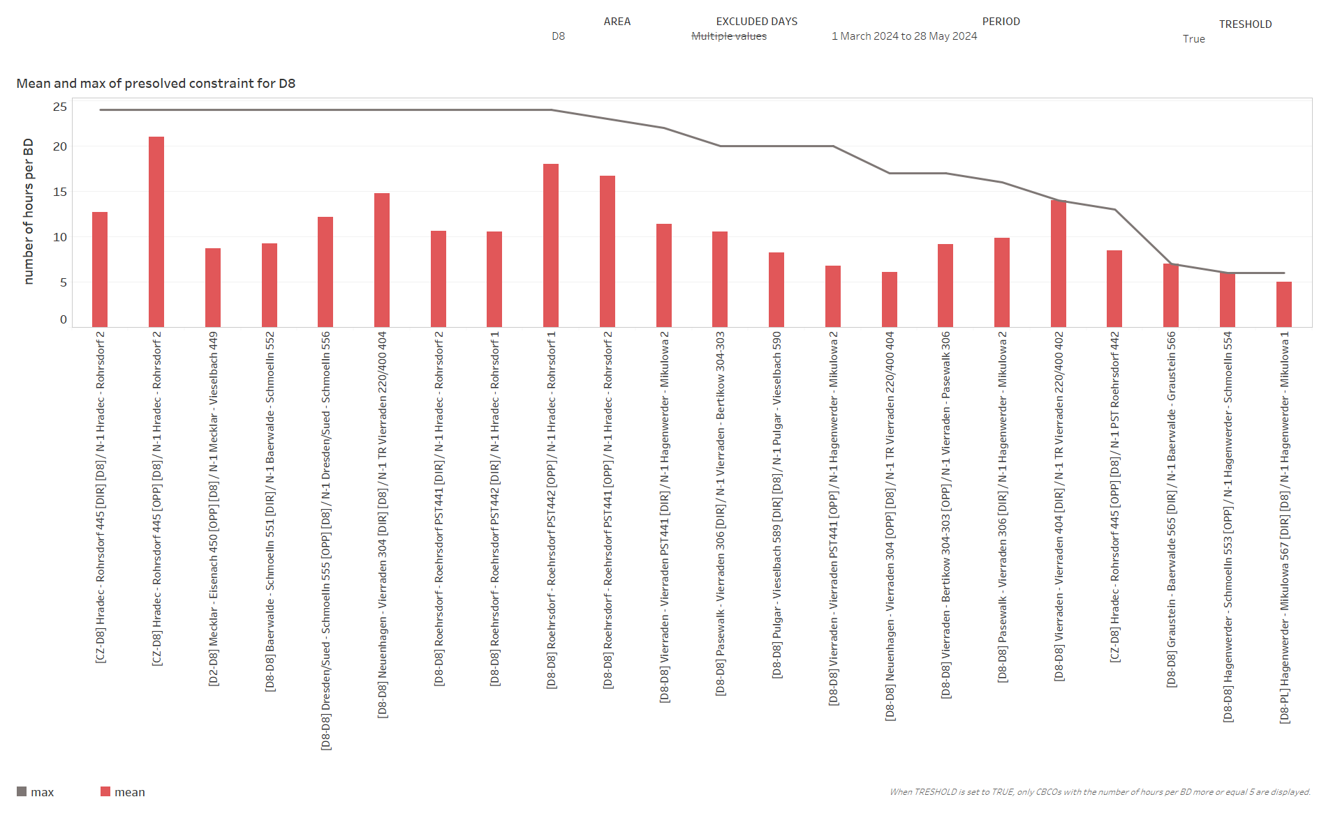
KPI 7
Most often pre-solved CNECs​

Slide 34
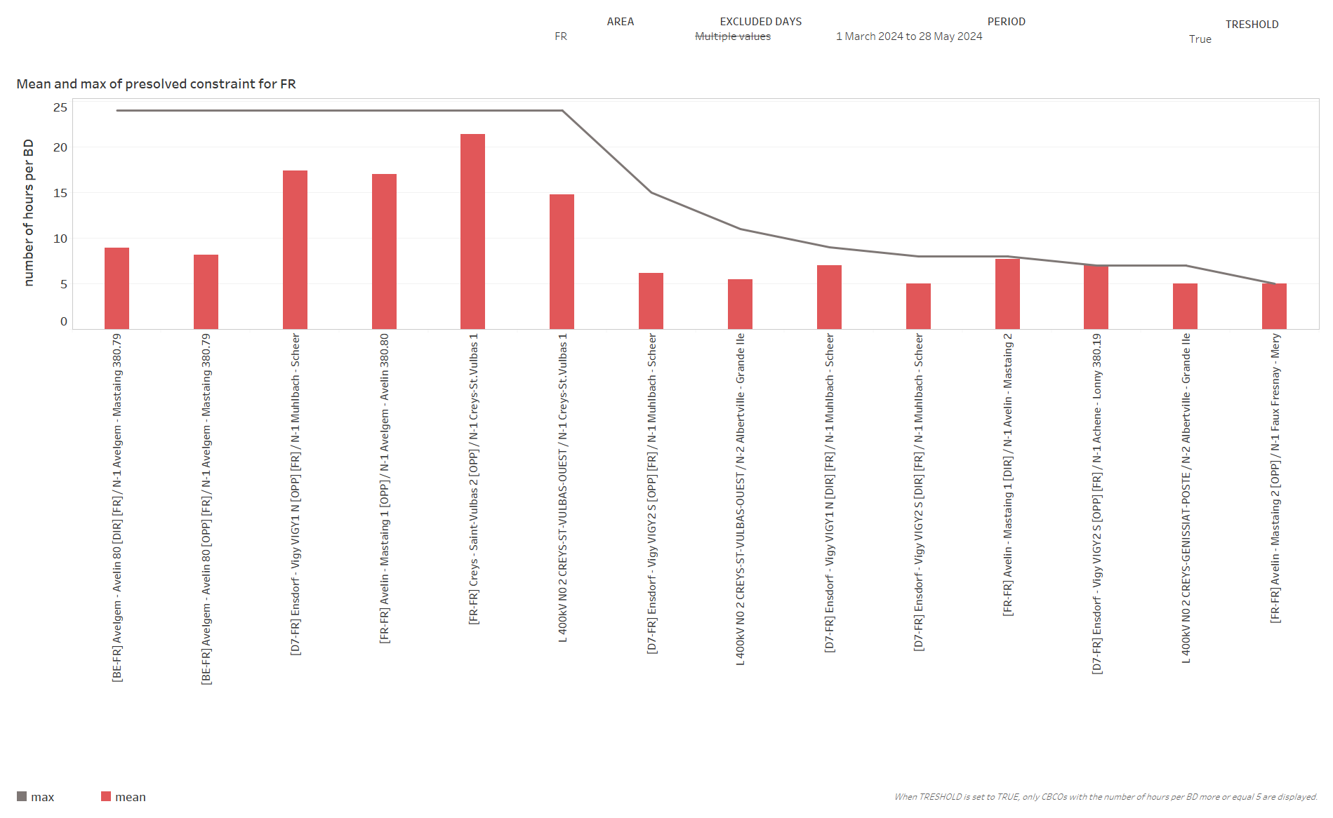
KPI 7
Most often pre-solved CNECs​

Slide 35
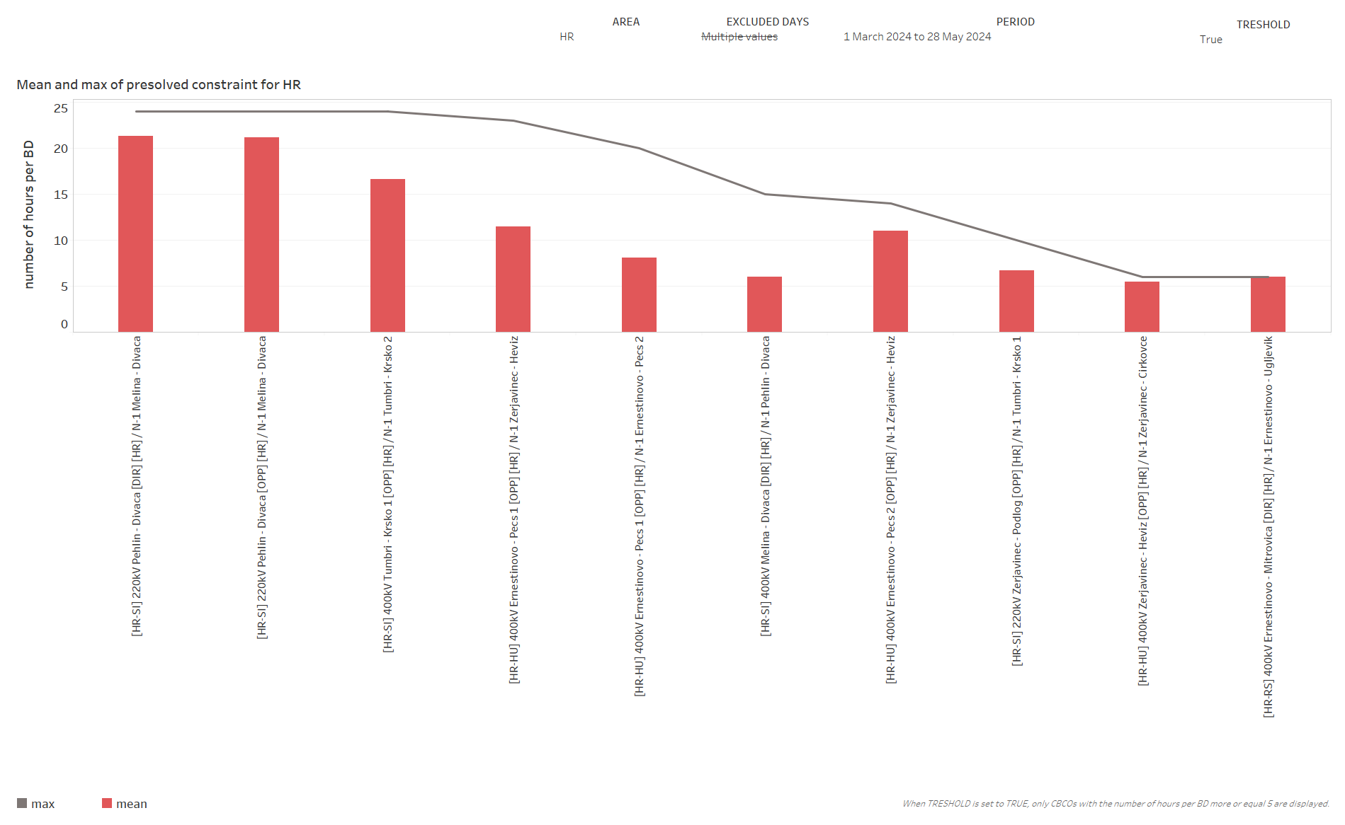
KPI 7
Most often pre-solved CNECs​

Slide 36
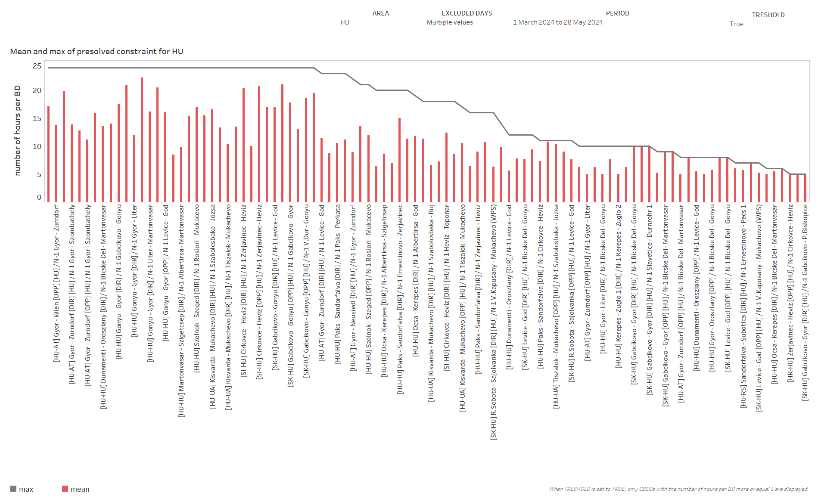
KPI 7
Most often pre-solved CNECs​

Slide 37
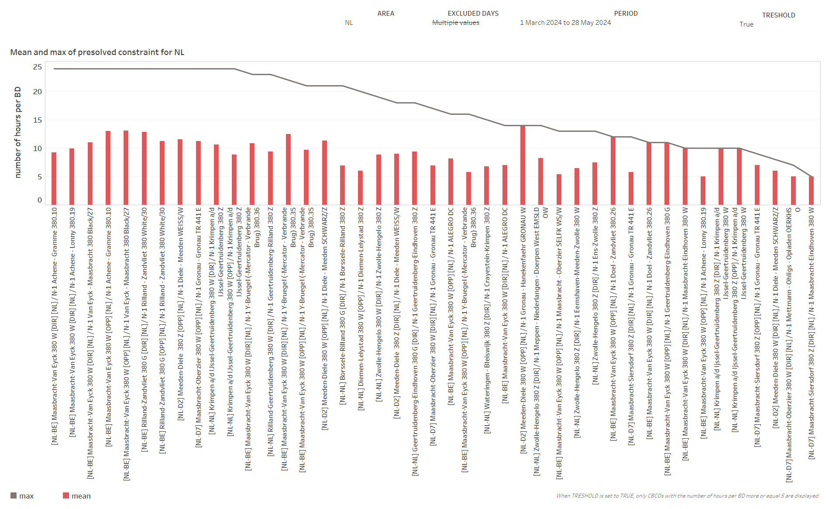
KPI 7
Most often pre-solved CNECs​

Slide 38
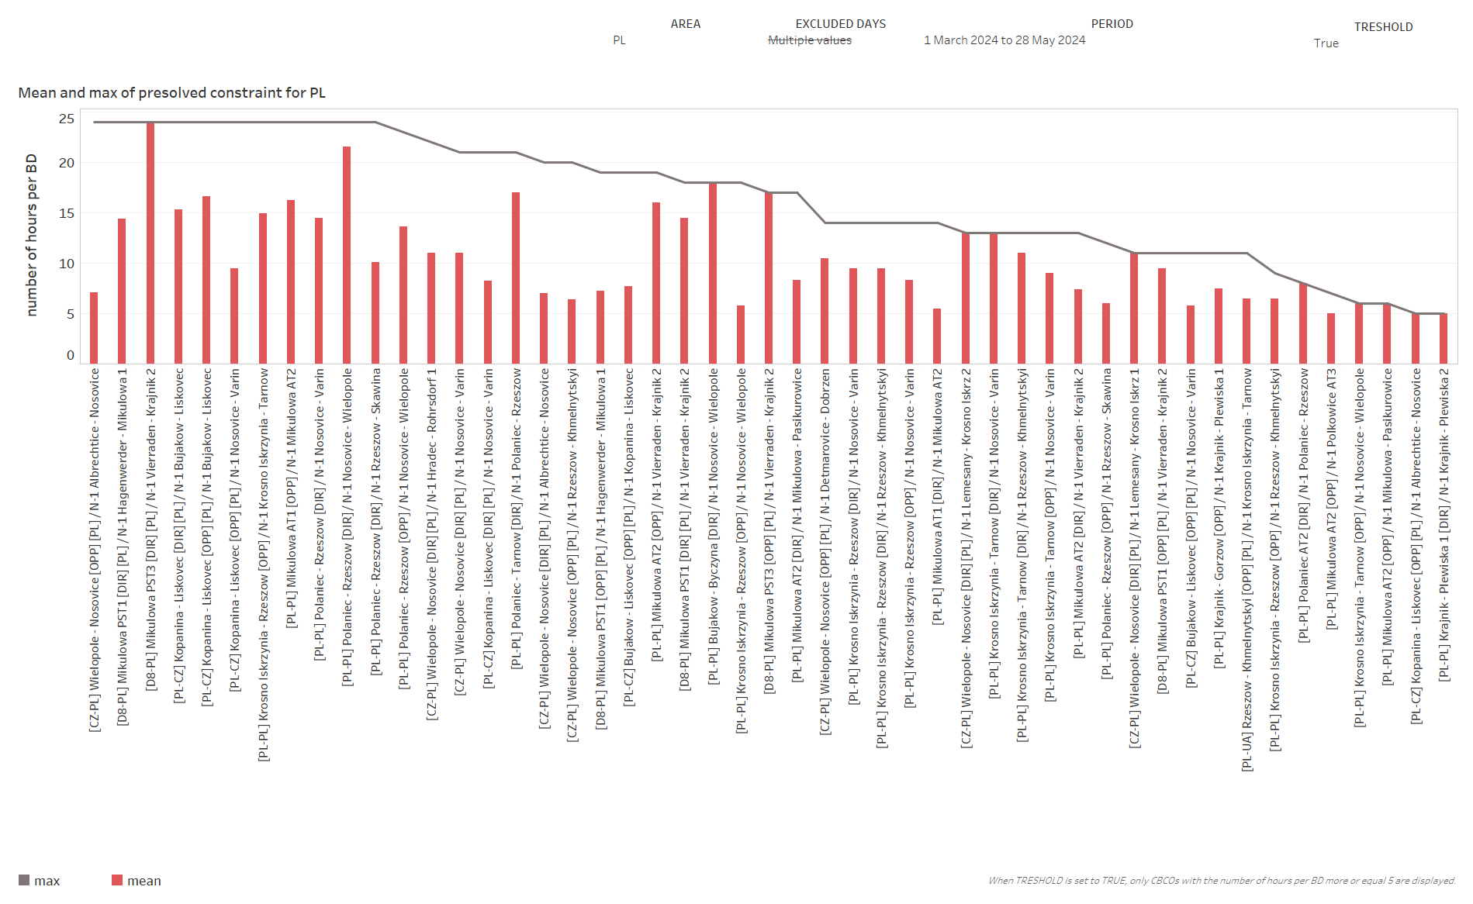
KPI 7
Most often pre-solved CNECs​

Slide 39
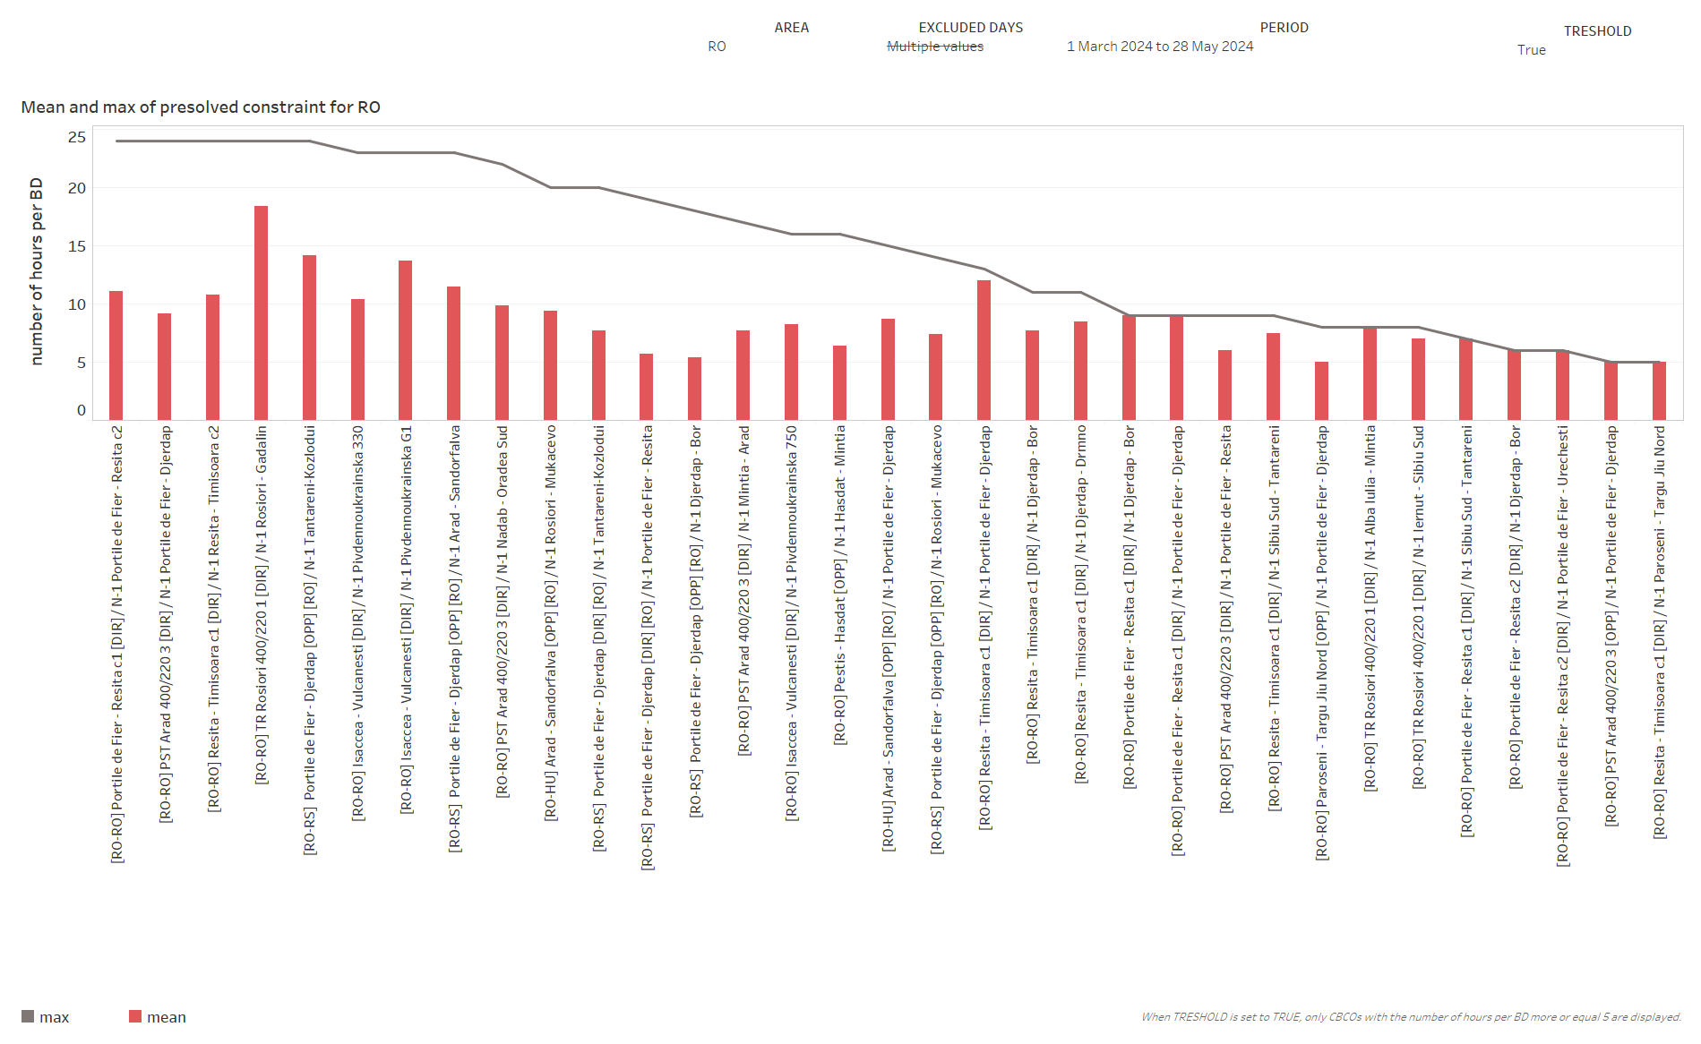
KPI 7
Most often pre-solved CNECs​

Slide 40
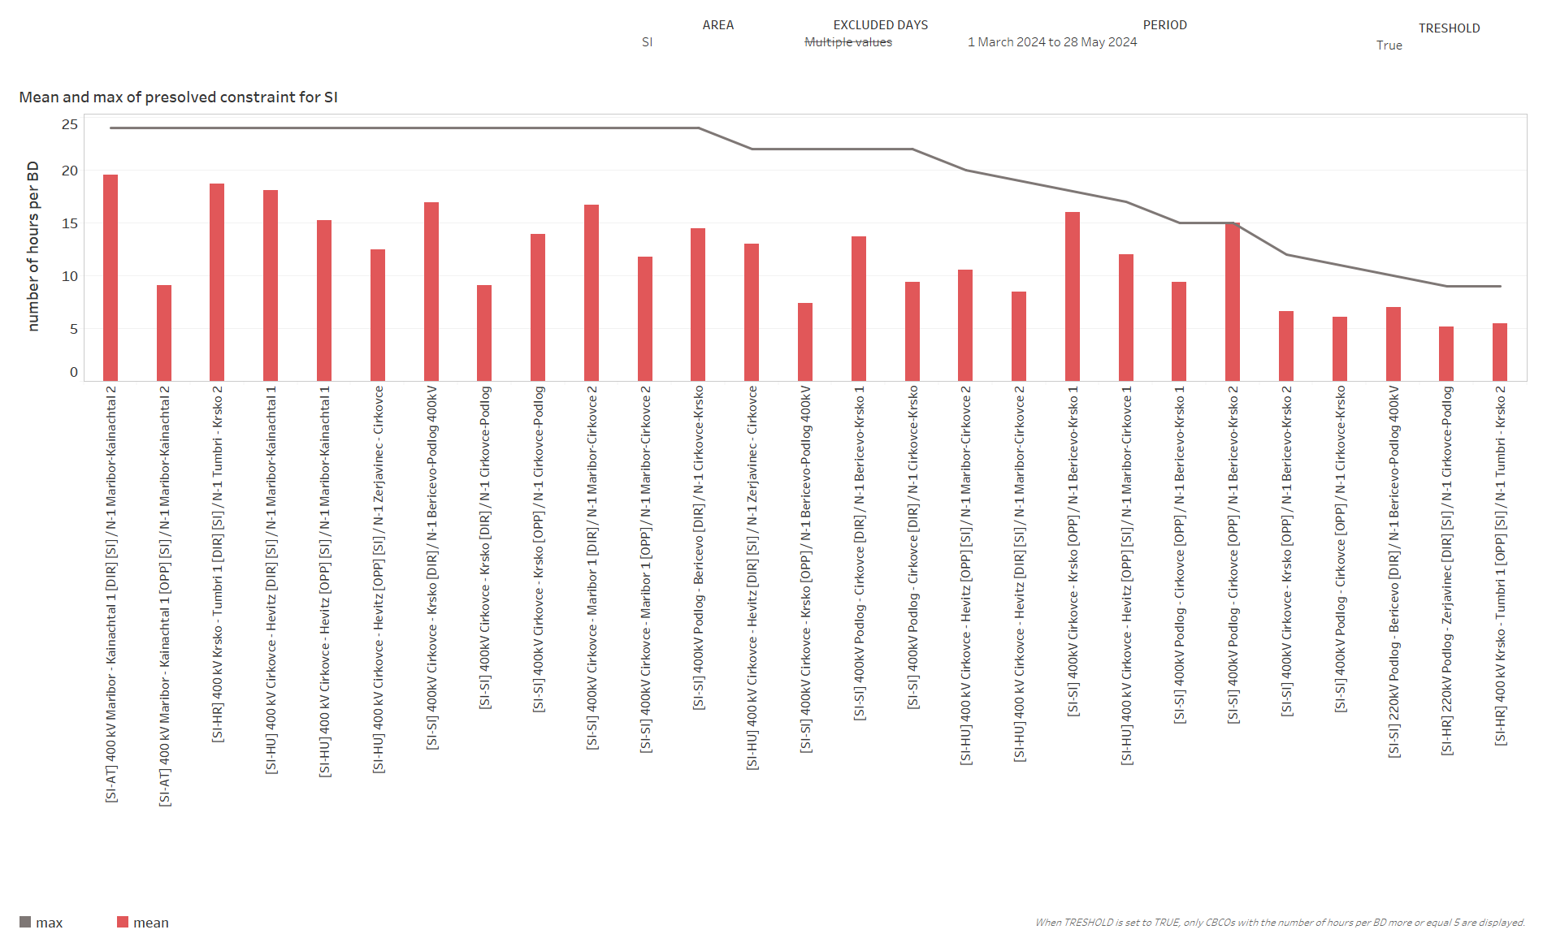
KPI 7
Most often pre-solved CNECs​

Slide 41
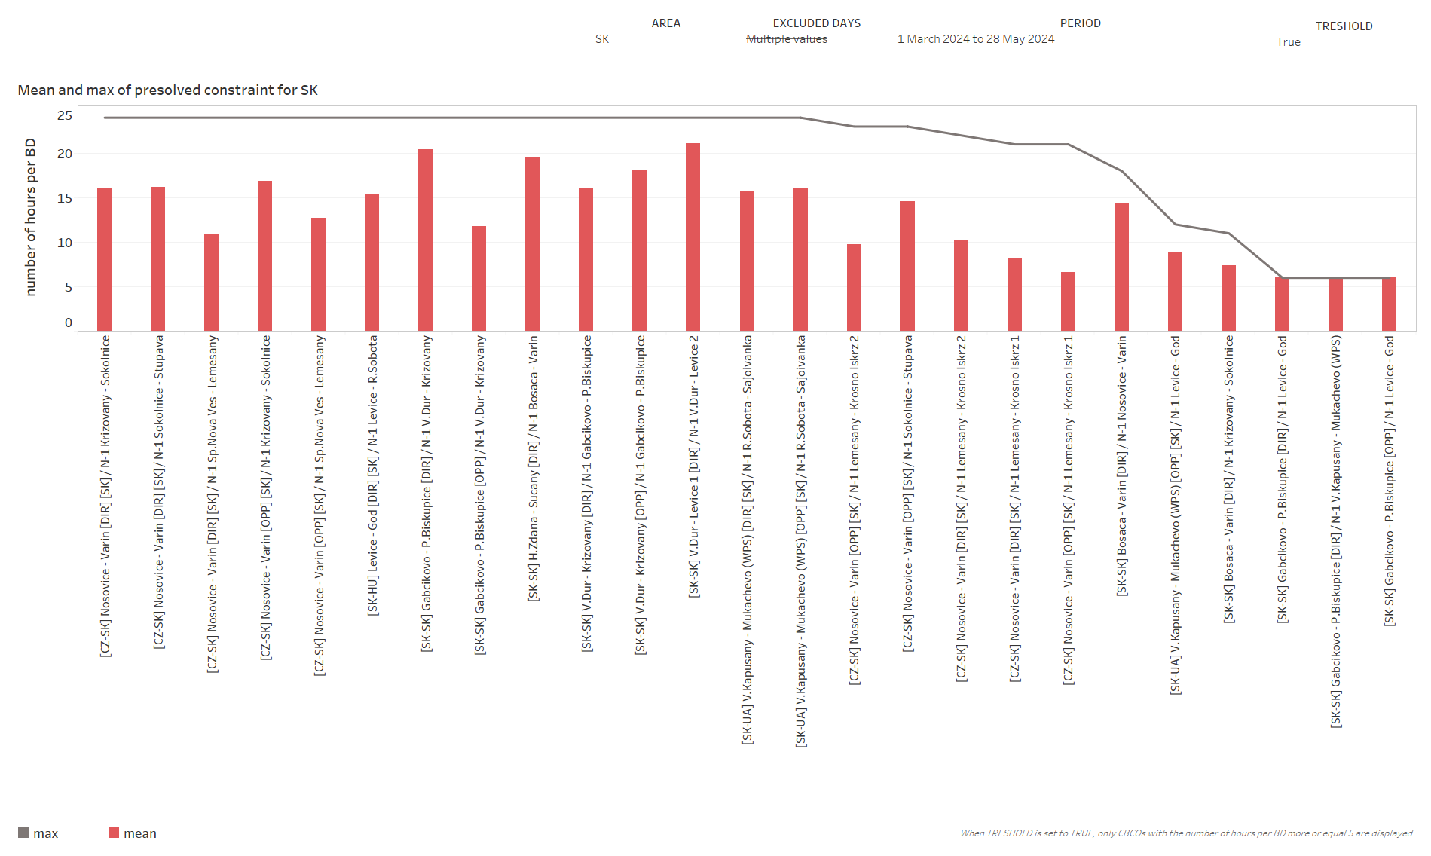
KPI 7
Most often pre-solved CNECs​

Slide 42
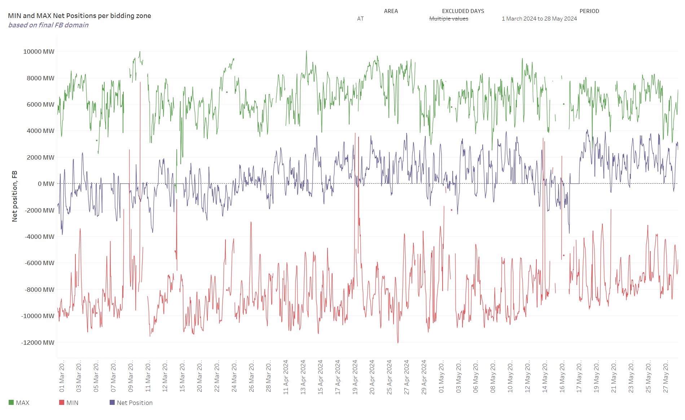
KPI 8 – Min and Max Net Positions per bidding zone
(a) Based on final FB domain

Slide 43
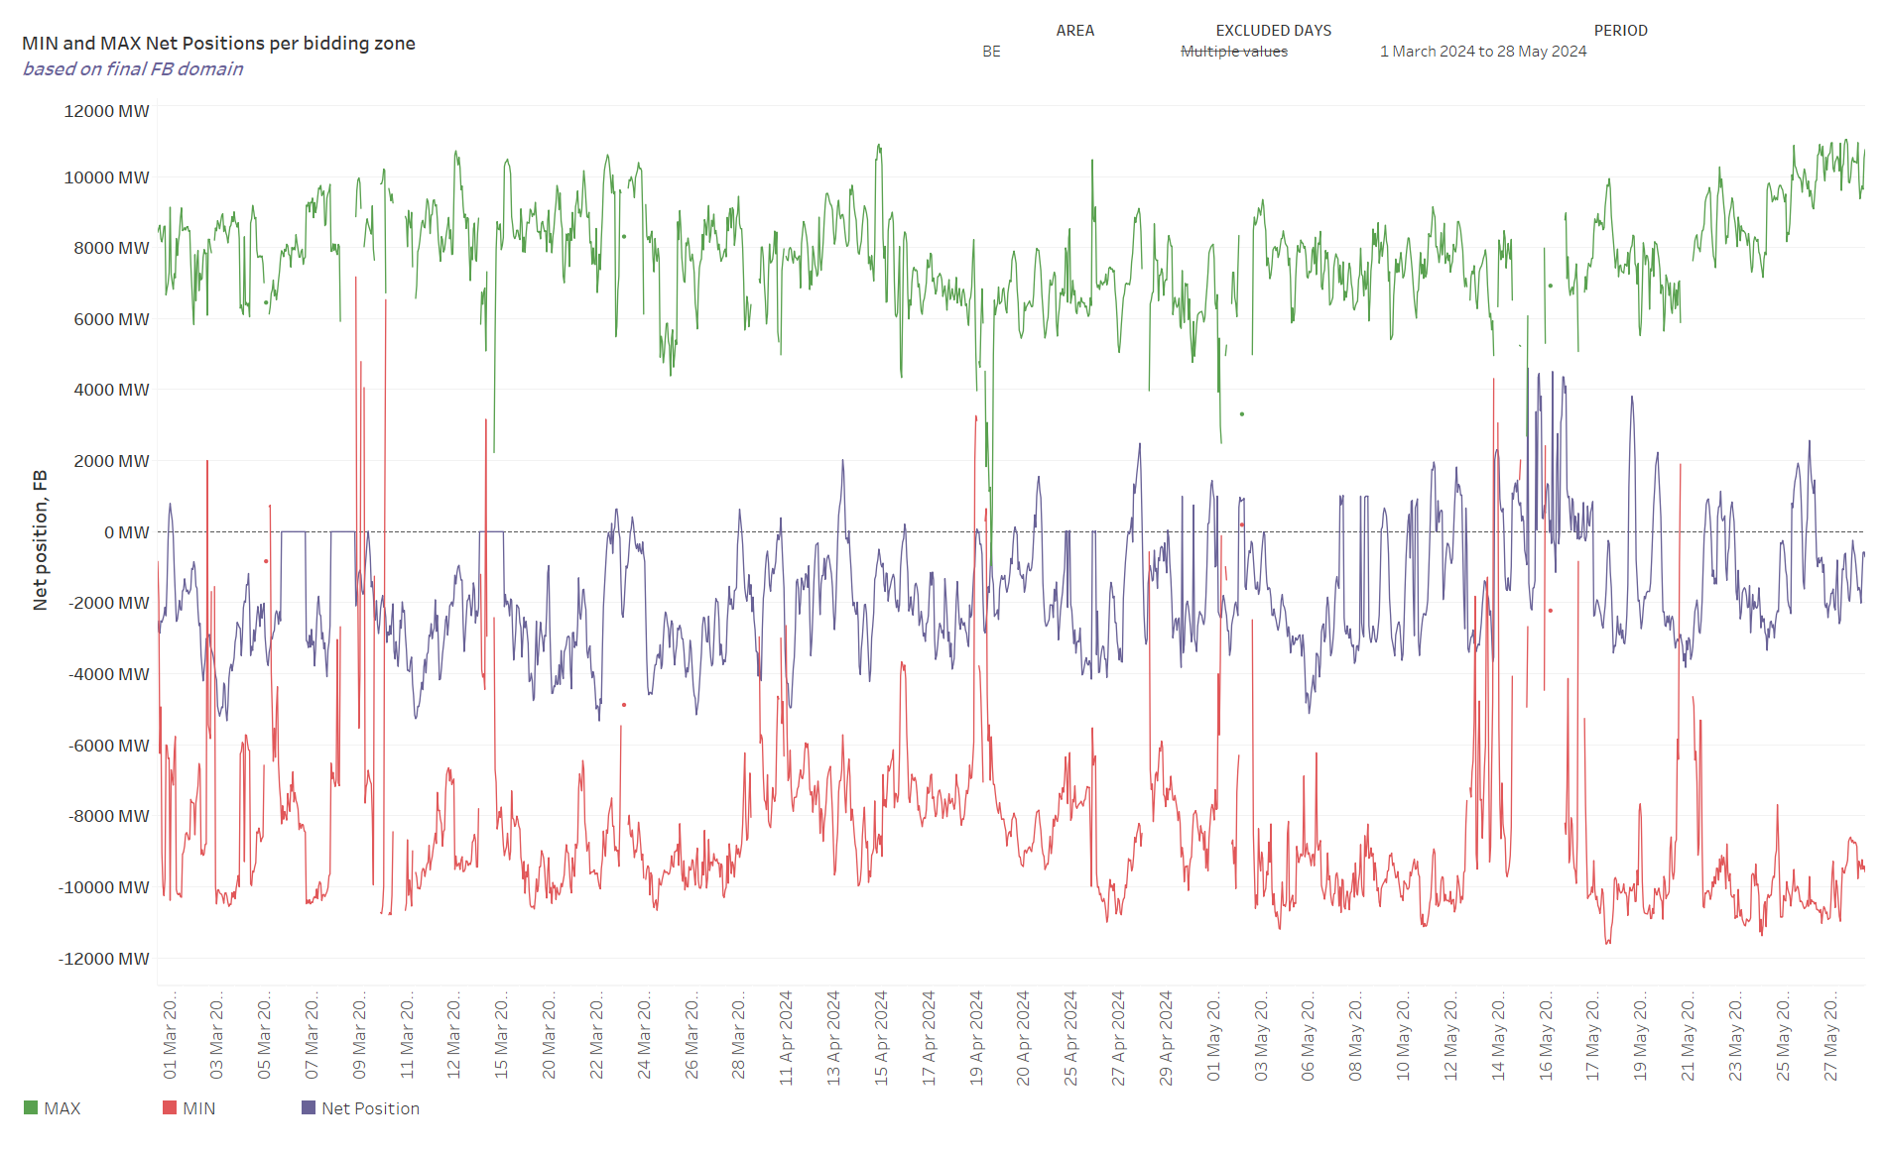
KPI 8 – Min and Max Net Positions per bidding zone
(a) Based on final FB domain

Slide 44
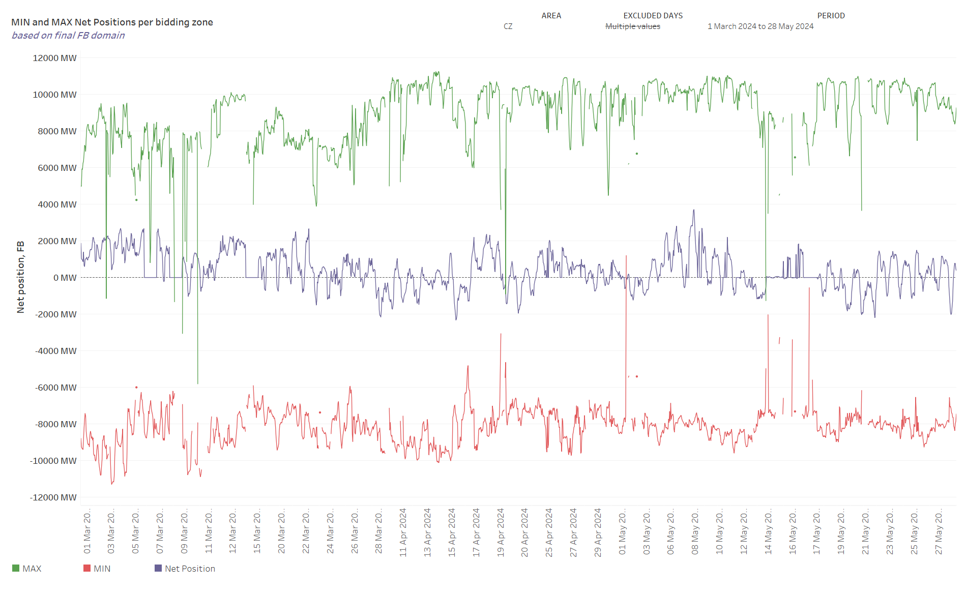
KPI 8 – Min and Max Net Positions per bidding zone
(a) Based on final FB domain

Slide 45
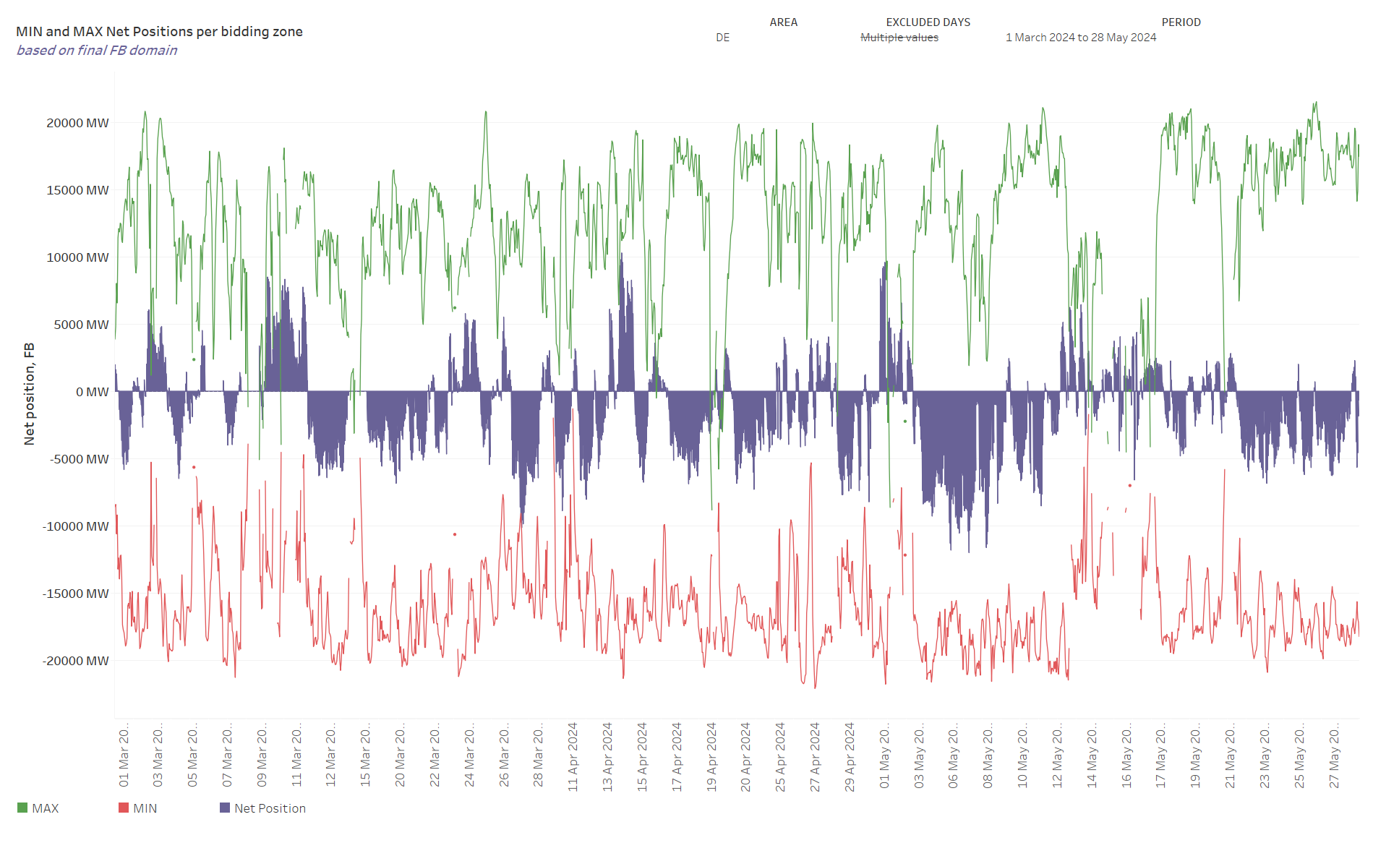
KPI 8 – Min and Max Net Positions per bidding zone
(a) Based on final FB domain
Note - Missing values of min and max net positions for some timestamps are caused by empty domains.

Slide 46
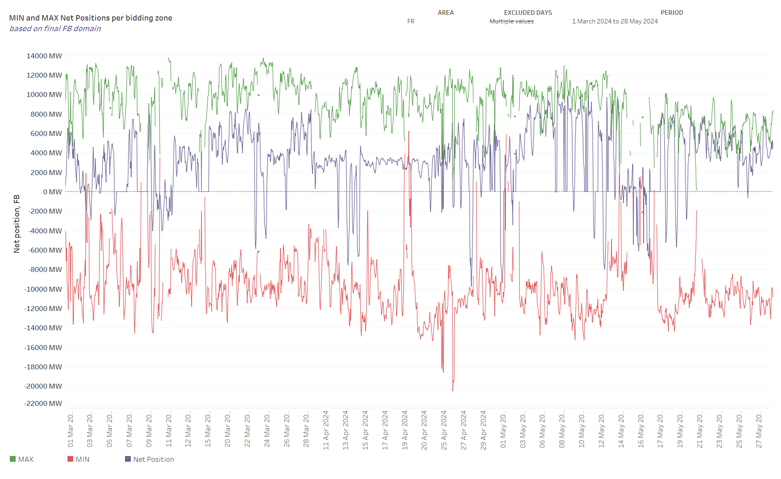
KPI 8 – Min and Max Net Positions per bidding zone
(a) Based on final FB domain
Note - Missing values of min and max net positions for some timestamps are caused by empty domains.

Slide 47
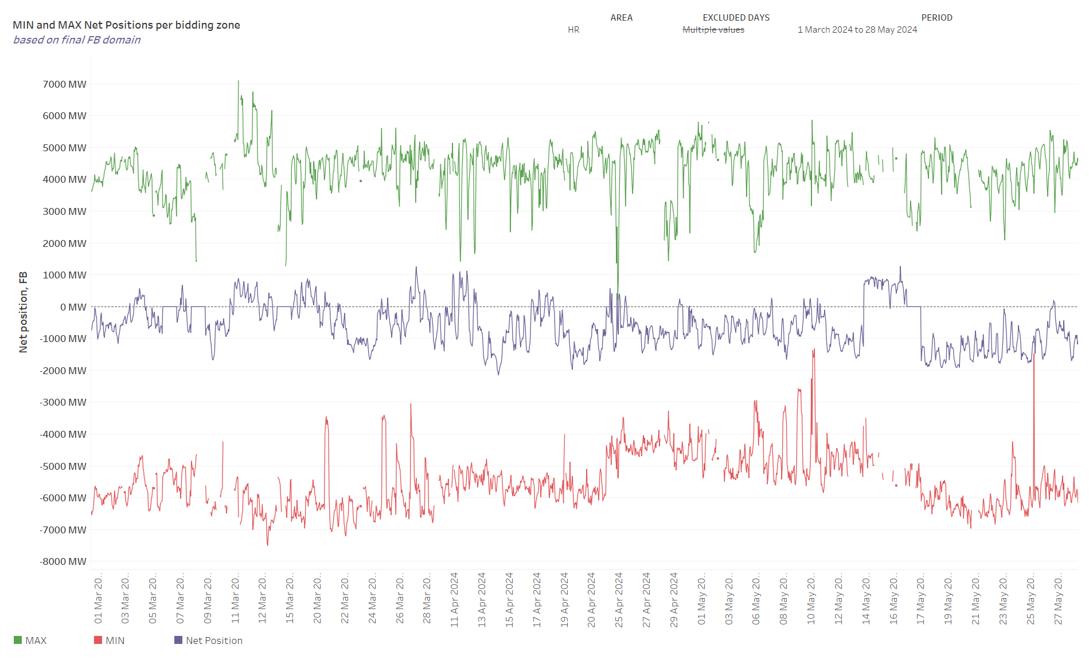
KPI 8 – Min and Max Net Positions per bidding zone
(a) Based on final FB domain
Note - Missing values of min and max net positions for some timestamps are caused by empty domains.

Slide 48
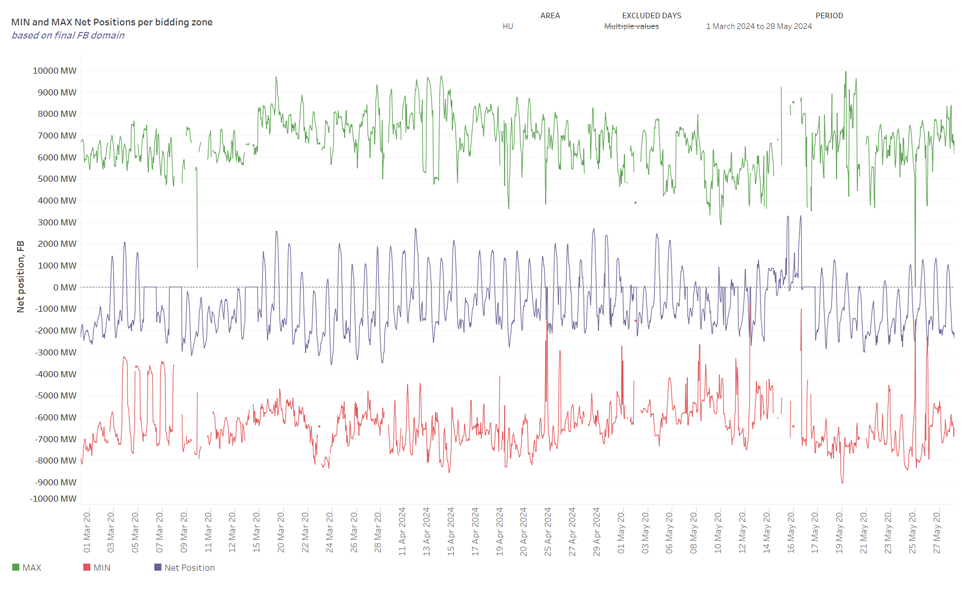
KPI 8 – Min and Max Net Positions per bidding zone
(a) Based on final FB domain
Note - Missing values of min and max net positions for some timestamps are caused by empty domains.

Slide 49
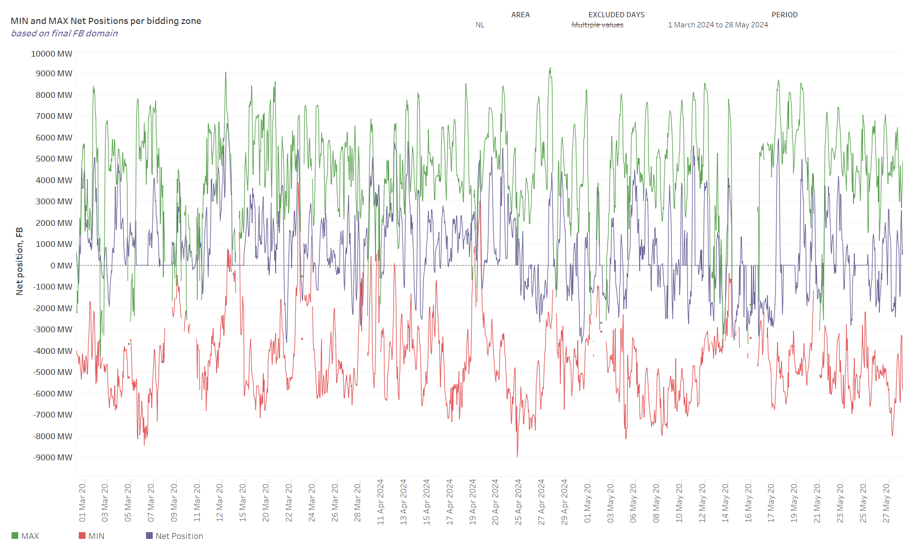
KPI 8 – Min and Max Net Positions per bidding zone
(a) Based on final FB domain
Note - Missing values of min and max net positions for some timestamps are caused by empty domains.

Slide 50
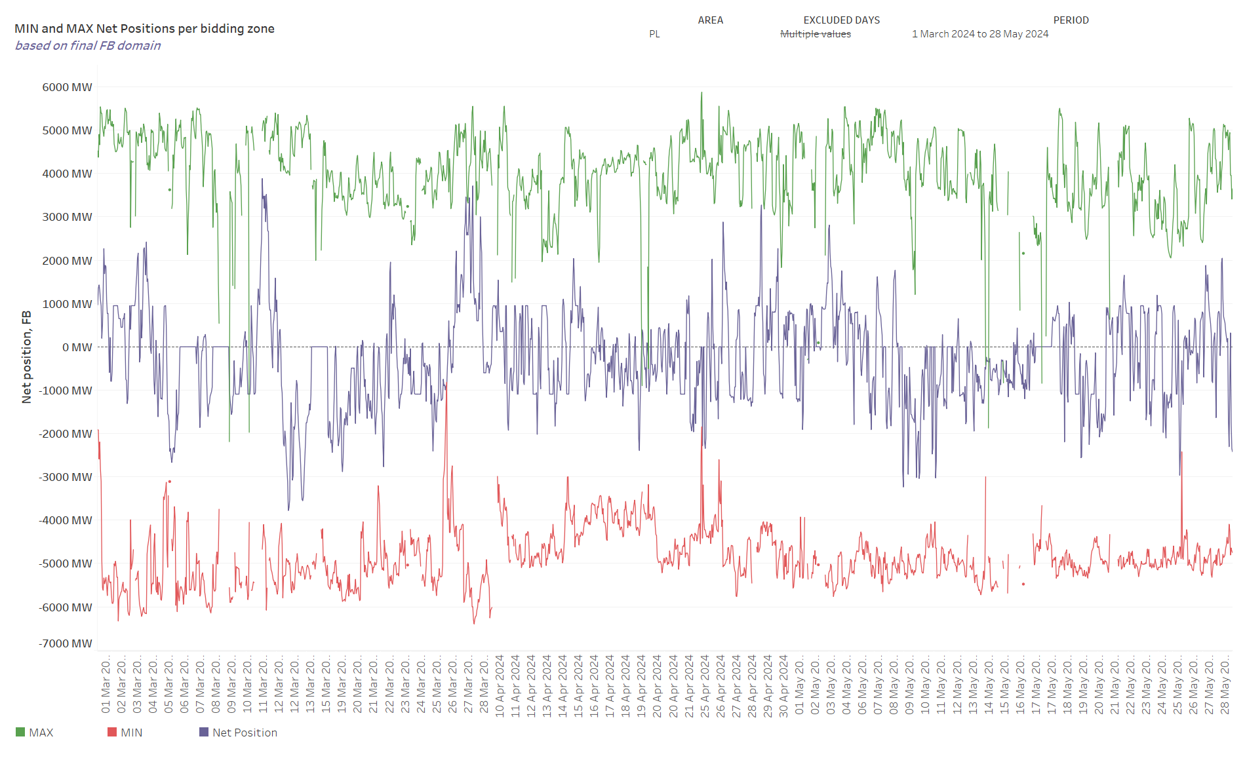
KPI 8 – Min and Max Net Positions per bidding zone
(a) Based on final FB domain
Note - Missing values of min and max net positions for some timestamps are caused by empty domains.

Slide 51
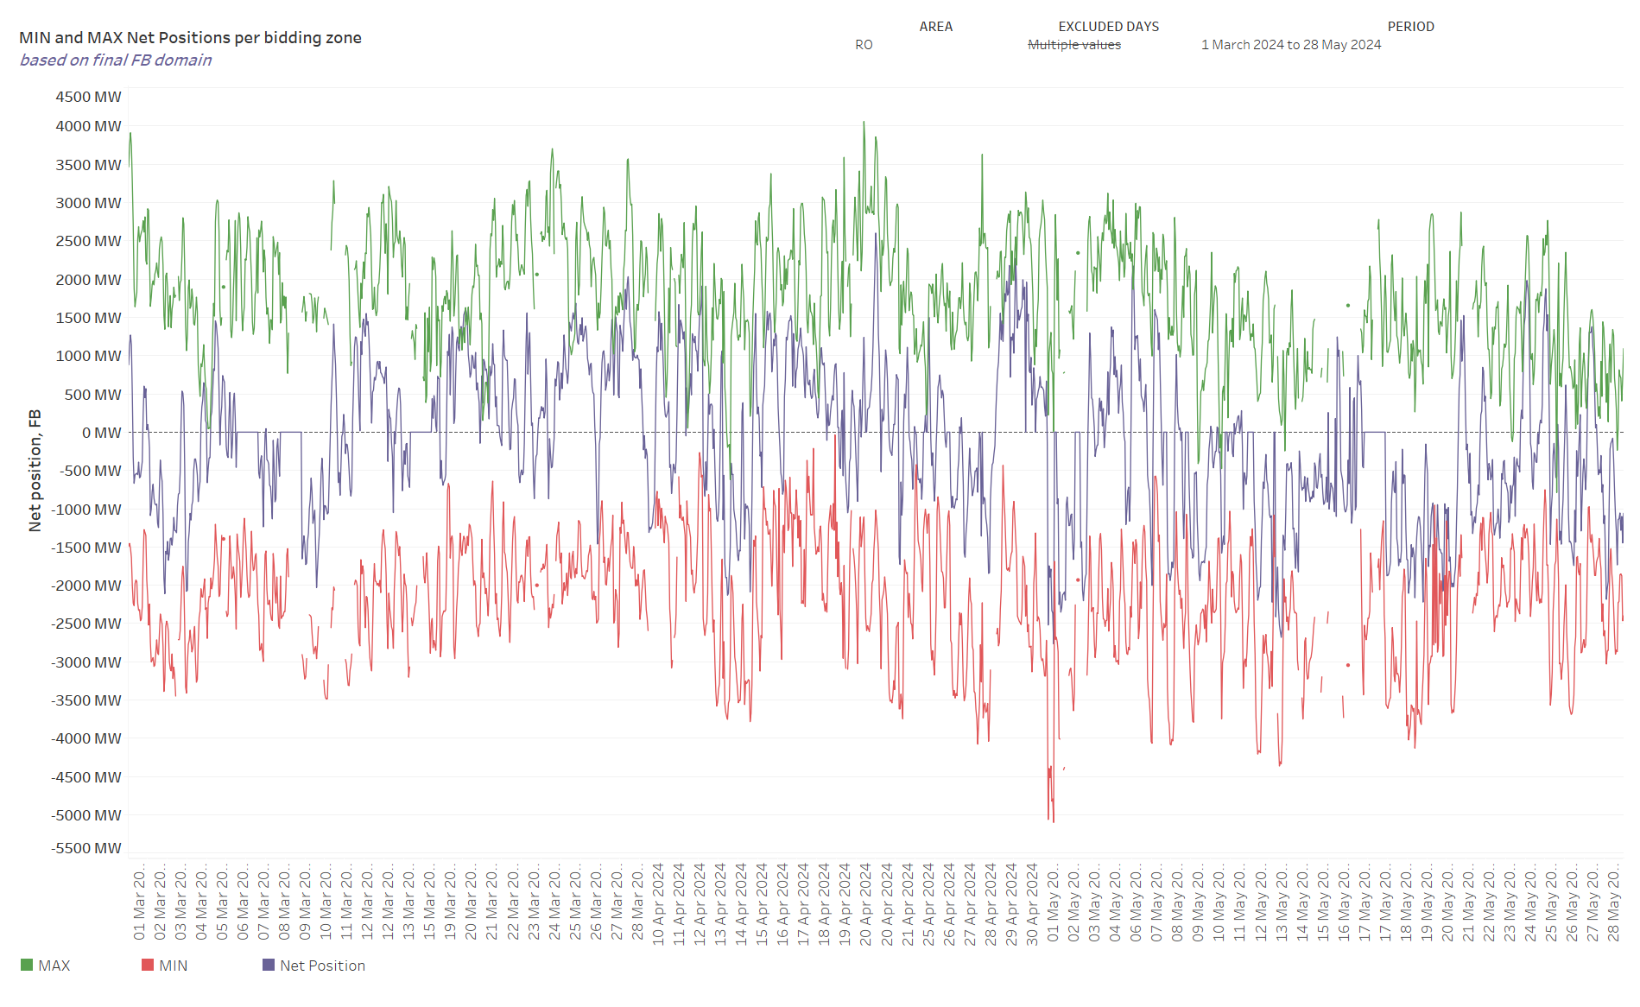
KPI 8 – Min and Max Net Positions per bidding zone
(a) Based on final FB domain
Note - Missing values of min and max net positions for some timestamps are caused by empty domains.

Slide 52
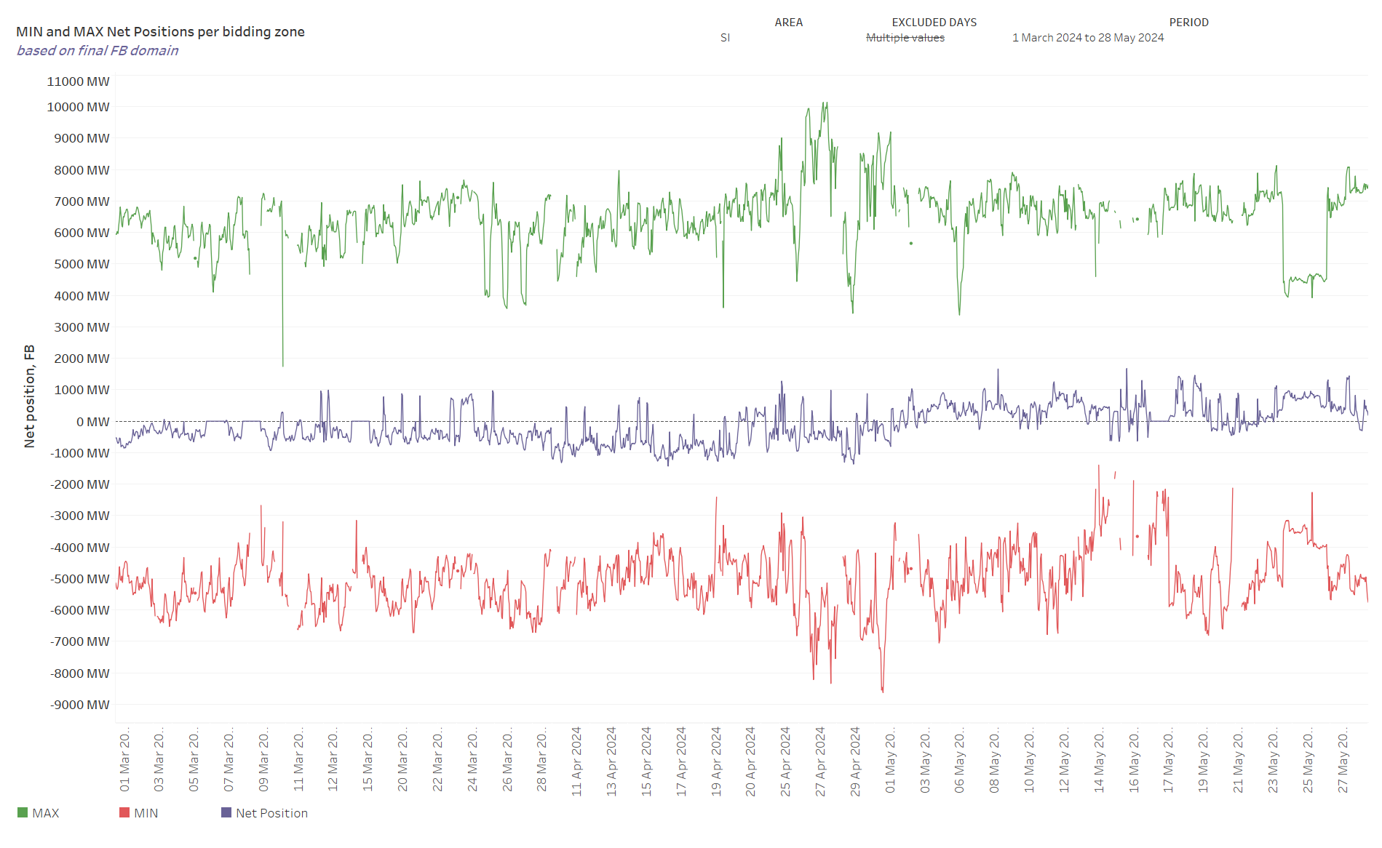
KPI 8 – Min and Max Net Positions per bidding zone
(a) Based on final FB domain
Note - Missing values of min and max net positions for some timestamps are caused by empty domains.

Slide 53
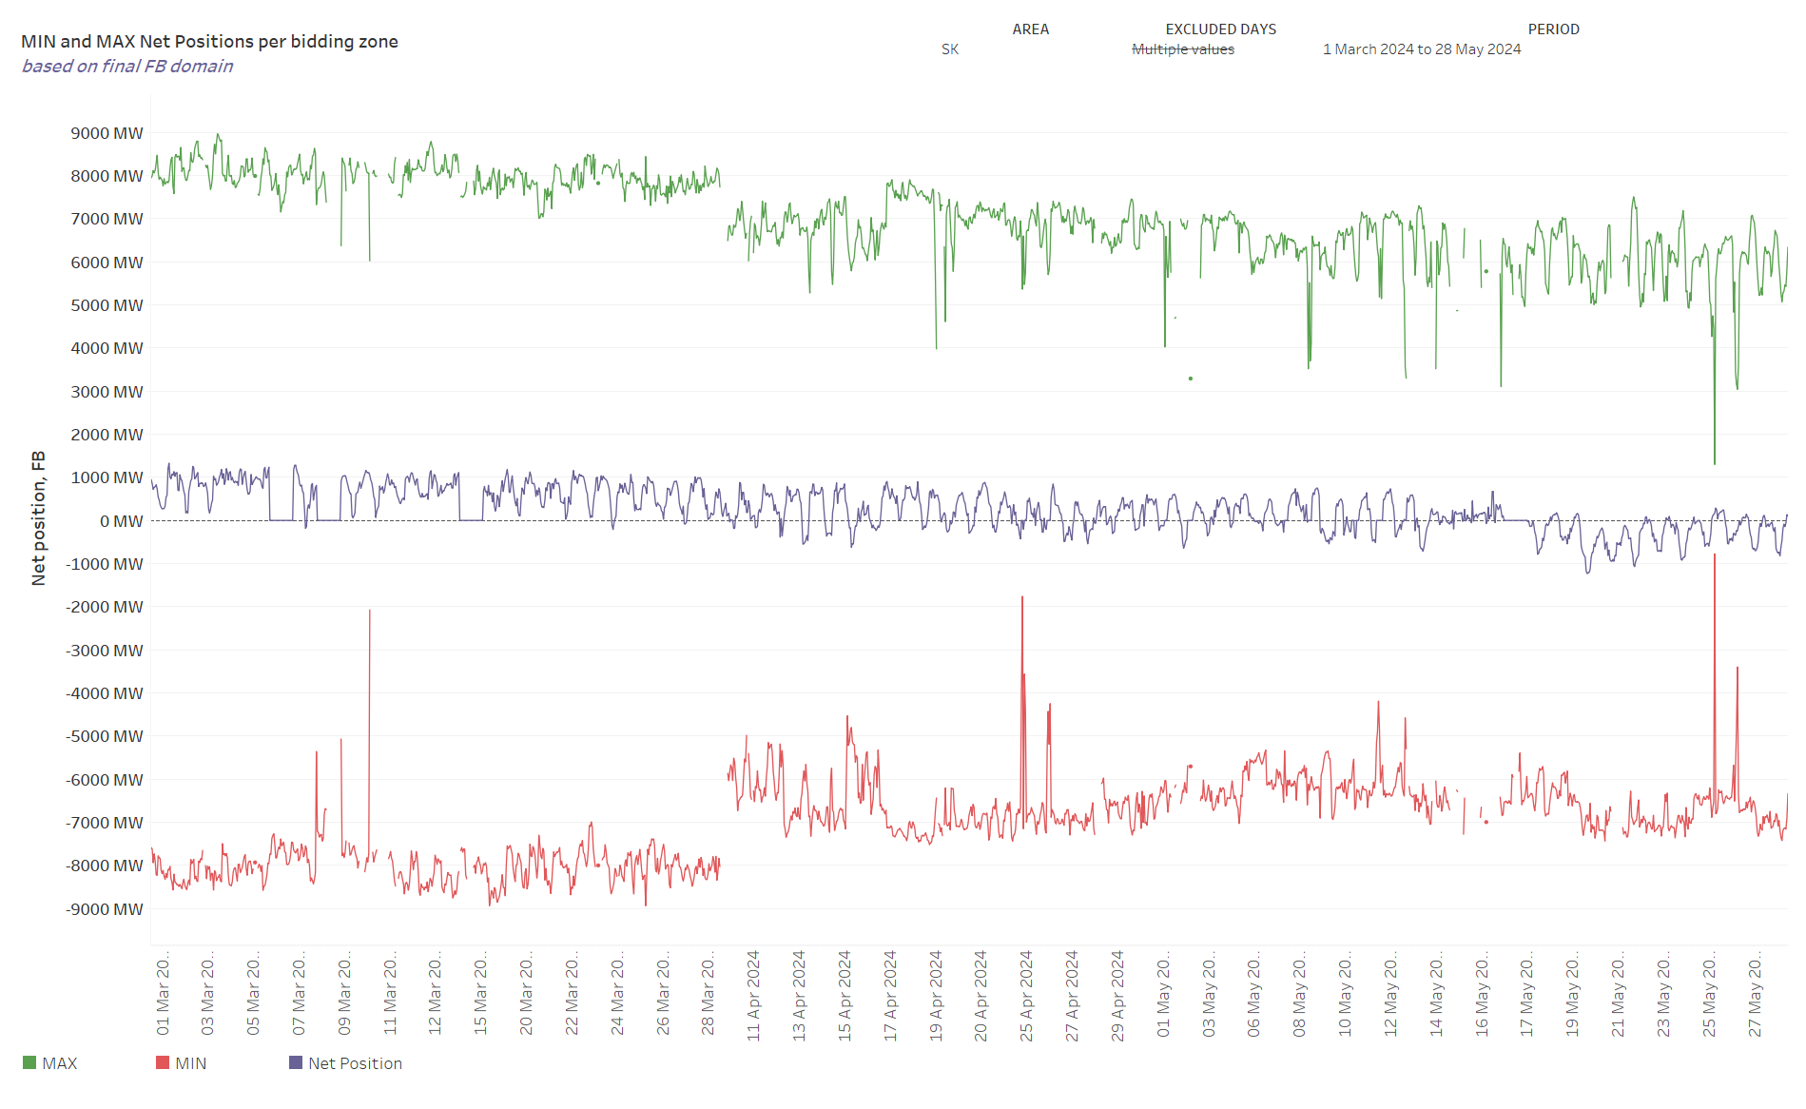
KPI 8 – Min and Max Net Positions per bidding zone
(a) Based on final FB domain
Note - Missing values of min and max net positions for some timestamps are caused by empty domains.

Slide 54
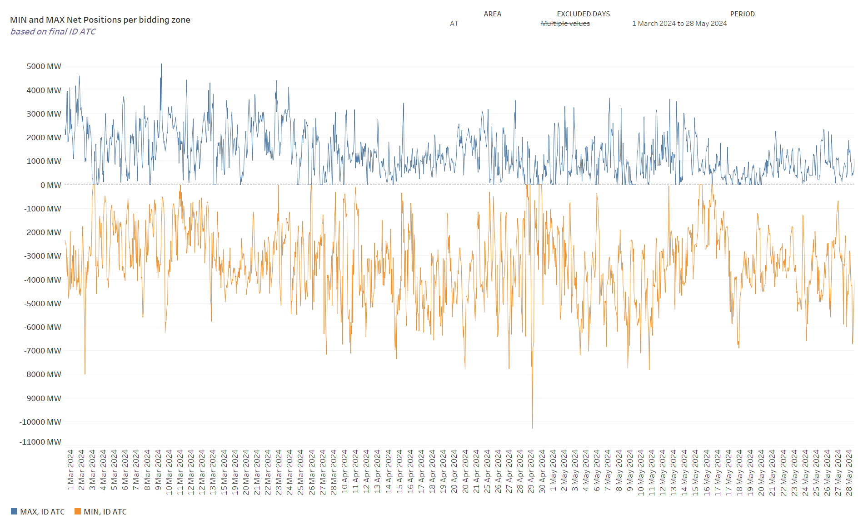
KPI 8 – Min and Max Net Positions per bidding zone
(b) Based on final ID ATC
Note - Missing values of min and max net positions for some timestamps are caused by empty domains.

Slide 55

KPI 8 – Min and Max Net Positions per bidding zone
(b) Based on final ID ATC
Note - Missing values of min and max net positions for some timestamps are caused by empty domains.

Slide 56

KPI 8 – Min and Max Net Positions per bidding zone
(b) Based on final ID ATC
Note - Missing values of min and max net positions for some timestamps are caused by empty domains.

Slide 57

KPI 8 – Min and Max Net Positions per bidding zone
(b) Based on final ID ATC
Note - Missing values of min and max net positions for some timestamps are caused by empty domains.

Slide 58

KPI 8 – Min and Max Net Positions per bidding zone
(b) Based on final ID ATC
Note - Missing values of min and max net positions for some timestamps are caused by empty domains.

Slide 59

KPI 8 – Min and Max Net Positions per bidding zone
(b) Based on final ID ATC
Note - Missing values of min and max net positions for some timestamps are caused by empty domains.

Slide 60

KPI 8 – Min and Max Net Positions per bidding zone
(b) Based on final ID ATC
Note - Missing values of min and max net positions for some timestamps are caused by empty domains.

Slide 61

KPI 8 – Min and Max Net Positions per bidding zone
(b) Based on final ID ATC
Note - Missing values of min and max net positions for some timestamps are caused by empty domains.

Slide 62

KPI 8 – Min and Max Net Positions per bidding zone
(b) Based on final ID ATC

Slide 63

KPI 8 – Min and Max Net Positions per bidding zone
(b) Based on final ID ATC
Note - Missing values of min and max net positions for some timestamps are caused by empty domains.

Slide 64

KPI 8 – Min and Max Net Positions per bidding zone
(b) Based on final ID ATC
Note - Missing values of min and max net positions for some timestamps are caused by empty domains.

Slide 65

KPI 8 – Min and Max Net Positions per bidding zone
(b) Based on final ID ATC
Note - Missing values of min and max net positions for some timestamps are caused by empty domains.

