Slide 1
Core IDCC(c) Operational KPI report
External // run KPI report
Q2 2025: 01/04/2025 – 24/06/2025

Slide 2
External // run KPI report
Introduction, reporting period and limitations
Context
According to Article 26(4) of the Core FB ID CCM, “Core TSOs shall continuously monitor the effects and the performance of the application of this methodology during the parallel run. And shall develop, in coordination with the Core regulatory authorities, the Agency and stakeholders, the monitoring and performance criteria and report on the outcome of this monitoring on quarterly basis in a report”.
IDCC(c) external // run started on 17th of December 2024 and finished on the 24th of June 2025(~6 months). The results of IDCC(c) have been published on [JAO website]
Reporting period
This report covers roughly 3 months (01/04/2025 – 24/06/2025) of IDCC(c) EXT //run results in the Core region, considering the go-live took place on the 25th June 2025.
4 business days have been excluded from the computation of KPIs due to:
For the business days abovementioned the IDCC(c) process failed or fallback was triggered due to the switch to prod environment. The problems identified were occasional, solved and a fix has been deployed.
For information, the business days with an IDCF of 1:15 instead of 2:15: 29/04/2025, 05/05/2025
BD | Reason | Fallback/ Process failure
14/05/2025 | Several inputs from the TSO data merging and AACs missing – Massive delays, and the process ended up failing due to outdated AACs | Process failure
16/05/2025 | Bug in AMICA leads to duplications of nodes which is not supported by the current FBPCM | ID2 Domain AAC Fallback
BD | Reason | Fallback/ Process failure
20/05/2025 | CB files not replaced automatically with the inputs from the previous process – Leading to unbounded domain closed with consistency constraints in the initial/final FB computation - Due to doublication of consistency constraints the process failed | Process failure
21/05/2025 | CB files not replaced automatically with the inputs from the previous process – Fallback triggered due to missing CB files | ID2 Domain AAC Fallback
AMICA – TSCNET tool for remedial actions' application
FBPCM – Flow-based Parameters Calculation Module
AAC – Already allocated capacities
FB – Flow-based

Slide 3
External // run KPI report
Overview of the KPIs covered during the // run
ATC related KPIs
Duration curve of Number of Core Oriented Bidding Zone Borders with Zero or Negative ID ATCs​
Frequency of Zero and Negative ID ATCs by Oriented Core Bidding Zone Border​
Delta comparison with IDCC(b) run at ~4:30
Frequency of isolated Core Bidding Zones of zero (or negative) ID ATCs in import, export and both directions​
Delta comparison with IDCC(b) run at ~4:30
Mean positive ID ATCs by Oriented Core Bidding Zone Border
Delta comparison with IDCC(b) run at ~4:30
TSOs’ adjustment after validation
Share of MTUs with intervention during IVA validation per TSO (IVA aggregations per TSO)
Limiting elements
Limiting constraints of the ATC domain​
20 most limiting ATC constraints
Mean and Max of ATC limiting constraints
Mean and Max of ATC limiting constraints per TSO
ATC Based Validation - Aggregations
Most often used pre-solved CNECs​
20 most limiting pre-solved constraints
Mean and Max of pre-solved constraints
Mean and Max of pre-solved constraints per TSO
Net positions
Min and Max Net Positions per Bidding Zone​
Based on final FB domain
Based on final ID ATC
Reading Guide with a detail description of the KPIs available on [JAO]
Included only as of IDCC(c) go-live date

Slide 4
External // run KPI report
Conclusions
Core TSOs are glad to report the current process stability with ~94% of business days successfully completed.
As presented in the Q1 report, the ATC related KPIs (ATCs + bidding zone isolation), which compare the available cross-zonal capacities at ~4:30 with and without IDCC(c) run, there is an overall "reflow effect" of the IDCC(c) calculation, in which the available capacity domain space is redistributed across all borders.
Thus, lowering the frequency of zero and negative ATCs, leading to less bidding zone isolation frequency. This happens because there are reopened border directions in the IDCC(c) run that were once closed during IDCC(b) run for longer periods. Consequently, the ATC levels decrease on other borders (those who would be used if the considered borders were not reopened).
In a nutshell, the "reflow effect" shows that more border directions are open more often with in general less positive ATCs, and less bidding zone isolation.
When compared to the results of the Q1 external // run KPI report, there is:
Typically lower frequency of zero and negative ATCs. However, there is a reflow effect, thus some border directions present an increase of the frequency of zero and negative ATCs. In addition, some of these with an high increase: AT>DE, FR>BE, FR>DE and SI>HR.
Lower frequency of isolated bidding zones (BZ) in import direction, specifically high decrease for NL BZ. In general, lower frequency in both directions, and in export direction except for FR BZ with an high increase (~26%).
Generally, slight increase of mean positive ATCs at Core level.
IVAs were in general not often applied. These were however more often applied compared to Q1, since not all TSOs started performing the individual validation step by then. Although not often applied, the IVAs applied by MAVIR were ~1200 MW. For ELES, low levels of application (~25 MW), however applied as much as 3 full days in ~3 months.
Same applies to the ATC-based validation (not all TSOs started performing the validation step before Q2), thus no comparison possible. For Q2, validations were often applied by TTG with ~1400 MW levels for NL>DE border direction.

Slide 5
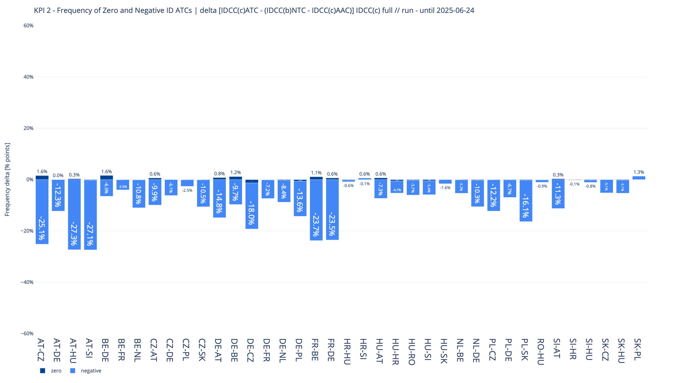
KPI 2A - Delta comparison with IDCC(b) run at ~4:30
Frequency of Zero and Negative ID ATCs by Oriented Core Bidding Zone Border​

Slide 6
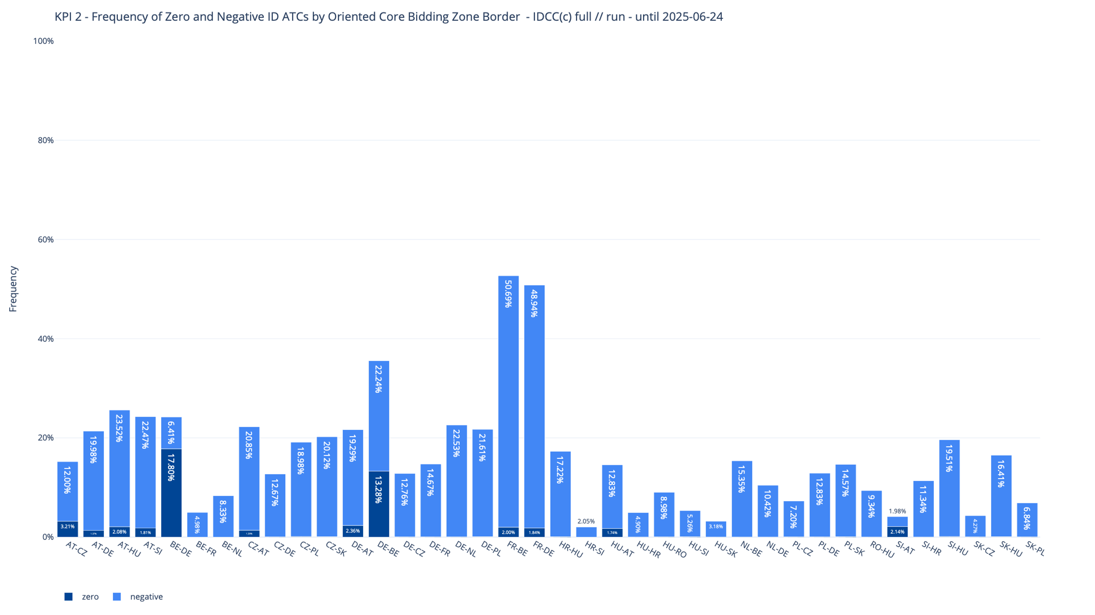
KPI 2
Frequency of Zero and Negative ID ATCs by Oriented Core Bidding Zone Border​

Slide 7
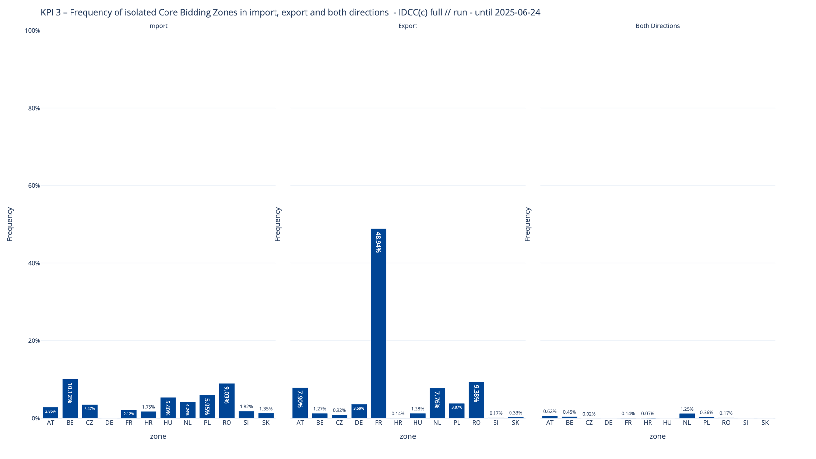
KPI 3
Frequency of isolated Core Bidding Zones of zero (or negative) ID ATCs in import, export and both directions ​​

Slide 8
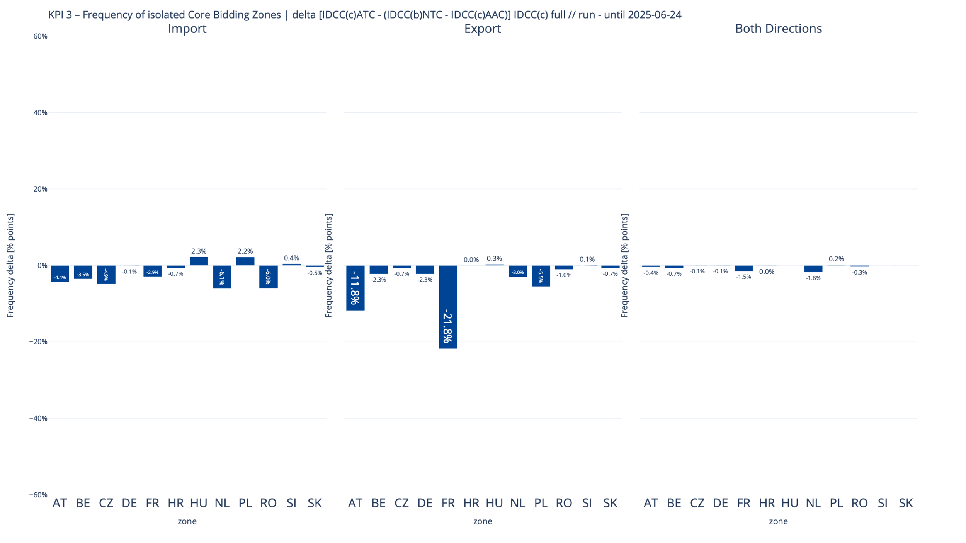
KPI 3A - Delta comparison with IDCC(b) run at ~4:30
Frequency of isolated Core Bidding Zones of zero (or negative) ID ATCs in import, export and both directions ​​

Slide 9
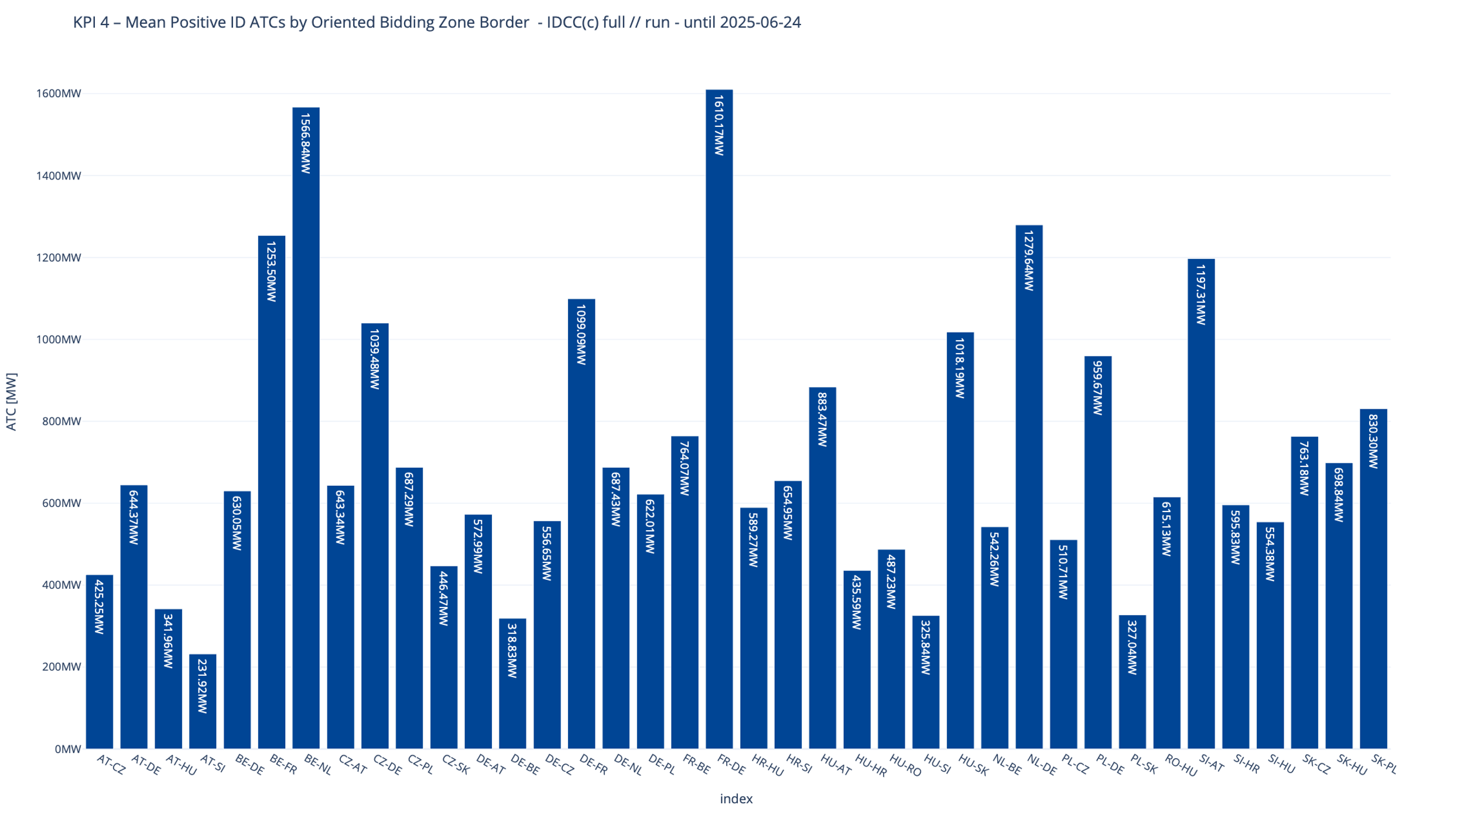
KPI 4
Mean positive ID ATCs by Oriented Core Bidding Zone Border

Slide 10
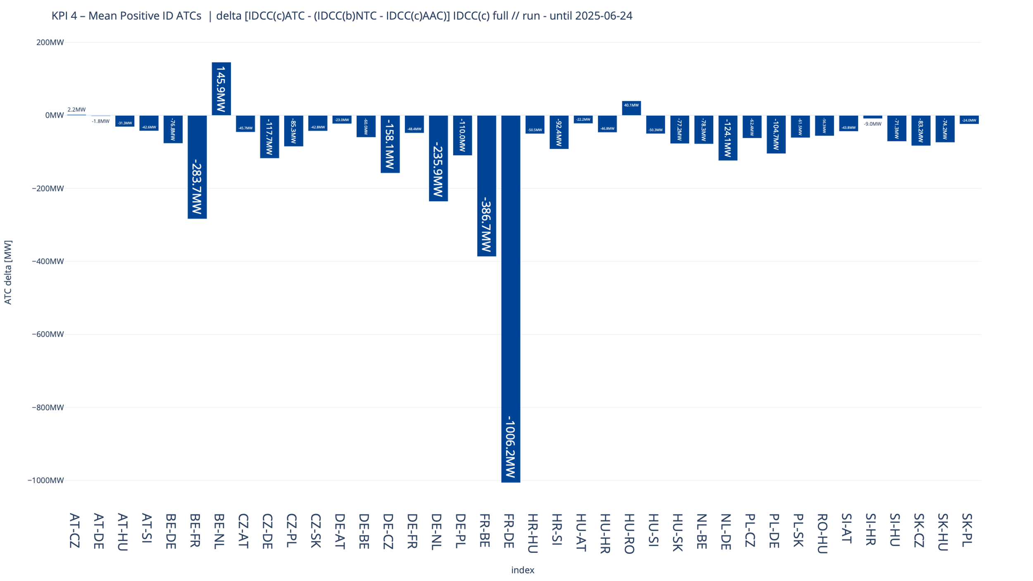
KPI 4A - Delta comparison with IDCC(b) run at ~4:30
Mean positive ID ATCs by Oriented Core Bidding Zone Border

Slide 11
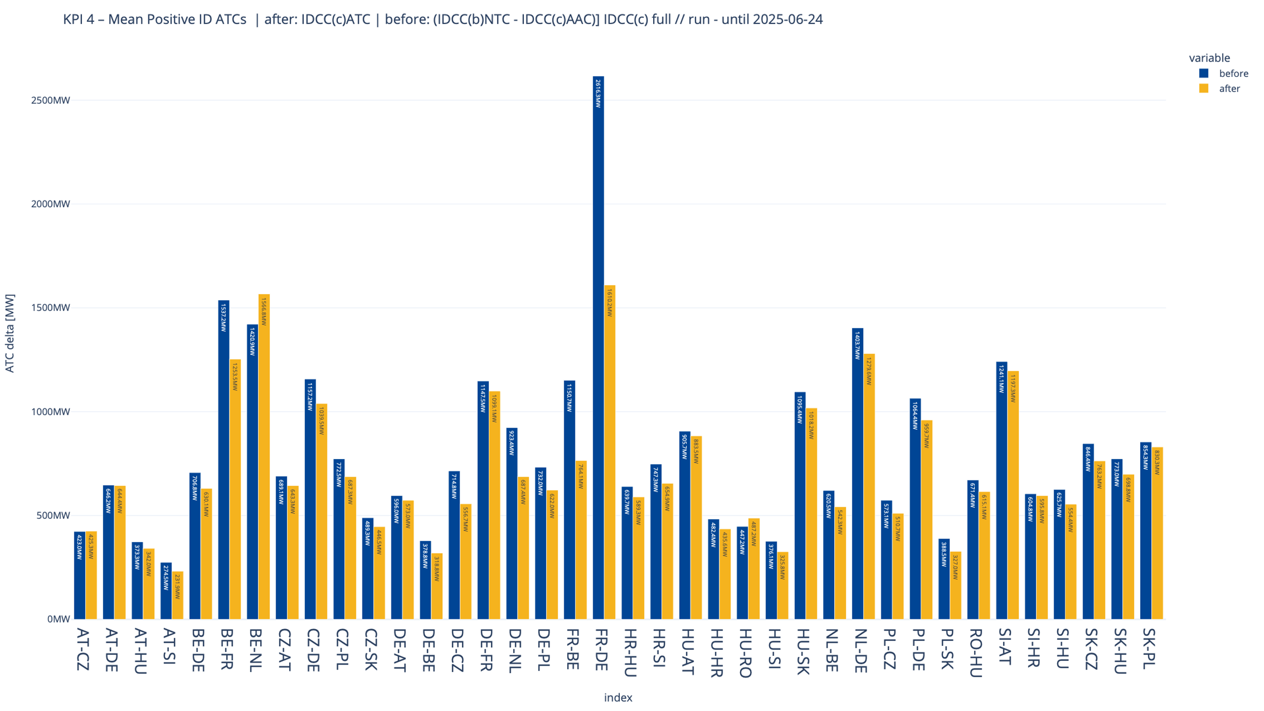
KPI 4A - Delta comparison with IDCC(b) run at ~4:30
Mean positive ID ATCs by Oriented Core Bidding Zone Border

Slide 12
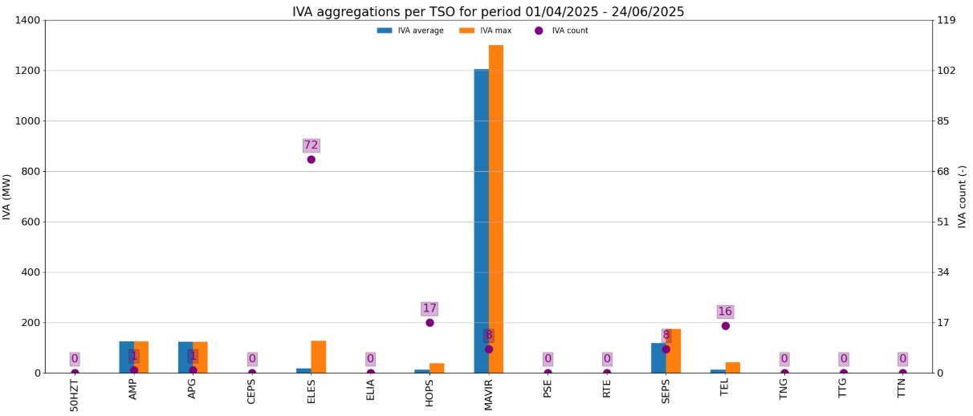
KPI 5
Share of MTUs with intervention during IVA validation per TSO (IVA aggregations per TSO)

Slide 13
KPI 6A & 6B - Limiting constraints of the ATC domain​
20 most limiting ATC constraints & Mean and Max of ATC limiting constraints

Slide 14
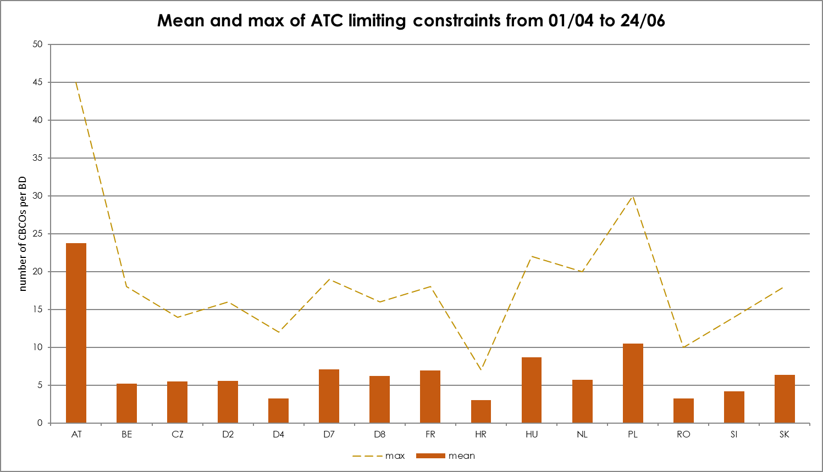
KPI 6A & 6B - Limiting constraints of the ATC domain​
20 most limiting ATC constraints & Mean and Max of ATC limiting constraints

Slide 15
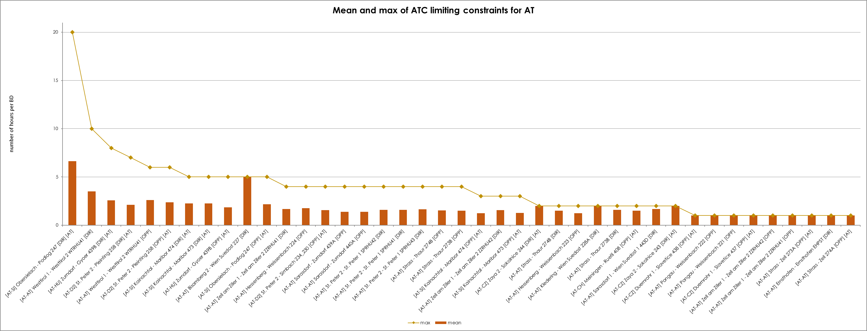
KPI 6C - Limiting constraints of the ATC domain​
Mean and Max of ATC limiting constraints per TSO - APG

Slide 16
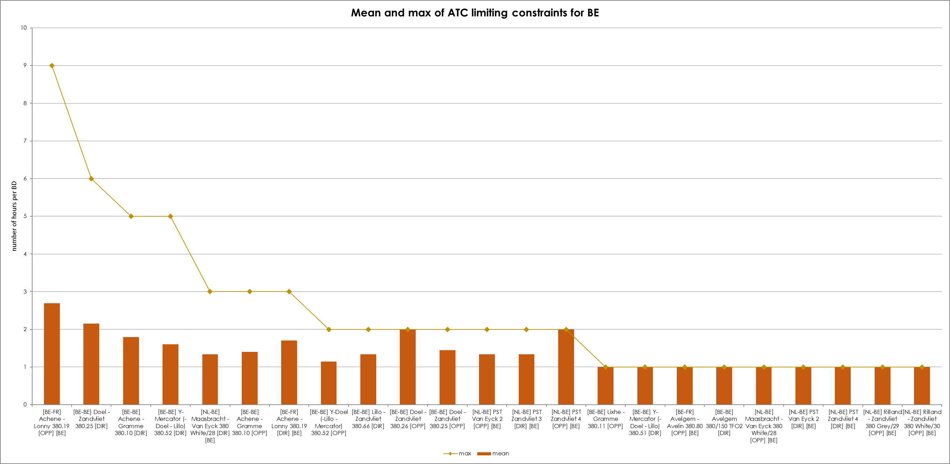
KPI 6C - Limiting constraints of the ATC domain​
Mean and Max of ATC limiting constraints per TSO - Elia

Slide 17
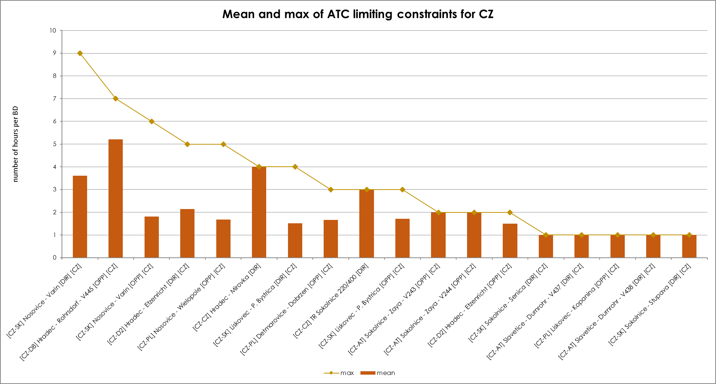
KPI 6C - Limiting constraints of the ATC domain​
Mean and Max of ATC limiting constraints per TSO – CEPS

Slide 18
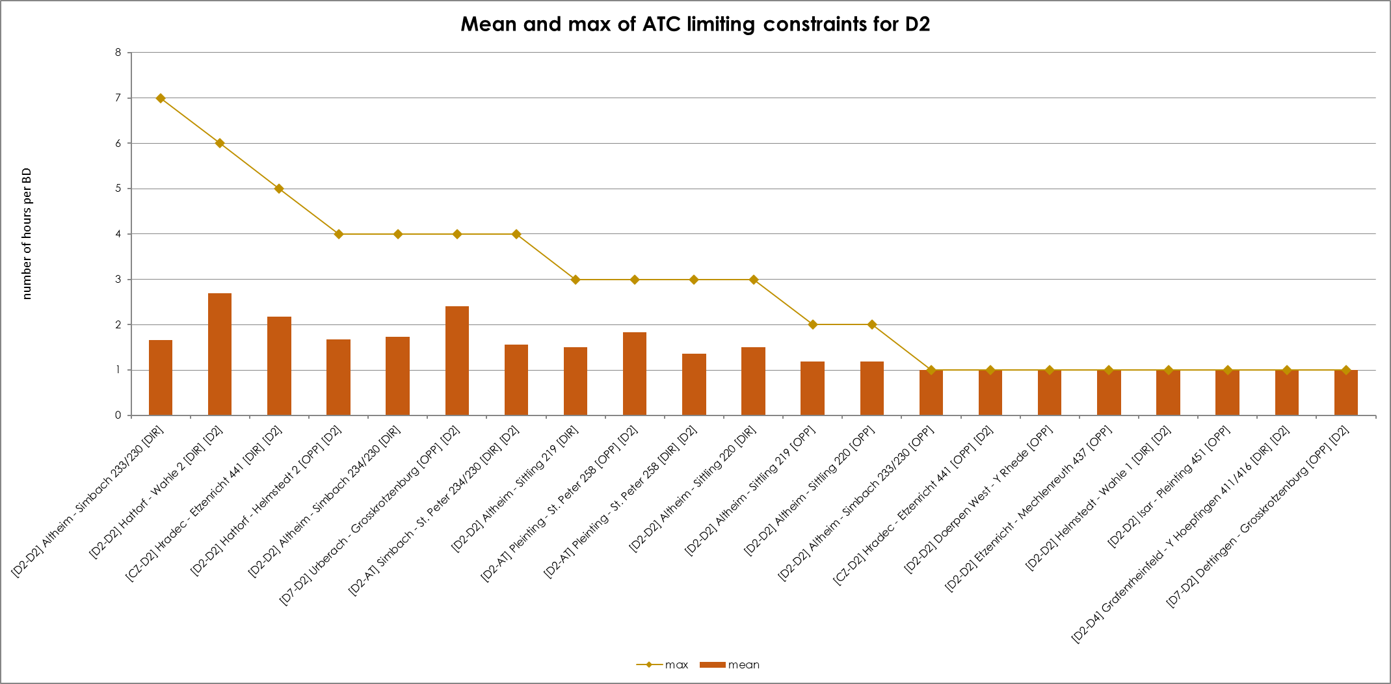
KPI 6C - Limiting constraints of the ATC domain​
Mean and Max of ATC limiting constraints per TSO – Tennet Germany

Slide 19
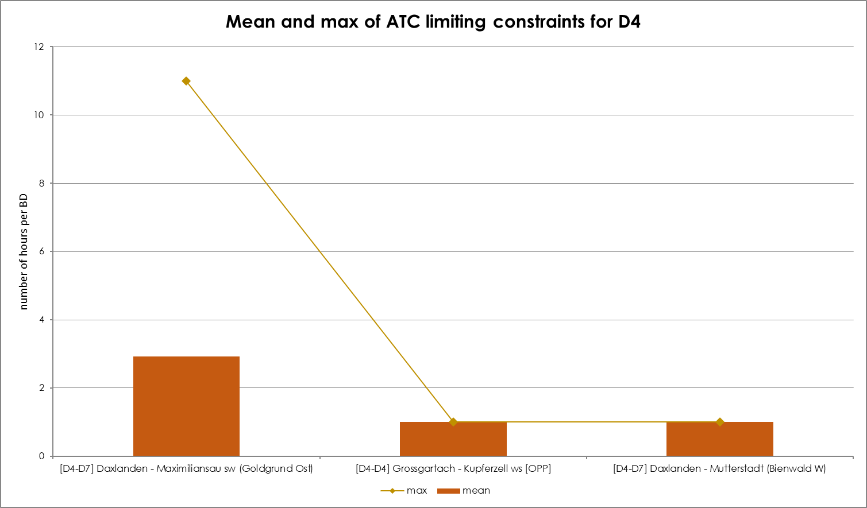
KPI 6C - Limiting constraints of the ATC domain​
Mean and Max of ATC limiting constraints per TSO – TransnetBW

Slide 20
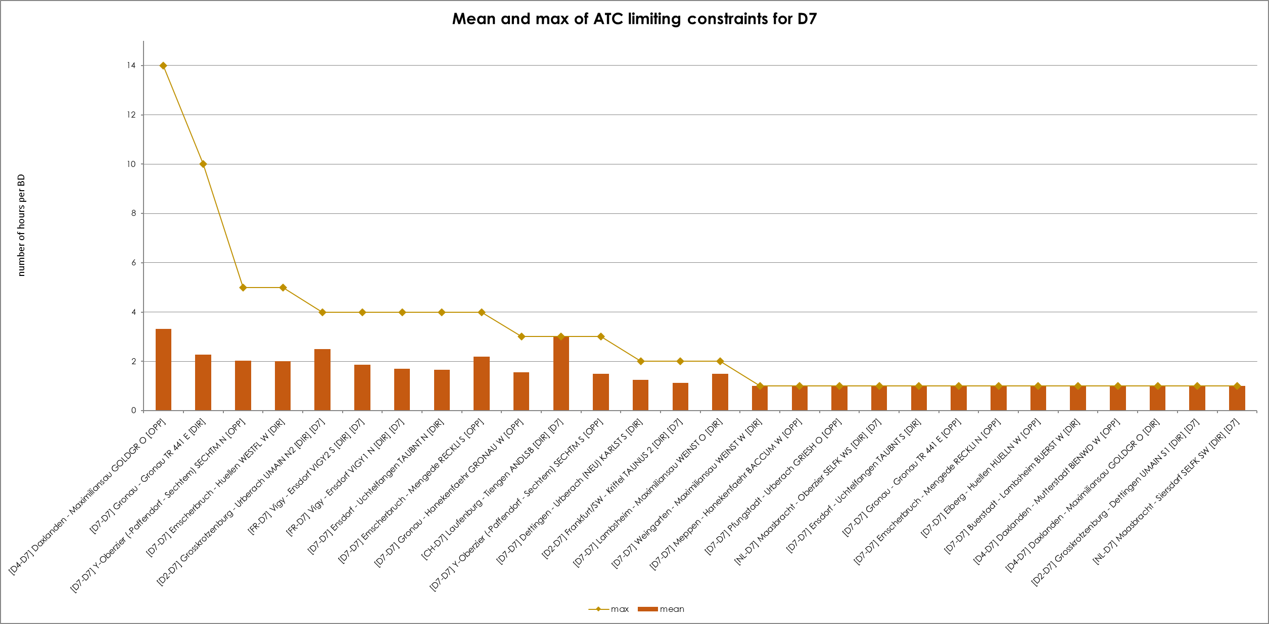
KPI 6C - Limiting constraints of the ATC domain​
Mean and Max of ATC limiting constraints per TSO – Amprion

Slide 21
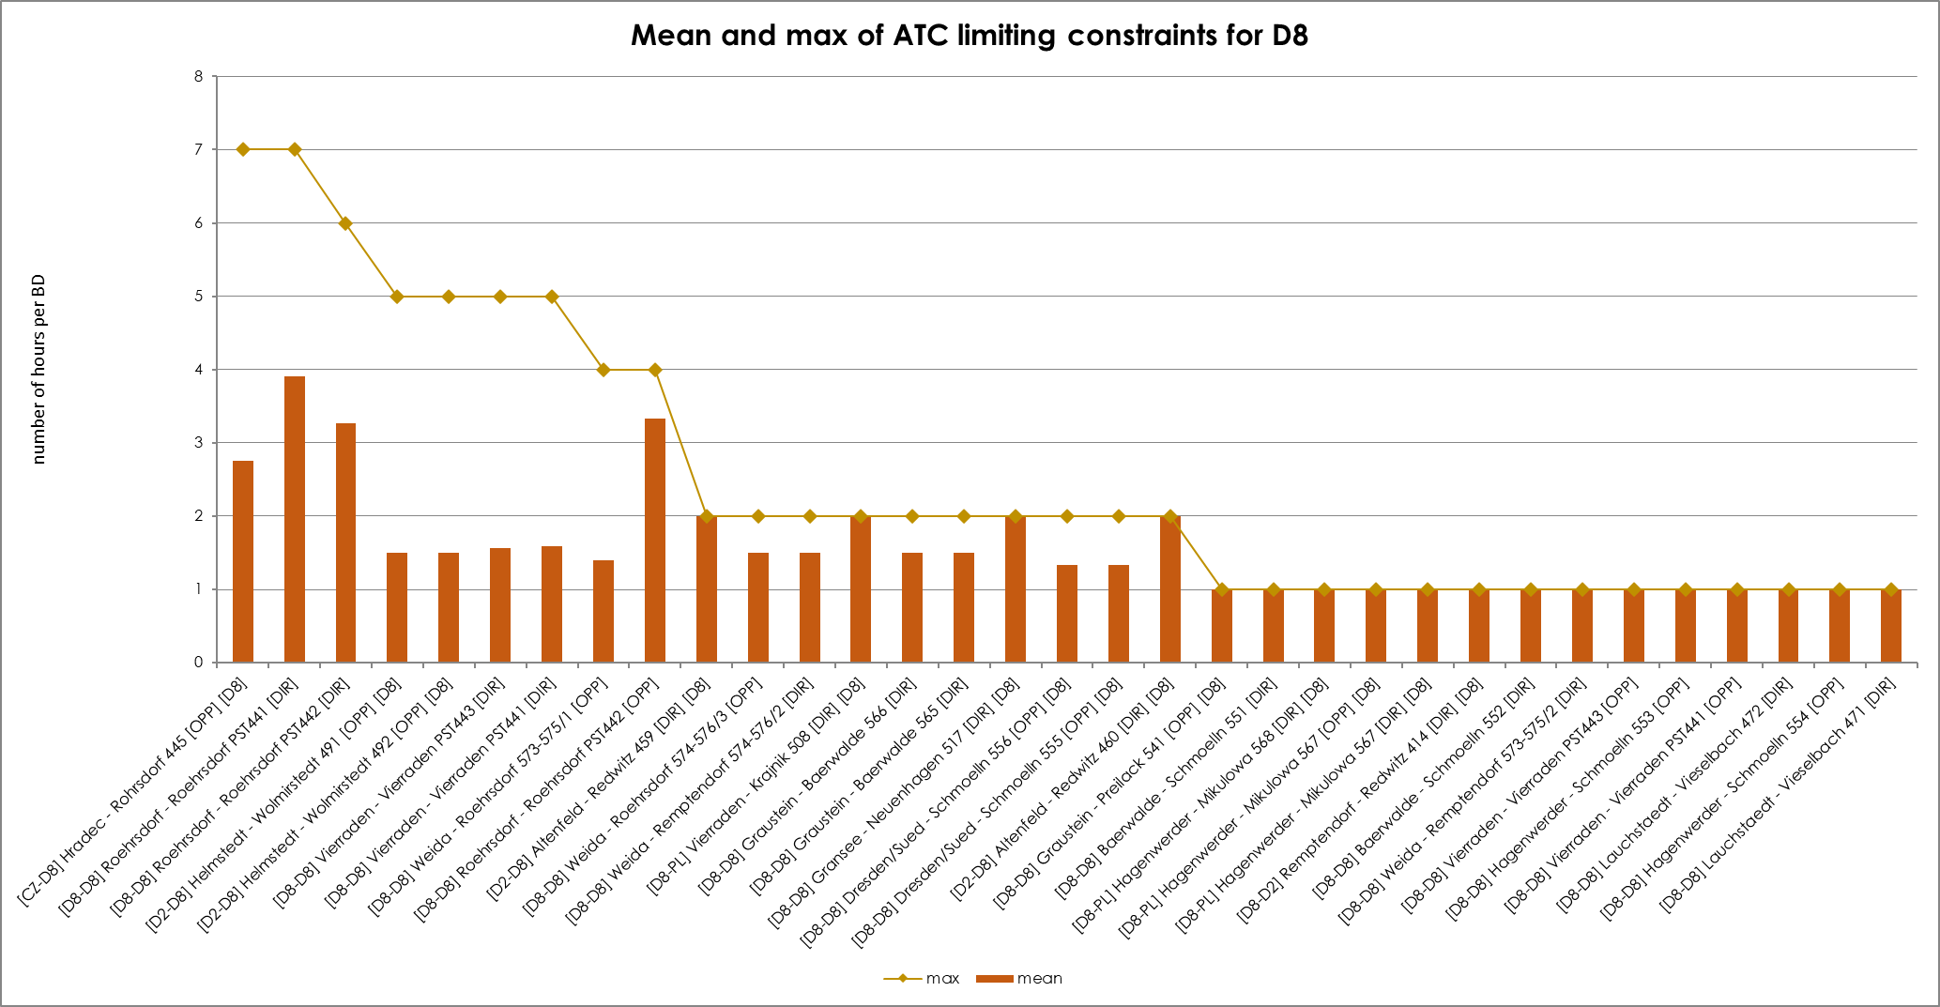
KPI 6C - Limiting constraints of the ATC domain​
Mean and Max of ATC limiting constraints per TSO – 50Hertz

Slide 22
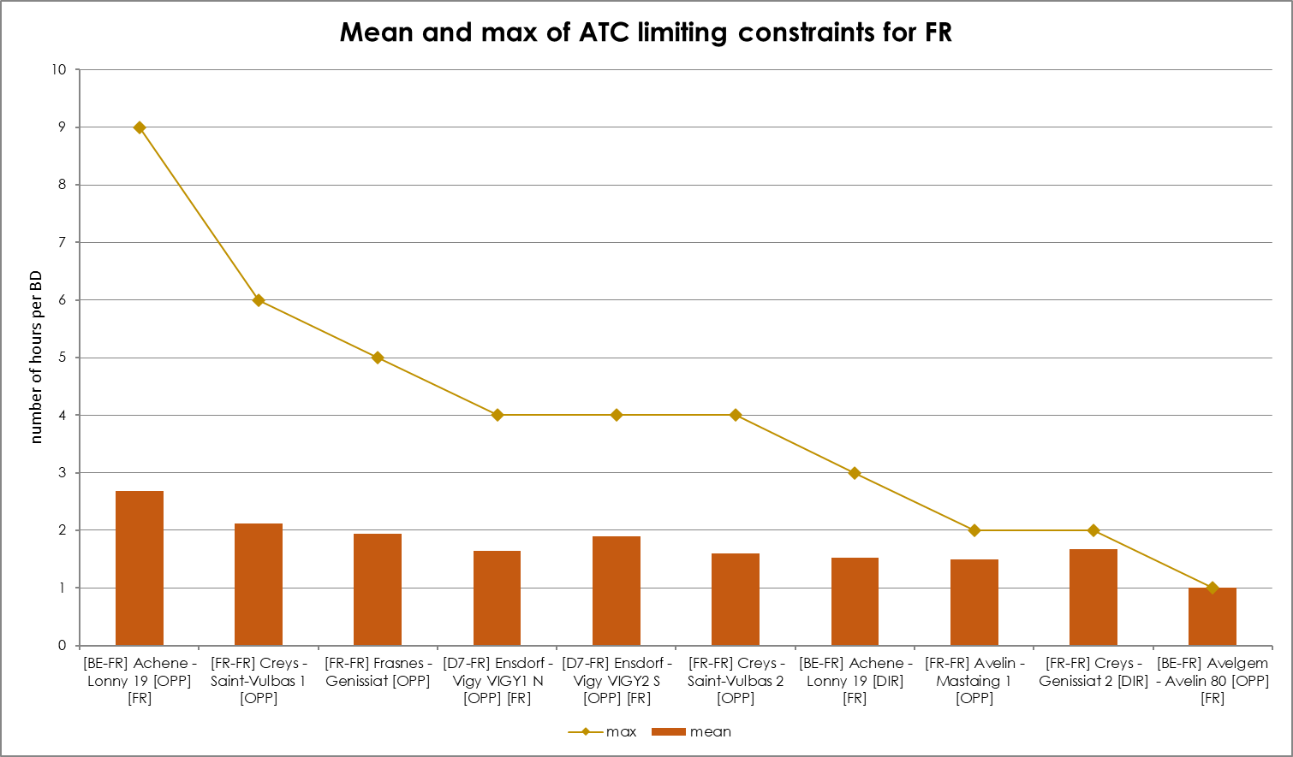
KPI 6C - Limiting constraints of the ATC domain​
Mean and Max of ATC limiting constraints per TSO – RTE

Slide 23
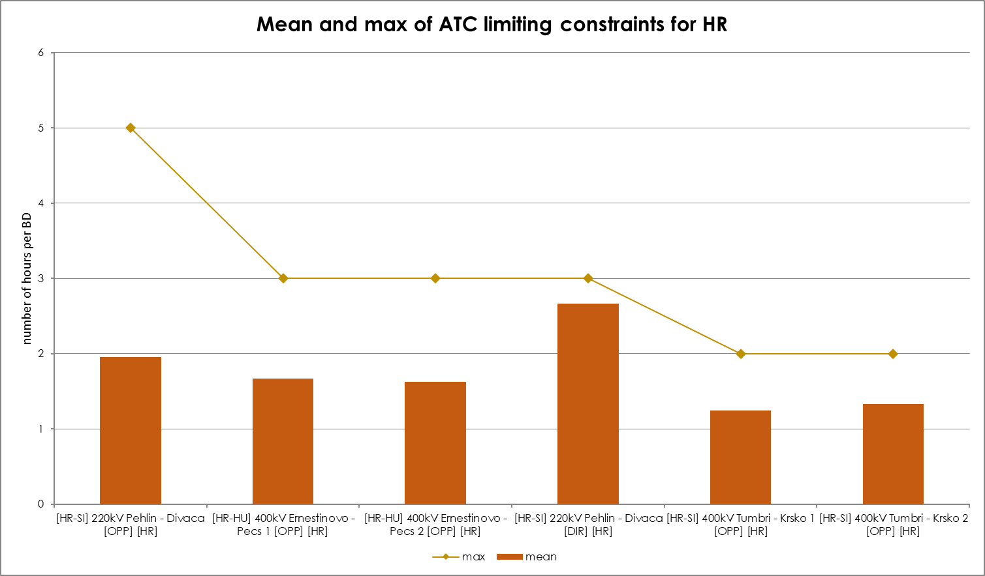
KPI 6C - Limiting constraints of the ATC domain​
Mean and Max of ATC limiting constraints per TSO – HOPS

Slide 24
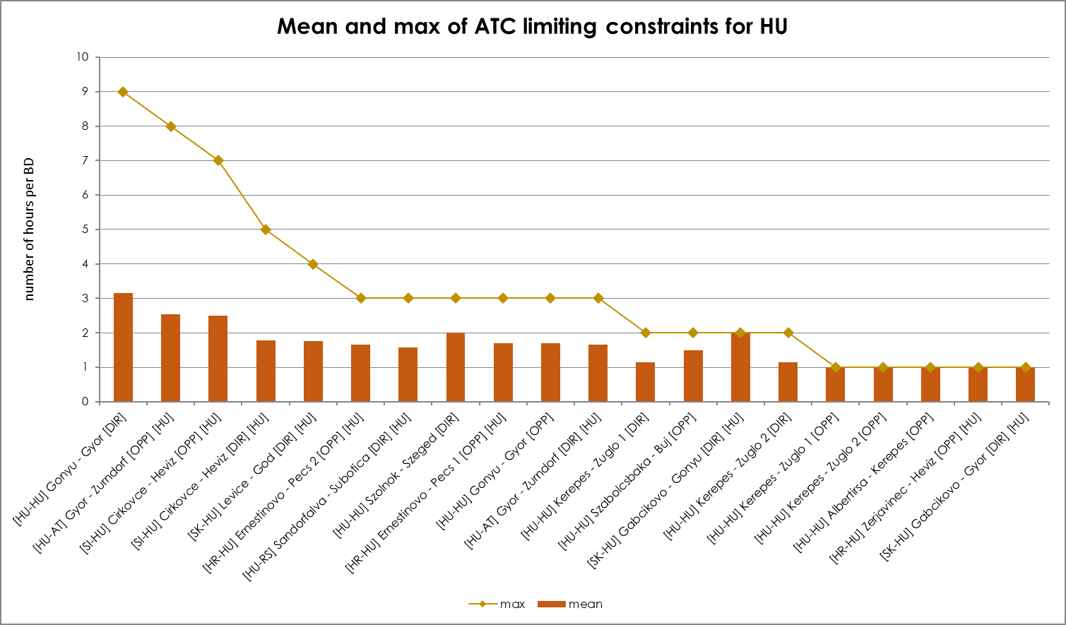
KPI 6C - Limiting constraints of the ATC domain​
Mean and Max of ATC limiting constraints per TSO – MAVIR

Slide 25
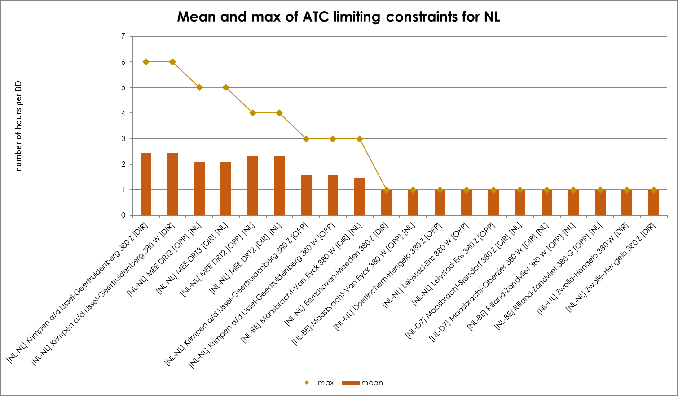
KPI 6C - Limiting constraints of the ATC domain​
Mean and Max of ATC limiting constraints per TSO – Tennet Netherlands

Slide 26
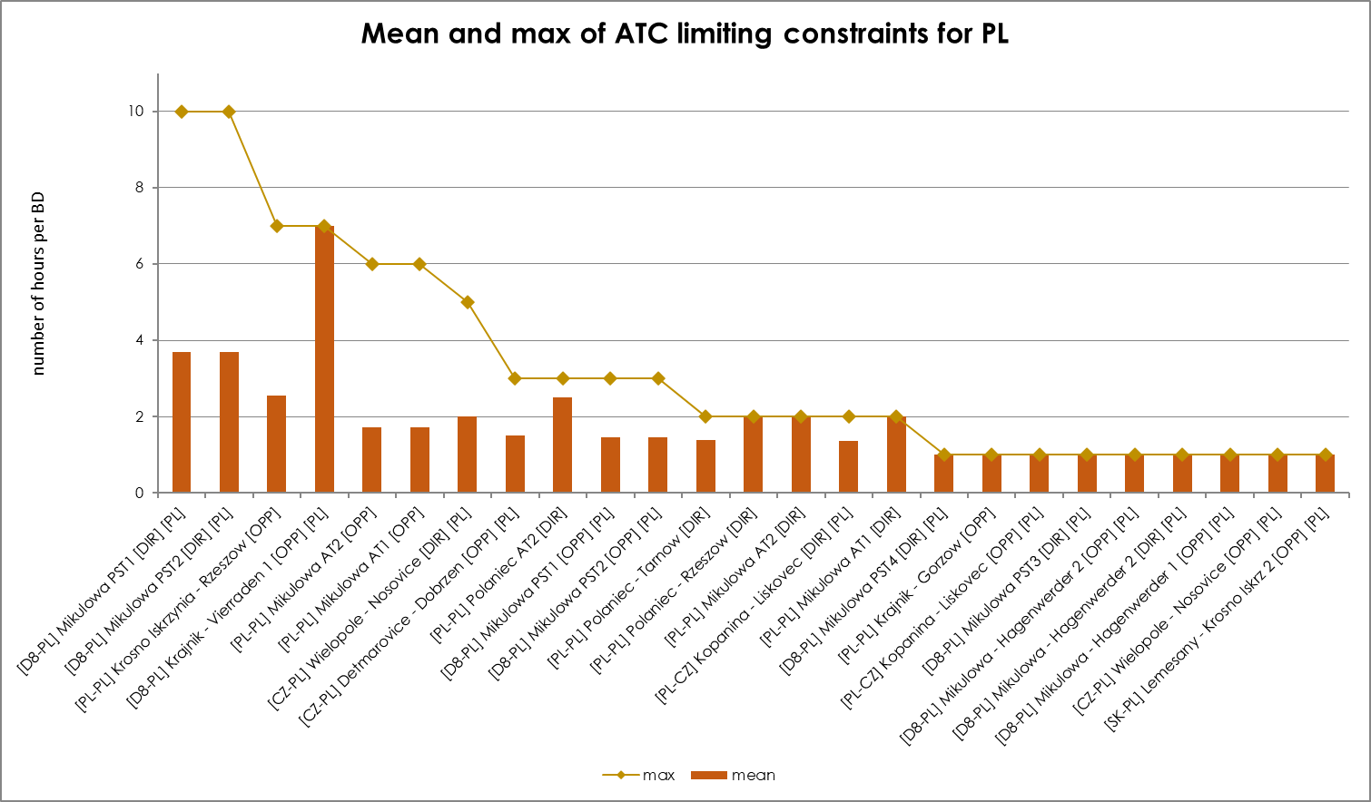
KPI 6C - Limiting constraints of the ATC domain​
Mean and Max of ATC limiting constraints per TSO – PSE

Slide 27
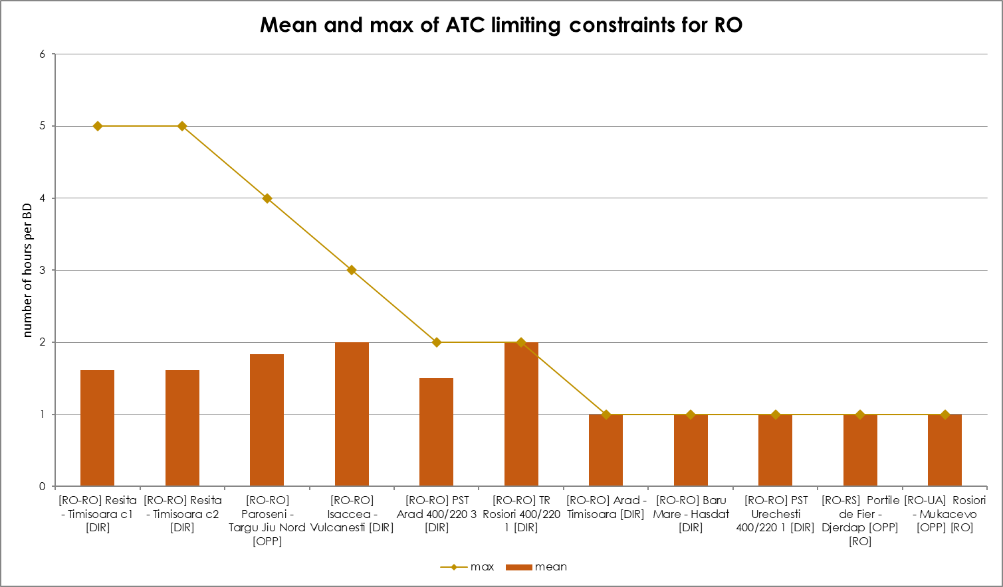
KPI 6C - Limiting constraints of the ATC domain​
Mean and Max of ATC limiting constraints per TSO – Transelectrica

Slide 28
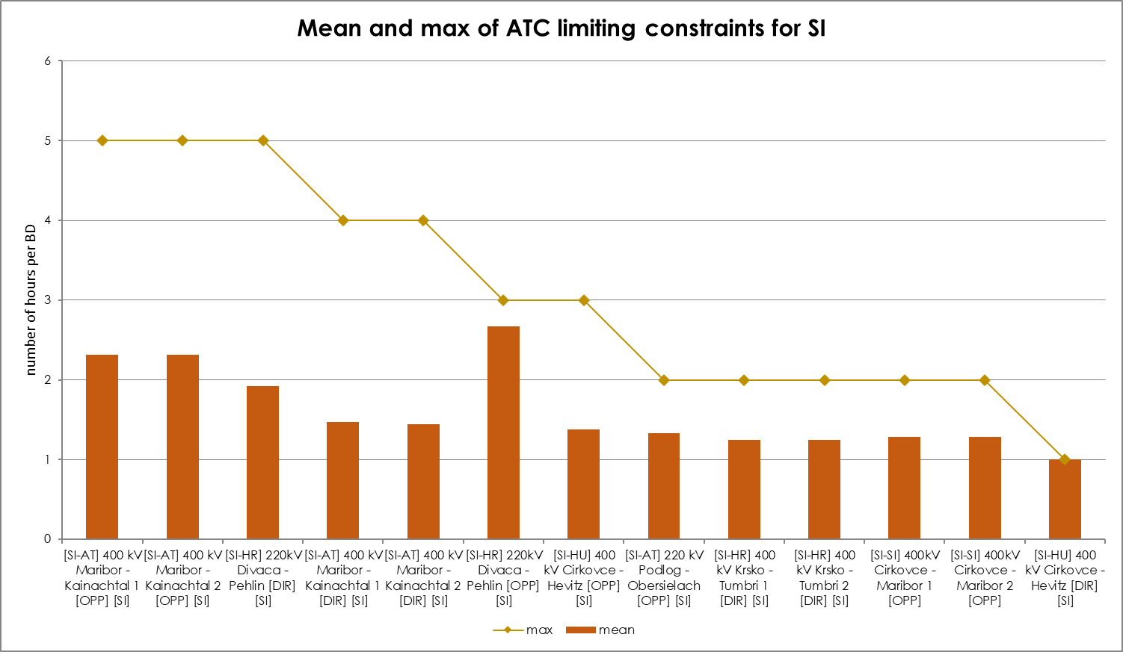
KPI 6C - Limiting constraints of the ATC domain​
Mean and Max of ATC limiting constraints per TSO – ELES

Slide 29
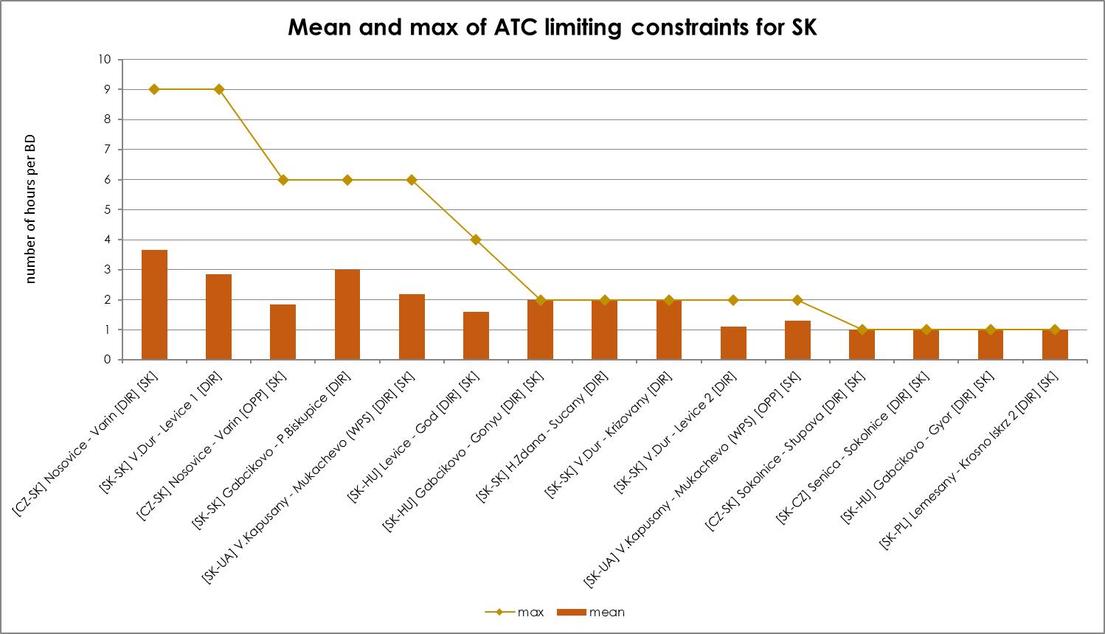
KPI 6C - Limiting constraints of the ATC domain​
Mean and Max of ATC limiting constraints per TSO - SEPS

Slide 30
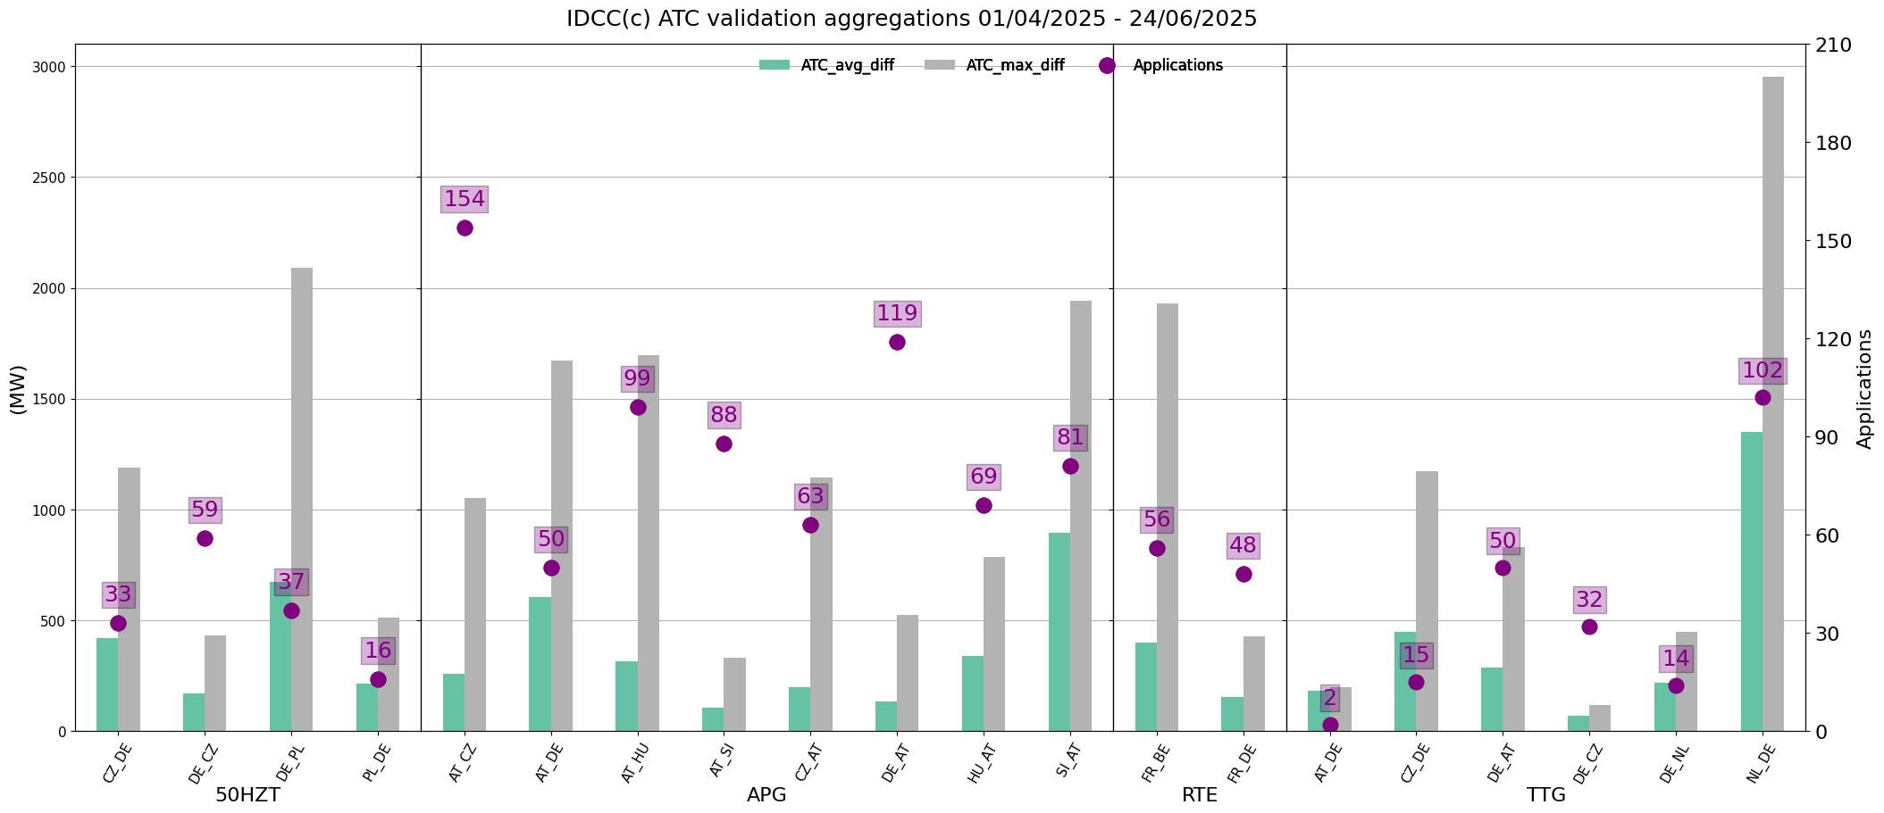
KPI 6D
ATC Based Validation - Aggregations

Slide 31
KPI 7A & 7B - Most often used pre-solved CNECs​
20 most limiting pre-solved constraints & Mean and Max of pre-solved constraints

Slide 32
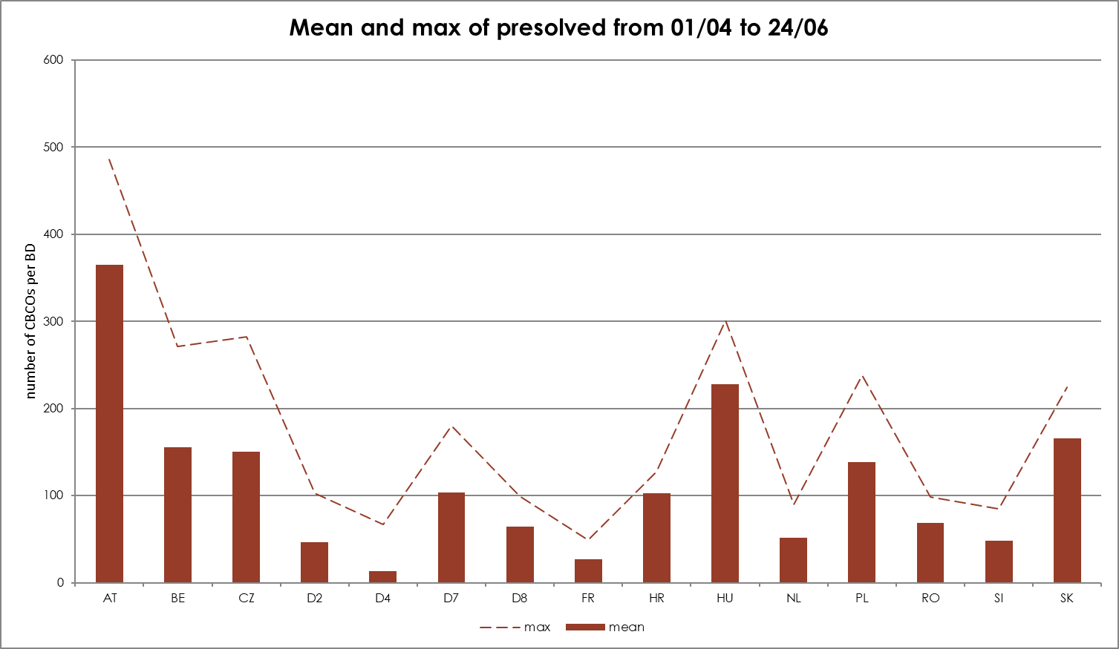
KPI 7A & 7B - Most often used pre-solved CNECs​
20 most limiting pre-solved constraints & Mean and Max of pre-solved constraints

Slide 33
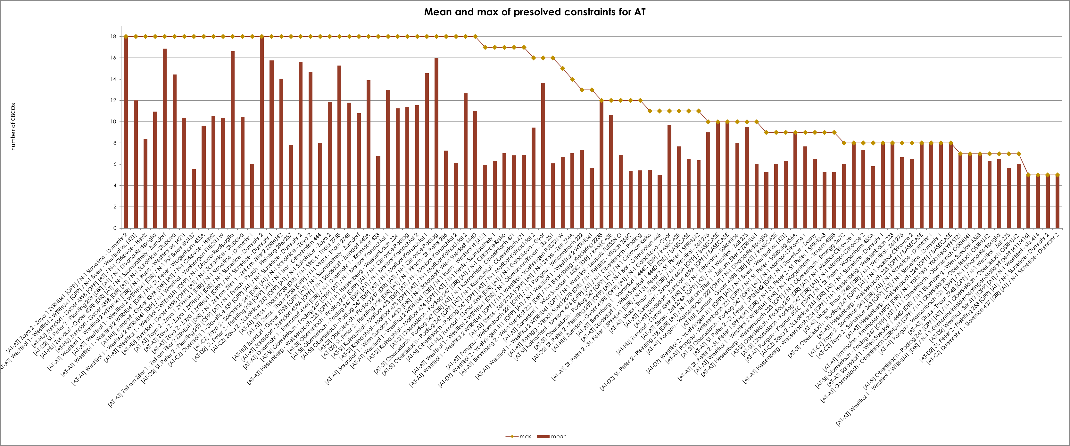
KPI 7C - Most often used pre-solved CNECs​ ​
Mean and Max of pre-solved constraints per TSO - APG

Slide 34
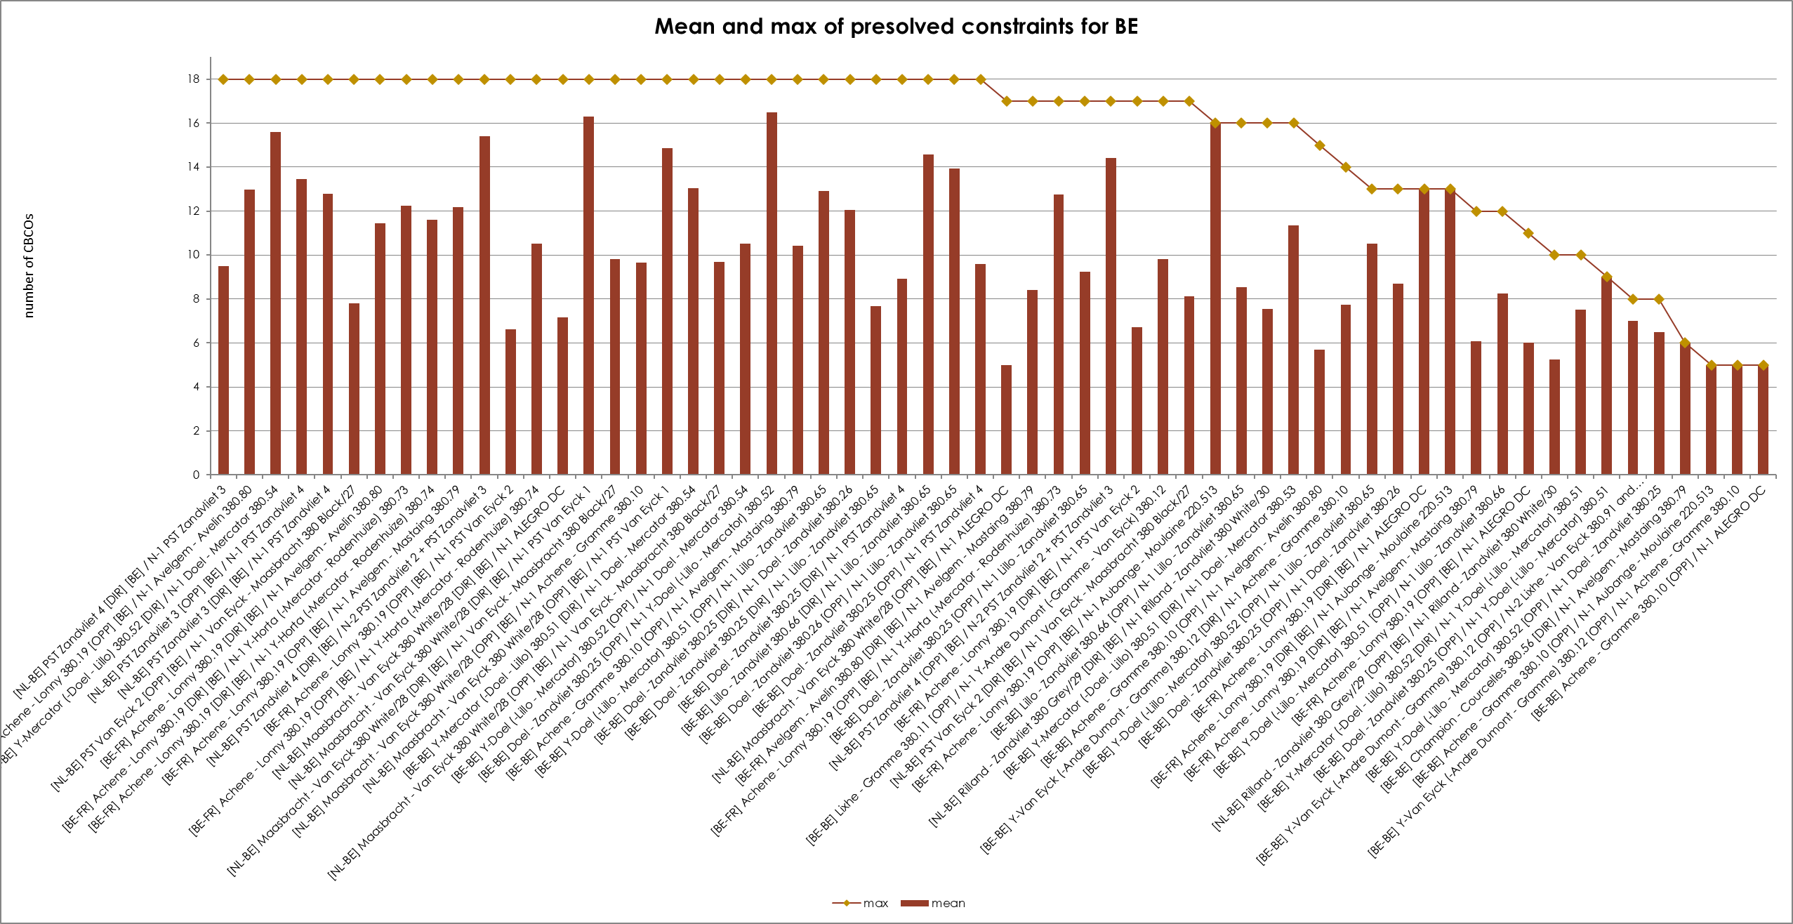
KPI 7C - Most often used pre-solved CNECs​ ​
Mean and Max of pre-solved constraints per TSO - Elia

Slide 35
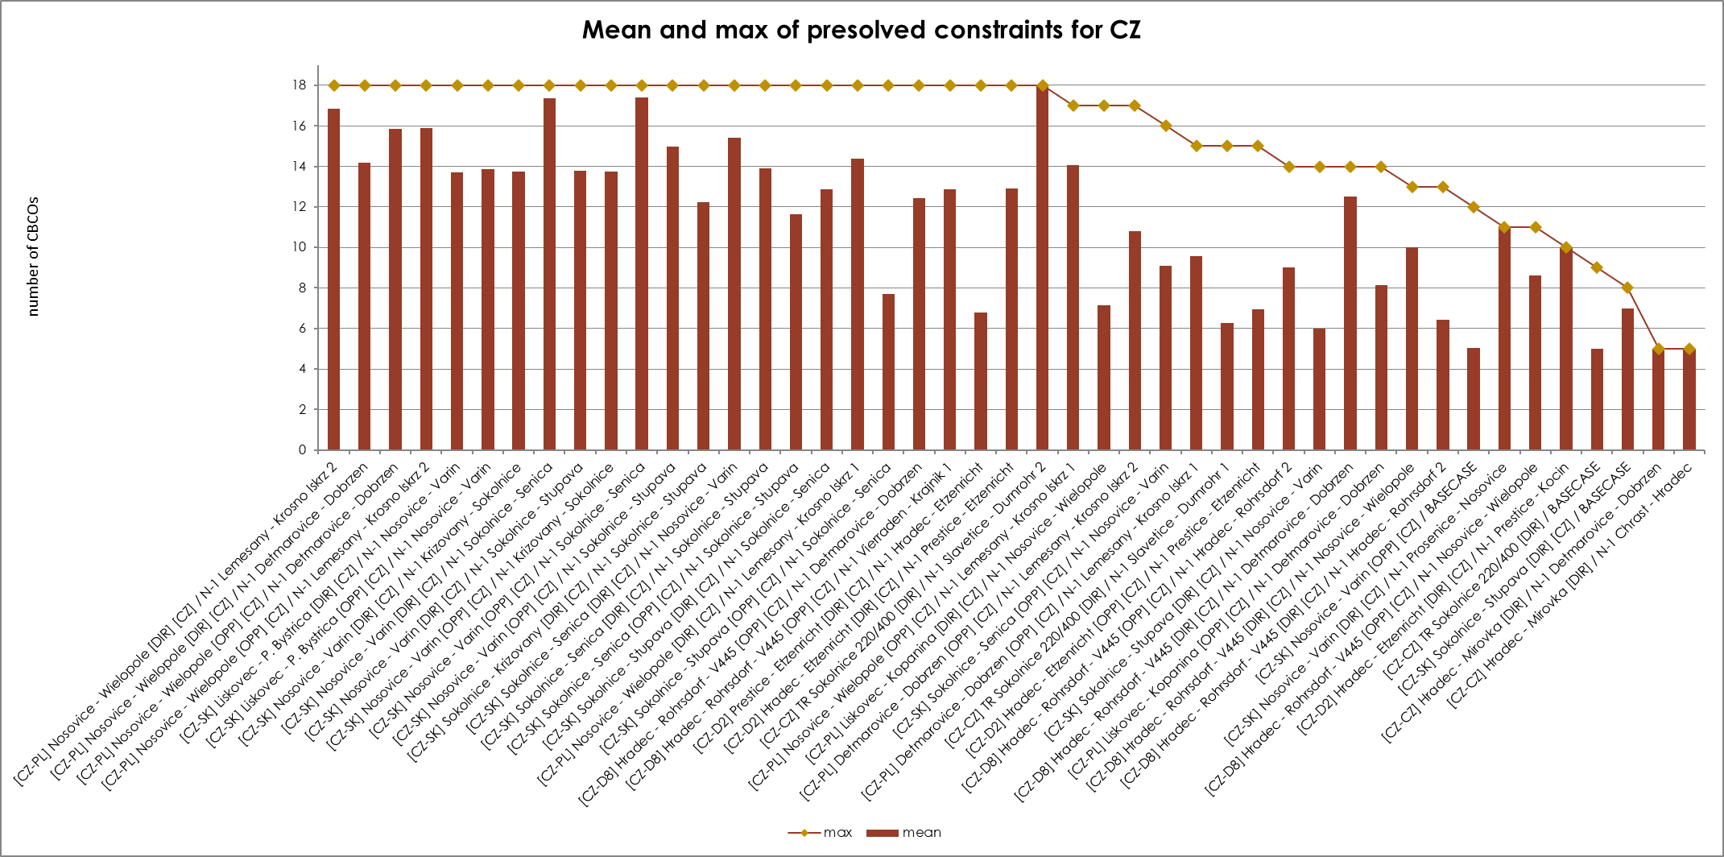
KPI 7C - Most often used pre-solved CNECs​ ​
Mean and Max of pre-solved constraints per TSO – CEPS

Slide 36
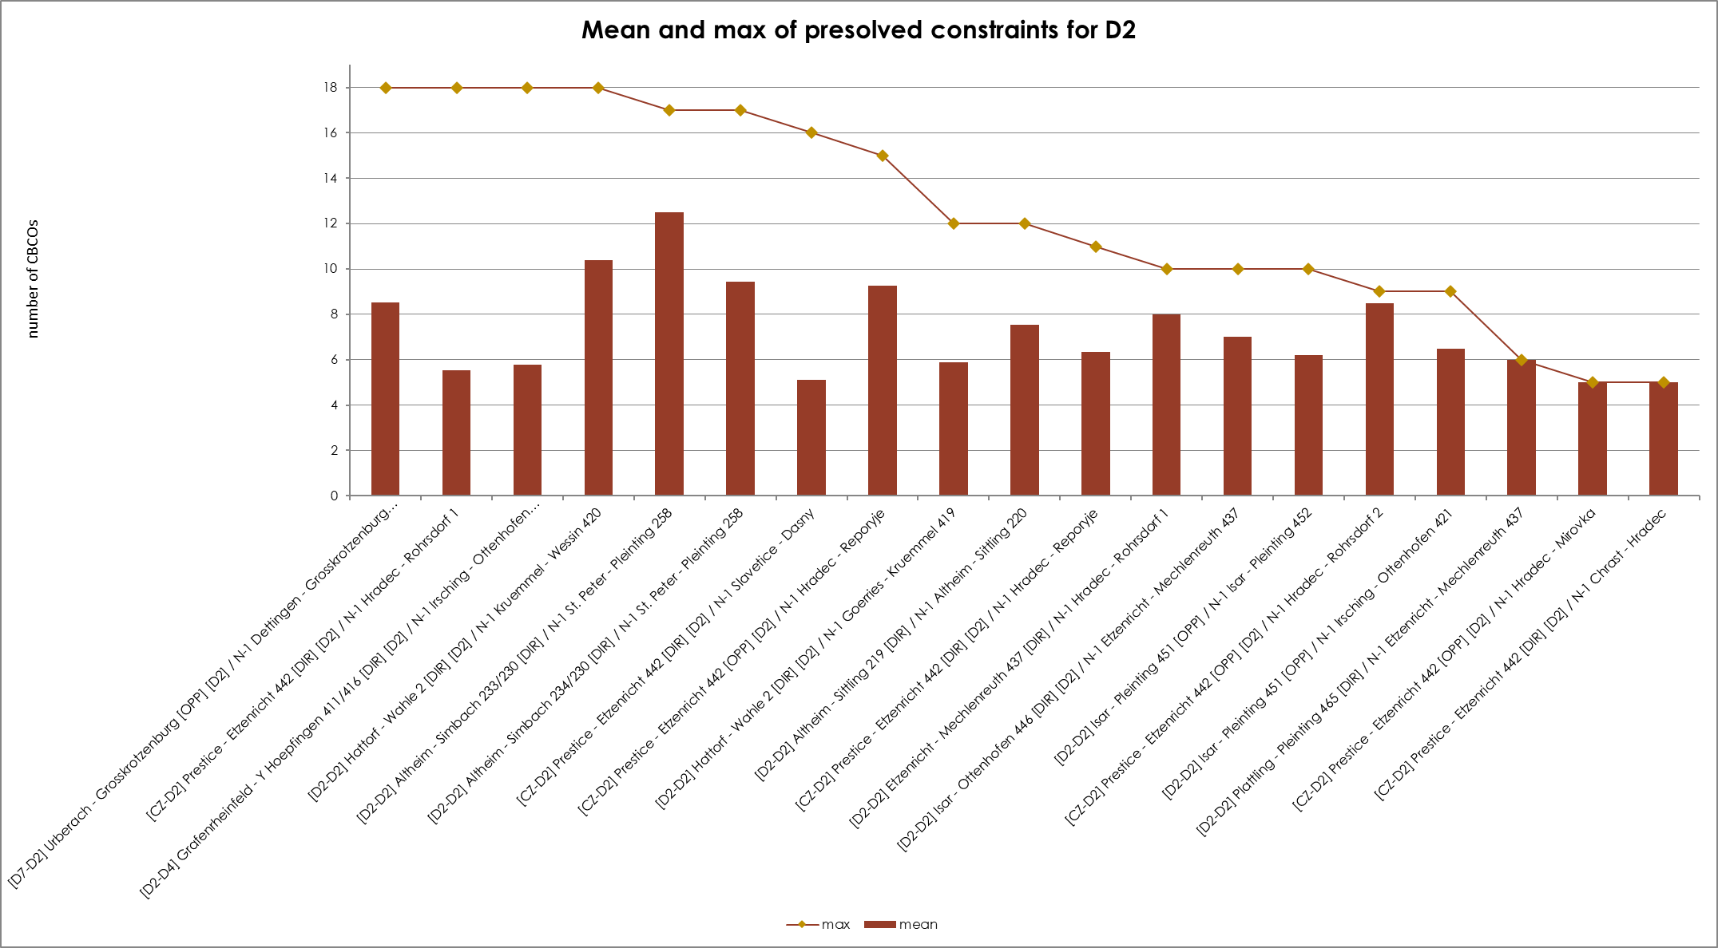
KPI 7C - Most often used pre-solved CNECs​ ​
Mean and Max of pre-solved constraints per TSO – Tennet Germany

Slide 37
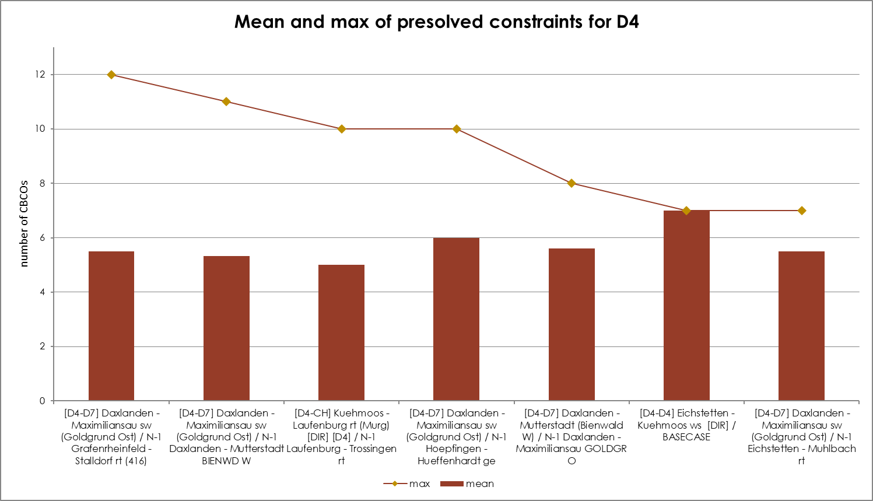
KPI 7C - Most often used pre-solved CNECs​ ​
Mean and Max of pre-solved constraints per TSO - TransnetBW

Slide 38
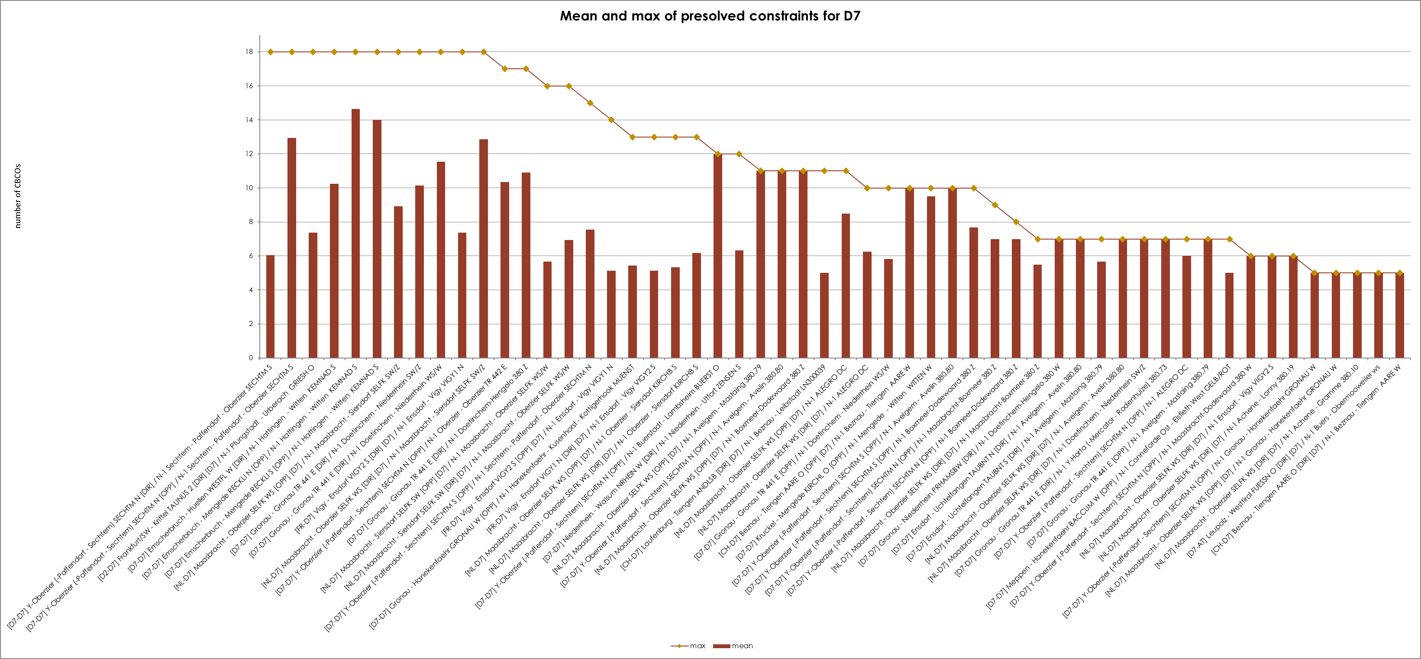
KPI 7C - Most often used pre-solved CNECs​ ​
Mean and Max of pre-solved constraints per TSO - Amprion

Slide 39
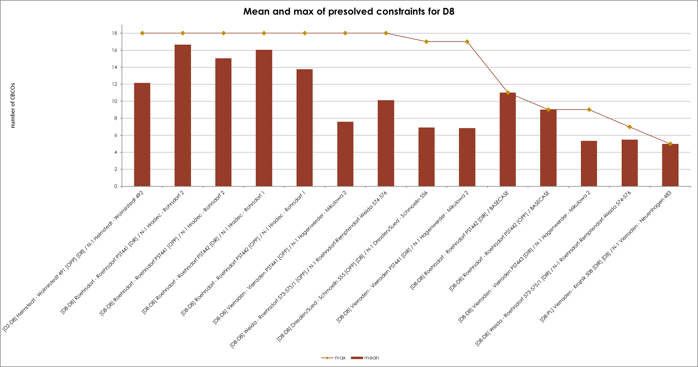
KPI 7C - Most often used pre-solved CNECs​ ​
Mean and Max of pre-solved constraints per TSO – 50Hertz

Slide 40
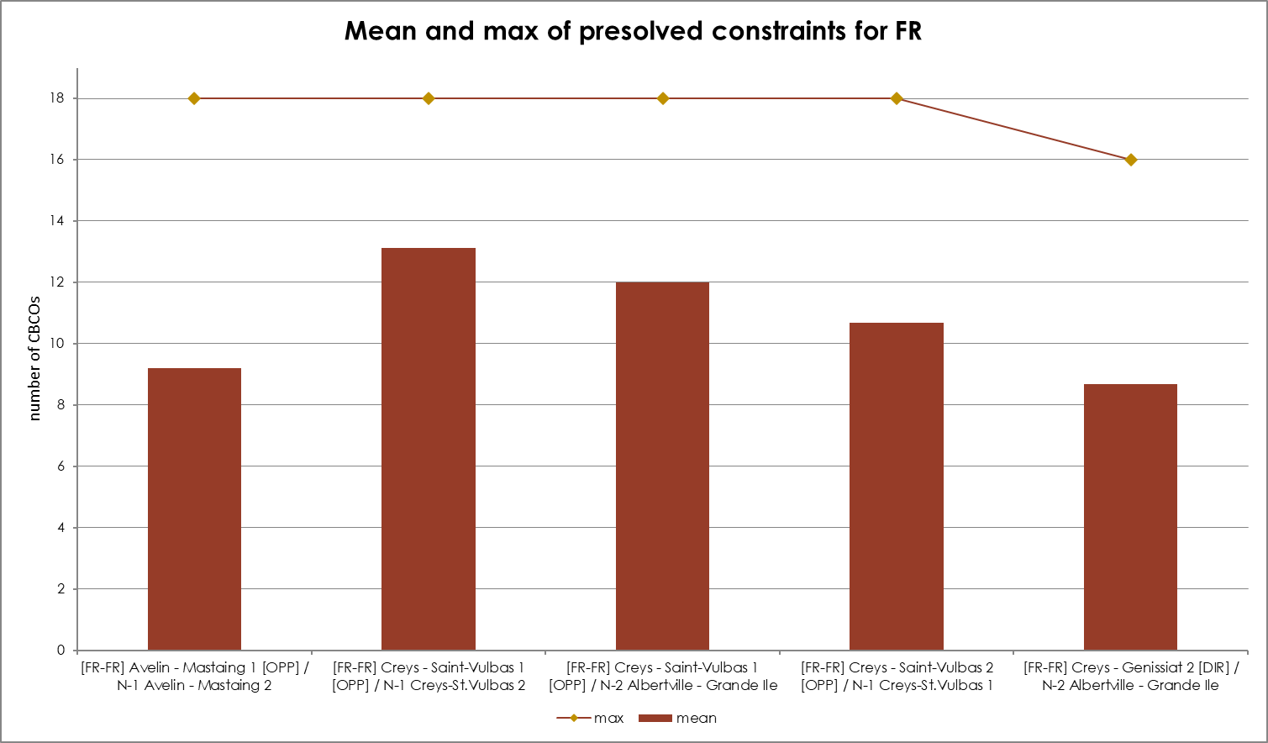
KPI 7C - Most often used pre-solved CNECs​ ​
Mean and Max of pre-solved constraints per TSO – RTE

Slide 41
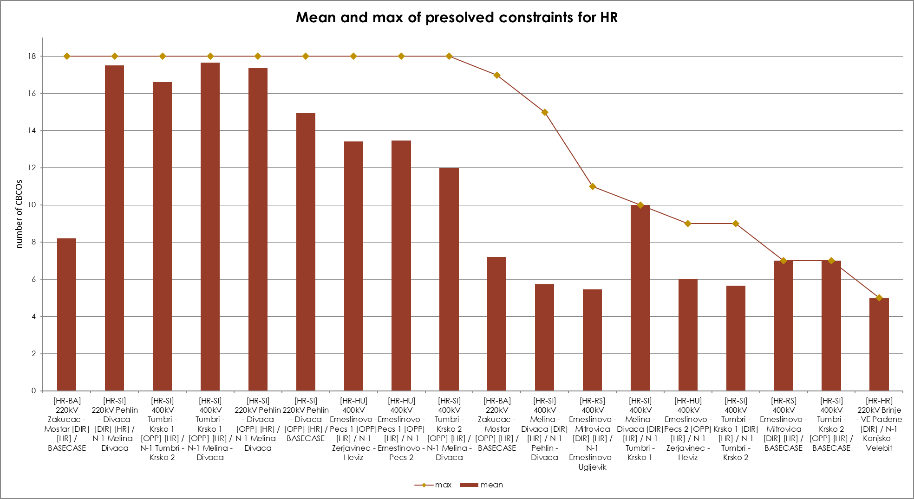
KPI 7C - Most often used pre-solved CNECs​ ​
Mean and Max of pre-solved constraints per TSO – HOPS

Slide 42
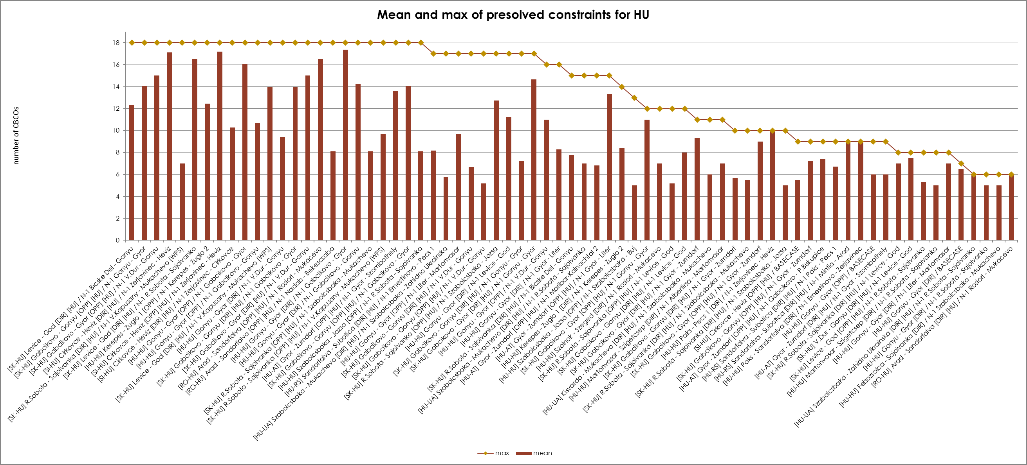
KPI 7C - Most often used pre-solved CNECs​ ​
Mean and Max of pre-solved constraints per TSO – MAVIR

Slide 43
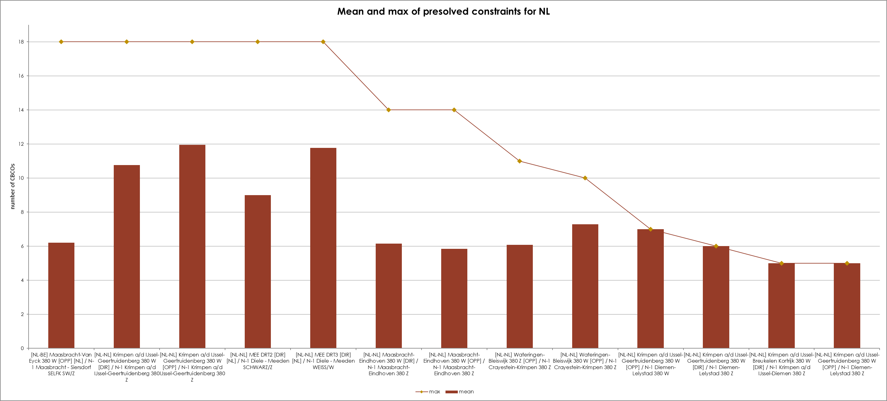
KPI 7C - Most often used pre-solved CNECs​ ​
Mean and Max of pre-solved constraints per TSO – Tennet Netherlands

Slide 44
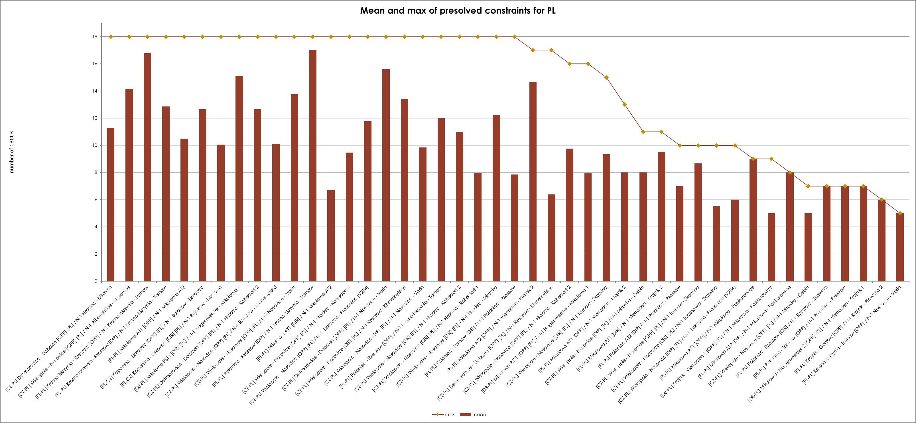
KPI 7C - Most often used pre-solved CNECs​ ​
Mean and Max of pre-solved constraints per TSO – PSE

Slide 45
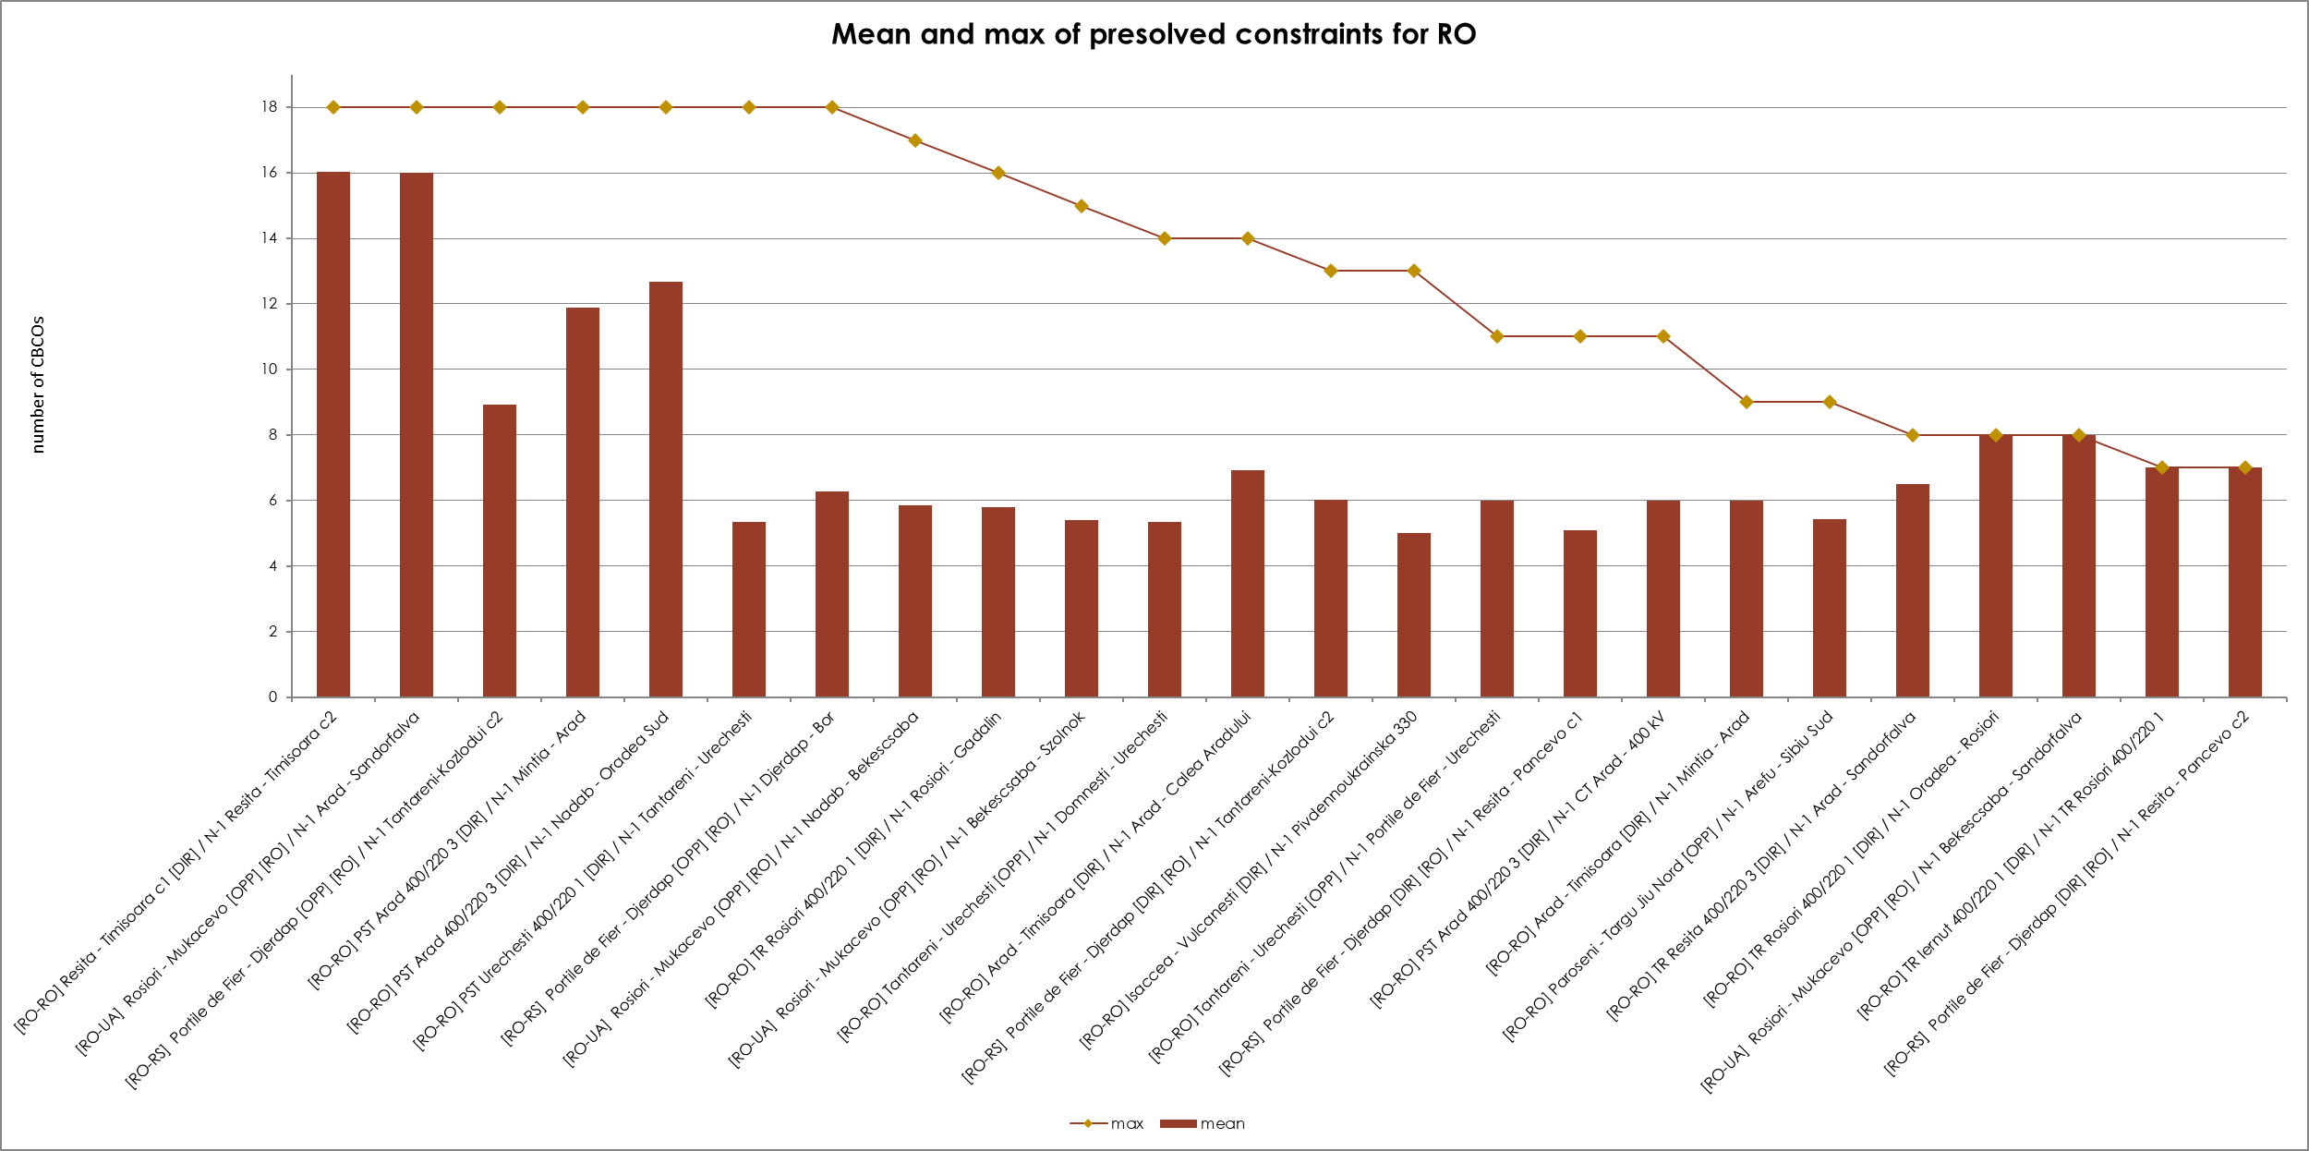
KPI 7C - Most often used pre-solved CNECs​ ​
Mean and Max of pre-solved constraints per TSO – Transeletrica

Slide 46
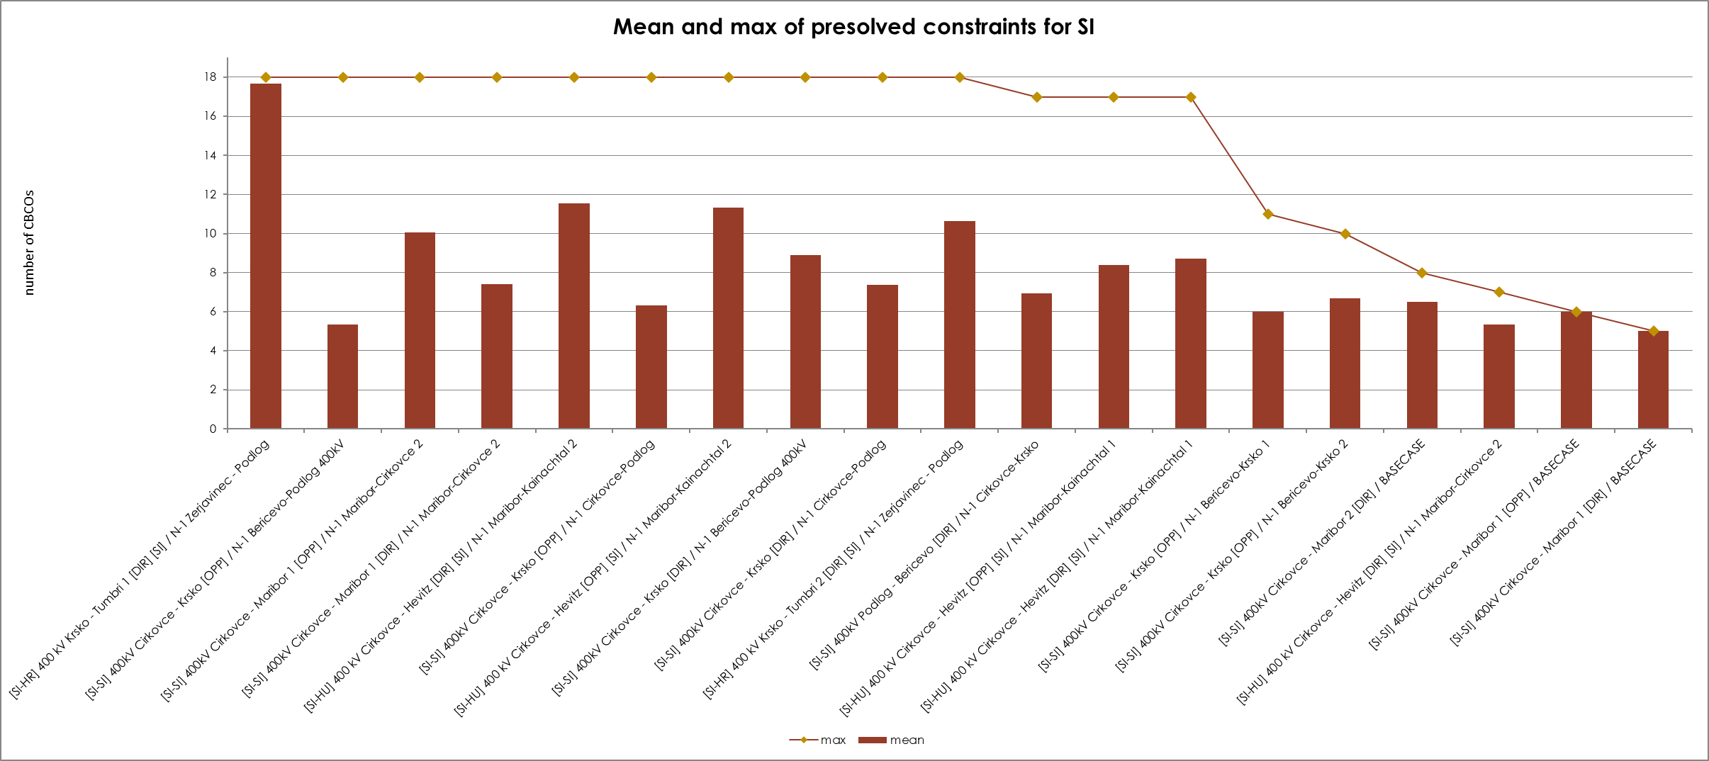
KPI 7C - Most often used pre-solved CNECs​ ​
Mean and Max of pre-solved constraints per TSO – ELES

Slide 47
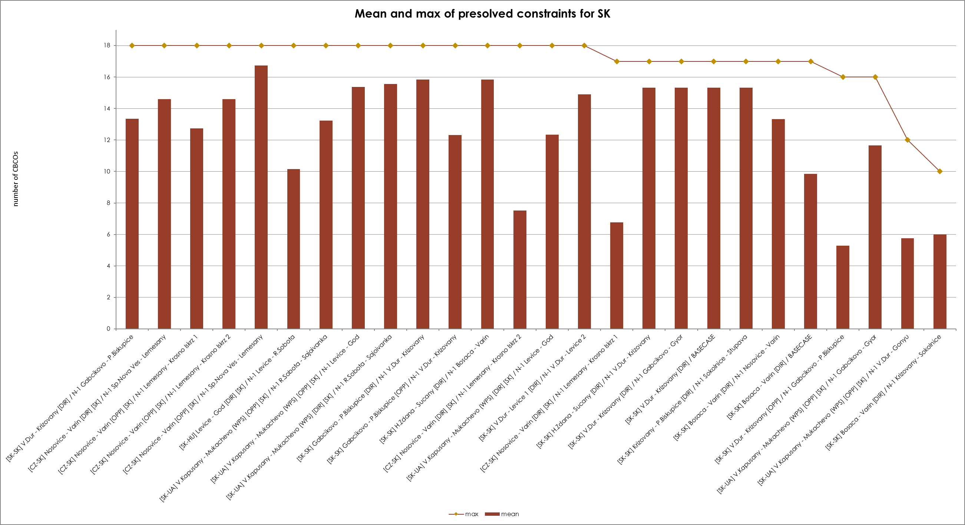
KPI 7C - Most often used pre-solved CNECs​ ​
Mean and Max of pre-solved constraints per TSO - SEPS

Slide 48
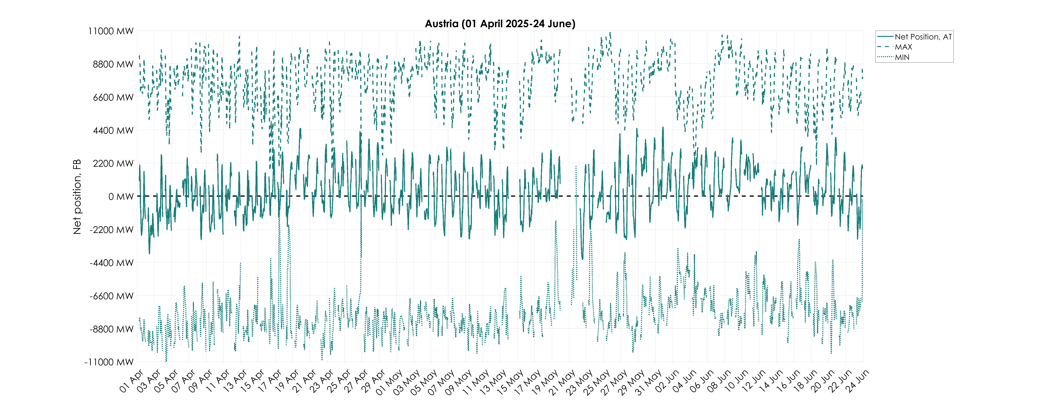
KPI 8A – Min and Max Net Positions per Bidding Zone​
Based on final FB domain – Austria

Slide 49
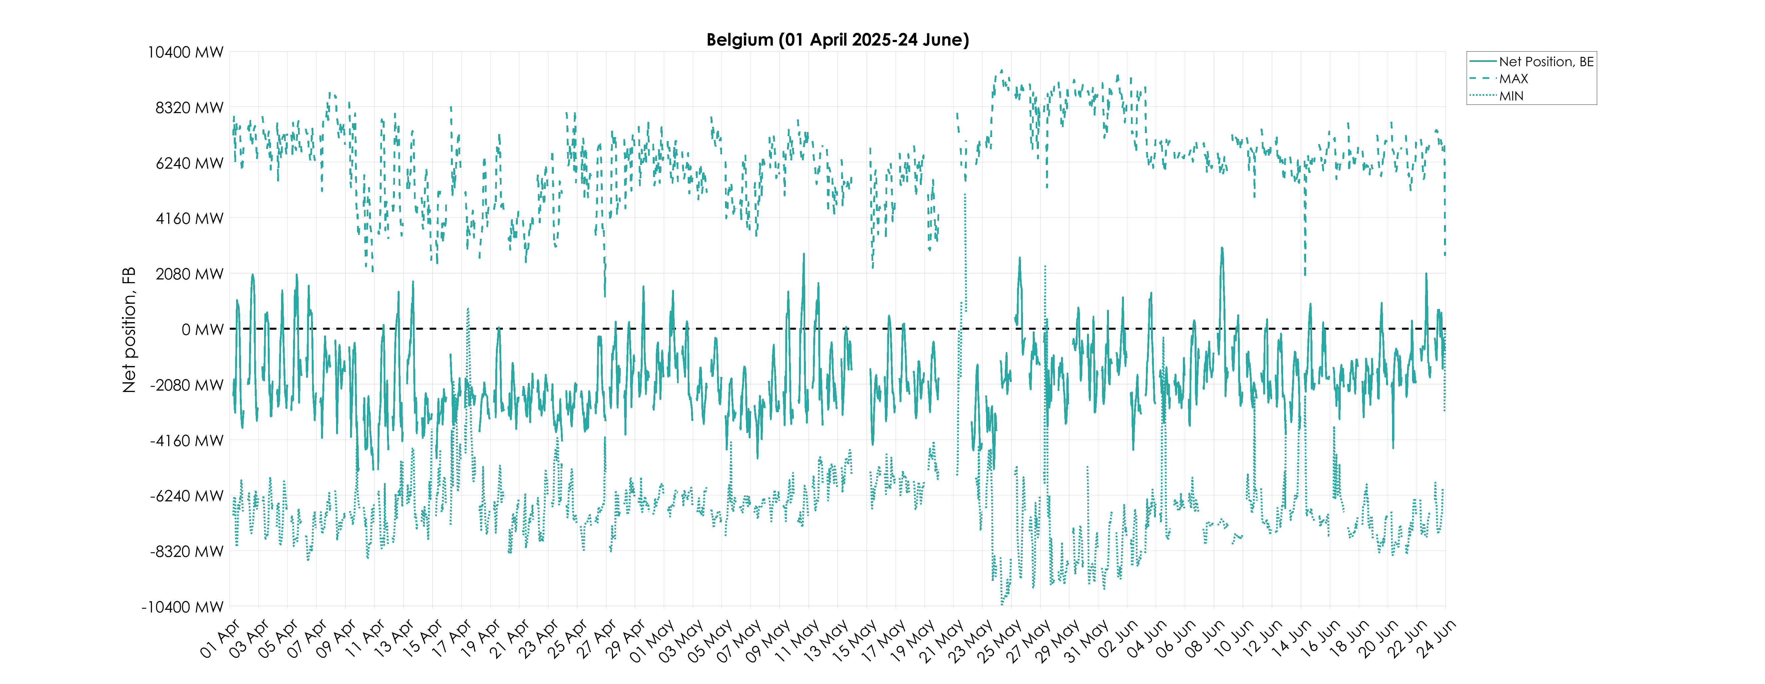
KPI 8A – Min and Max Net Positions per Bidding Zone​
Based on final FB domain – Belgium

Slide 50
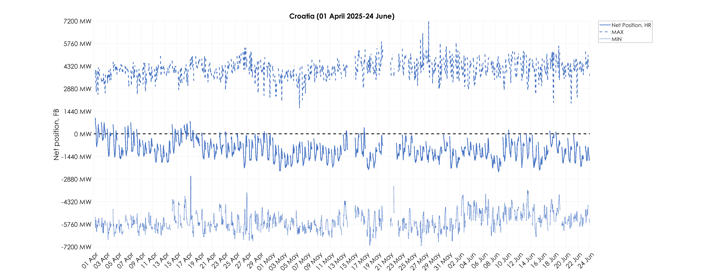
KPI 8A – Min and Max Net Positions per Bidding Zone​
Based on final FB domain – Croatia

Slide 51
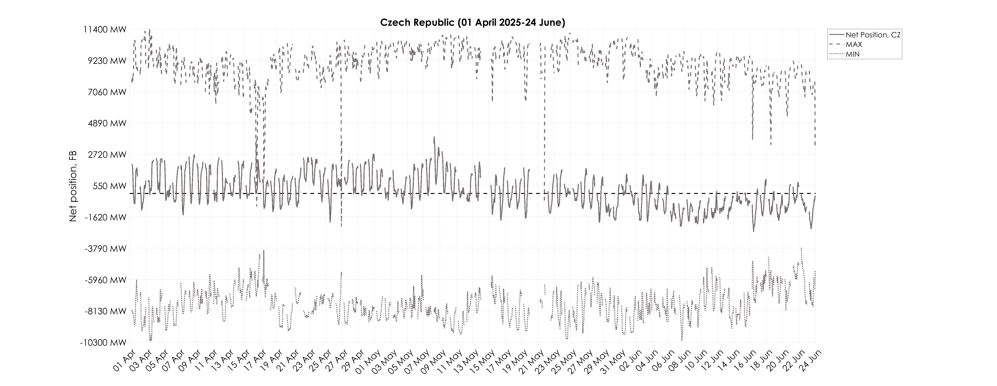
KPI 8A – Min and Max Net Positions per Bidding Zone​
Based on final FB domain – Czech Republic

Slide 52
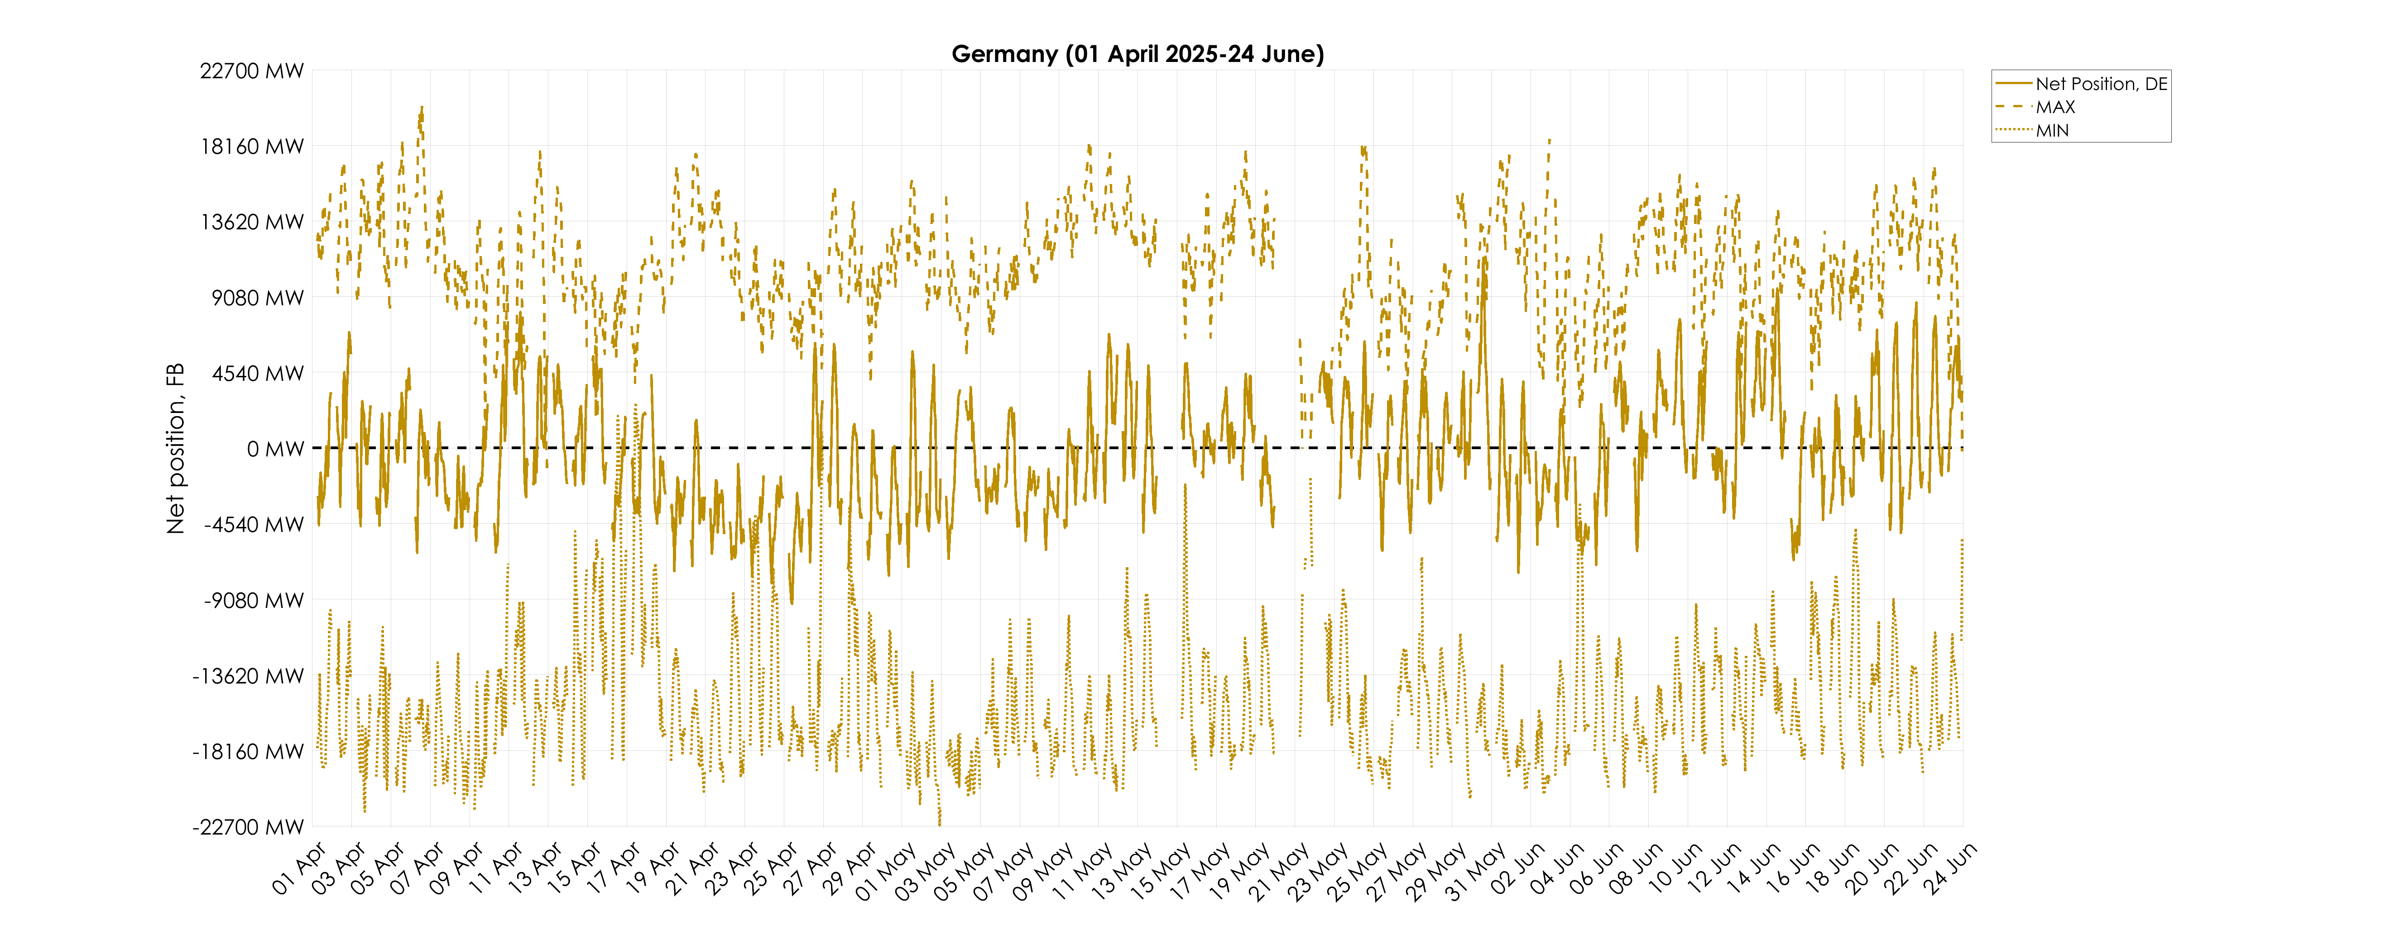
KPI 8A – Min and Max Net Positions per Bidding Zone​
Based on final FB domain – Germany

Slide 53
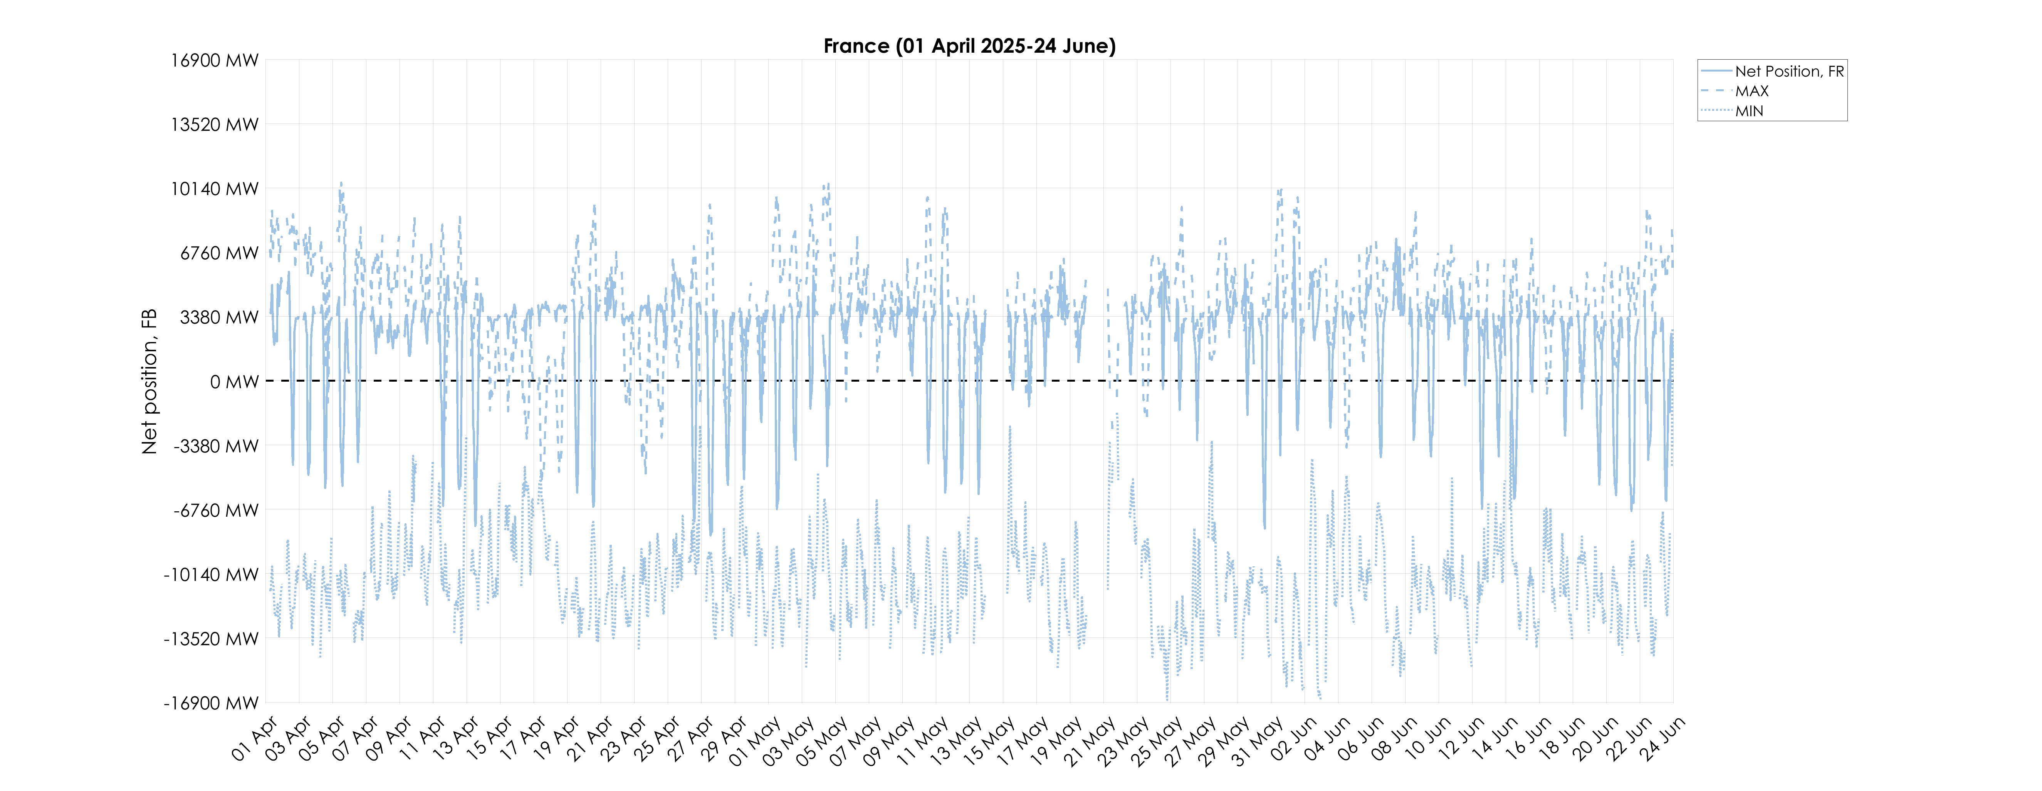
KPI 8A – Min and Max Net Positions per Bidding Zone​
Based on final FB domain – France

Slide 54
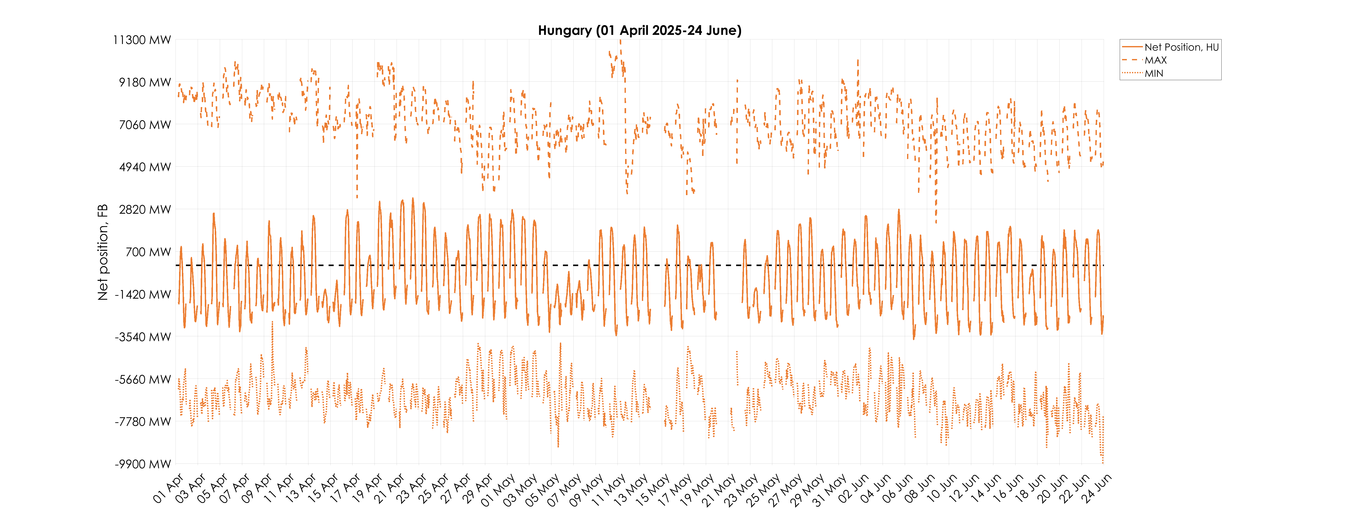
KPI 8A – Min and Max Net Positions per Bidding Zone​
Based on final FB domain – Hungary

Slide 55
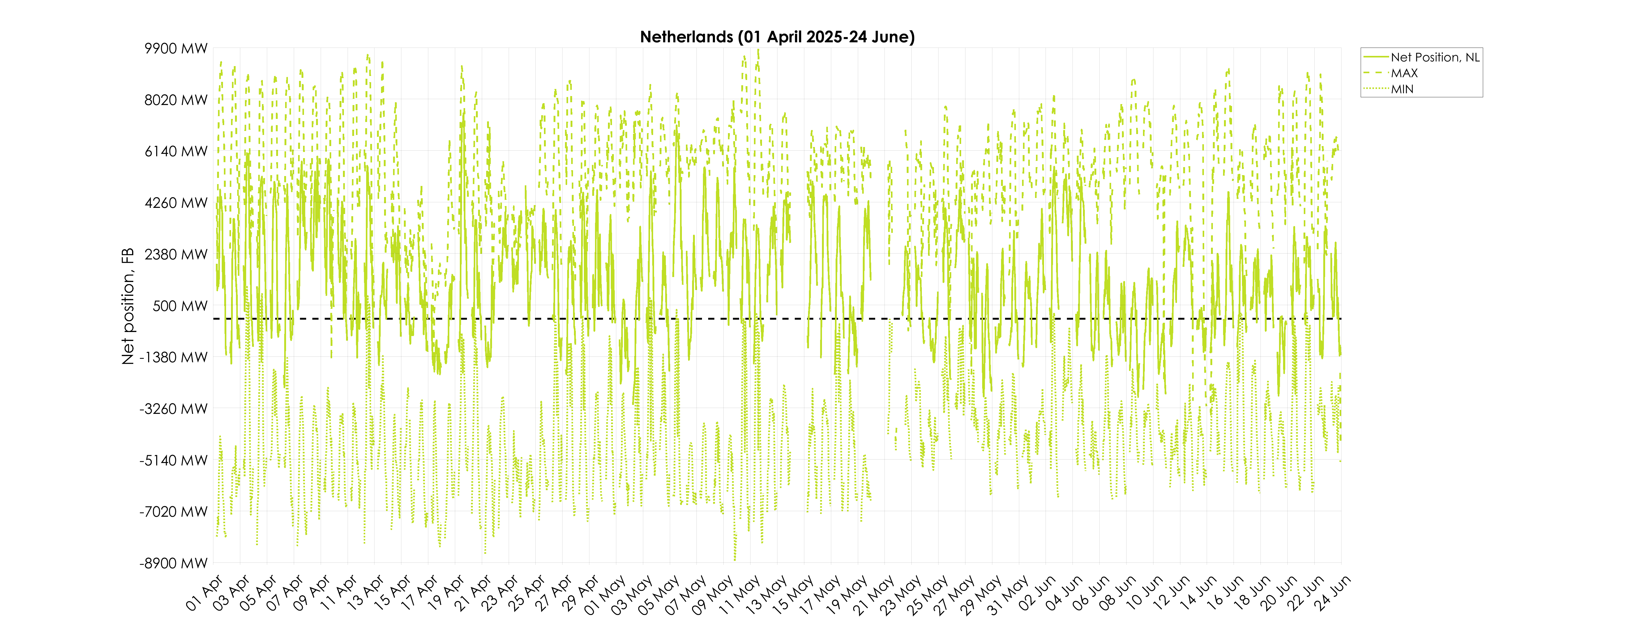
KPI 8A – Min and Max Net Positions per Bidding Zone​
Based on final FB domain – Netherlands

Slide 56
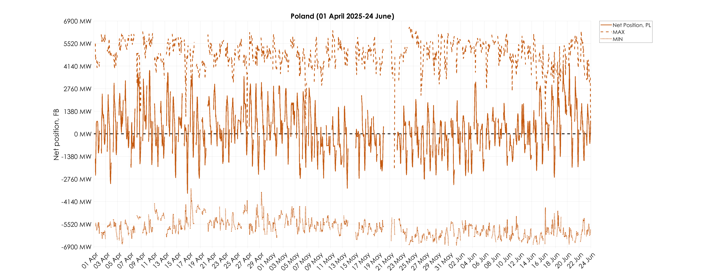
KPI 8A – Min and Max Net Positions per Bidding Zone​
Based on final FB domain – Poland

Slide 57

KPI 8A – Min and Max Net Positions per Bidding Zone​
Based on final FB domain – Romania

Slide 58

KPI 8A – Min and Max Net Positions per Bidding Zone​
Based on final FB domain – Slovenia

Slide 59

KPI 8A – Min and Max Net Positions per Bidding Zone​
Based on final FB domain – Slovakia

Slide 60

KPI 8B – Min and Max Net Positions per Bidding Zone​
Based on final ID ATC – Austria

Slide 61

KPI 8B – Min and Max Net Positions per Bidding Zone​
Based on final ID ATC – Belgium

Slide 62

KPI 8B – Min and Max Net Positions per Bidding Zone​
Based on final ID ATC – Croatia

Slide 63

KPI 8B – Min and Max Net Positions per Bidding Zone​
Based on final ID ATC – Czech Republic

Slide 64

KPI 8B – Min and Max Net Positions per Bidding Zone​
Based on final ID ATC – Germany

Slide 65

KPI 8B – Min and Max Net Positions per Bidding Zone​
Based on final ID ATC – France

Slide 66

KPI 8B – Min and Max Net Positions per Bidding Zone​
Based on final ID ATC – Hungary

Slide 67

KPI 8B – Min and Max Net Positions per Bidding Zone​
Based on final ID ATC – Netherlands

Slide 68

KPI 8B – Min and Max Net Positions per Bidding Zone​
Based on final ID ATC – Poland

Slide 69

KPI 8B – Min and Max Net Positions per Bidding Zone​
Based on final ID ATC – Romania

Slide 70

KPI 8B – Min and Max Net Positions per Bidding Zone​
Based on final ID ATC – Slovenia

Slide 71

KPI 8B – Min and Max Net Positions per Bidding Zone​
Based on final ID ATC – Slovakia

